Slide 1


Grade 8 Transitions Spring 2026
JL Jackson Secondary School

Slide 2


Slide 4
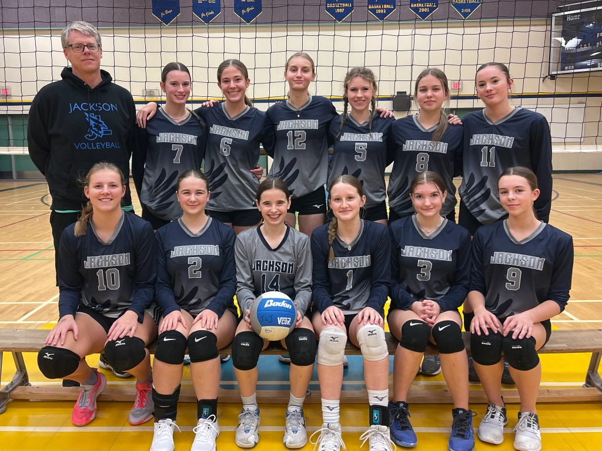
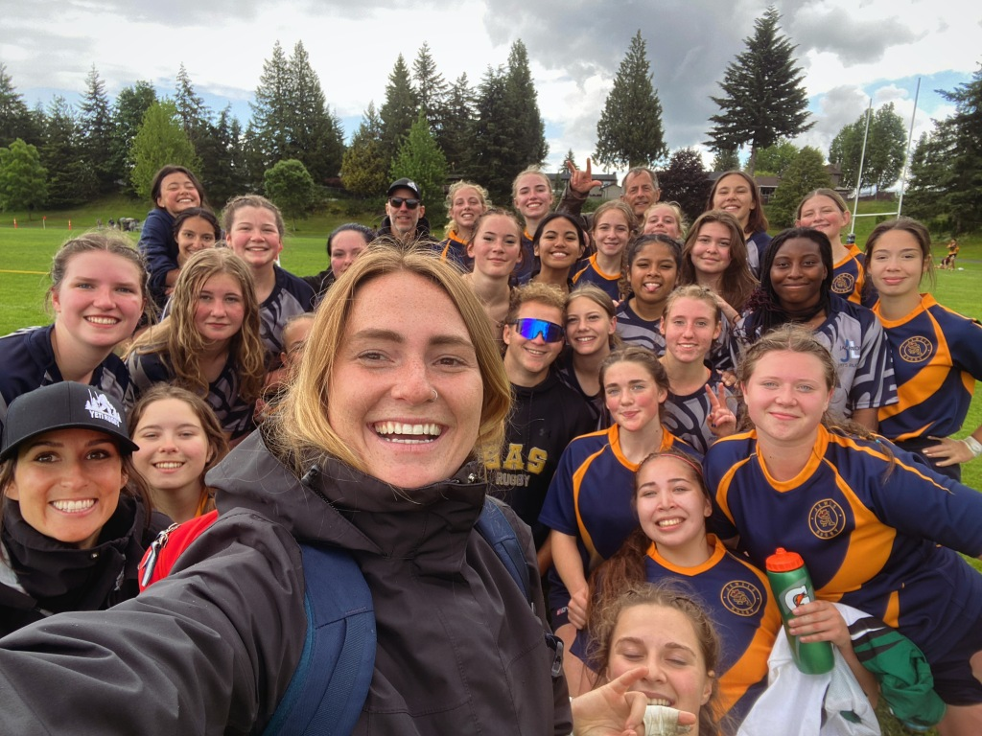
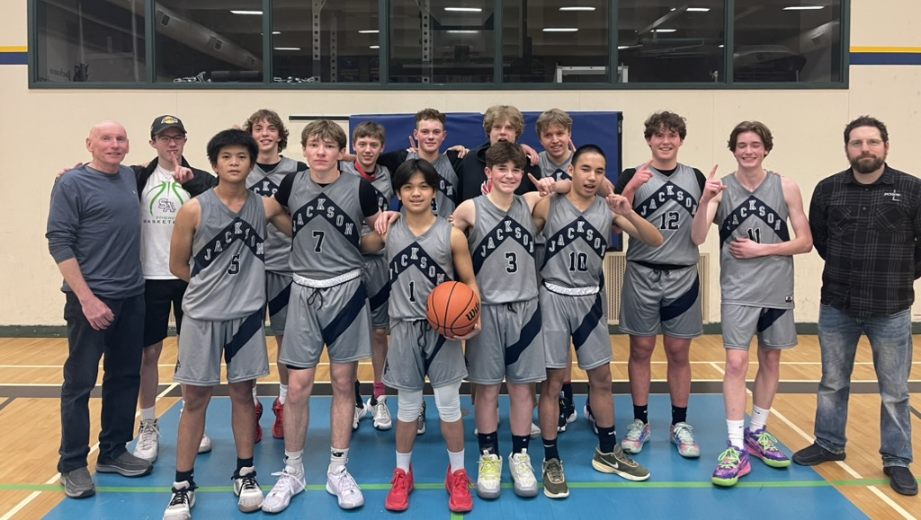
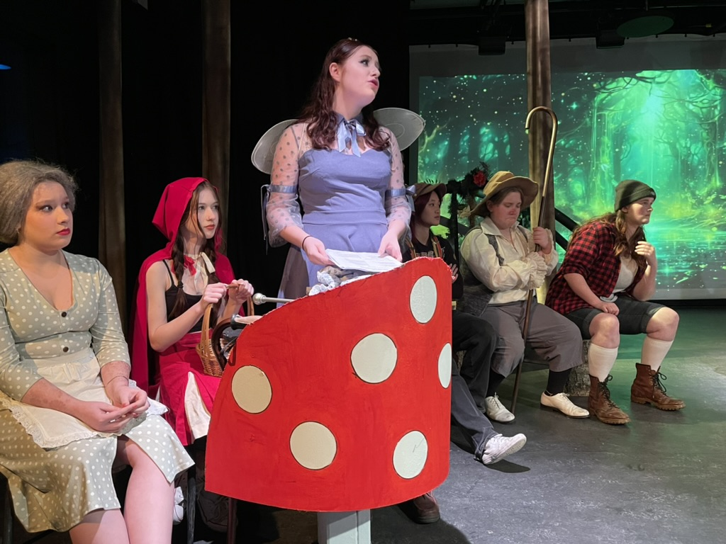
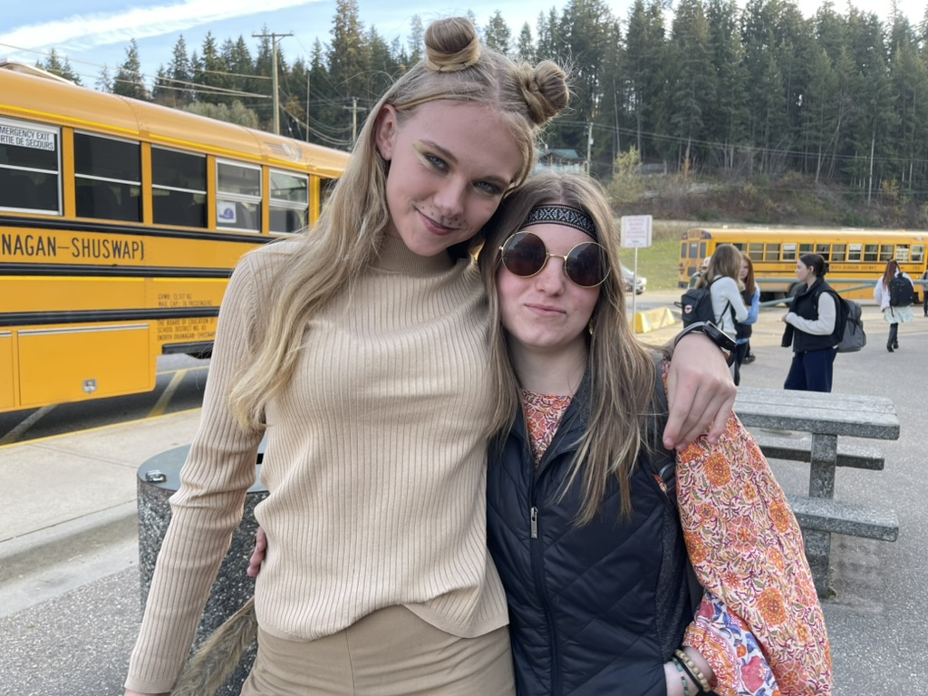
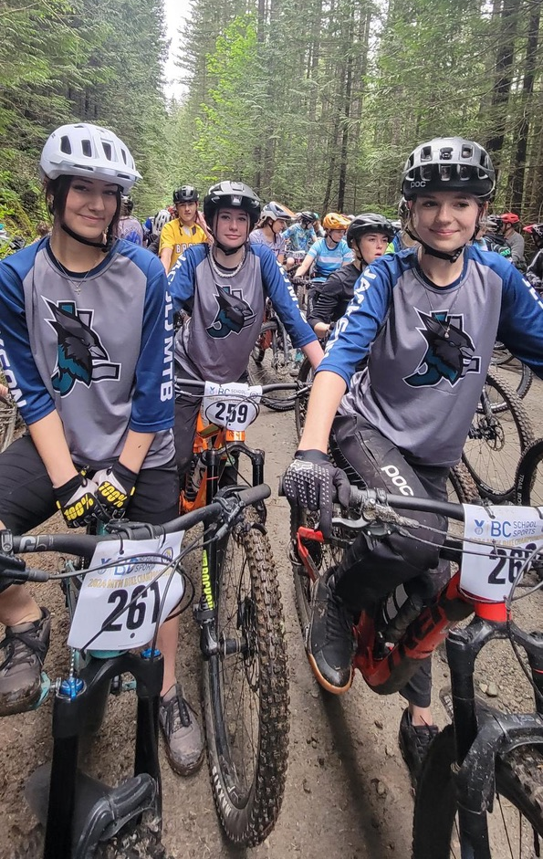
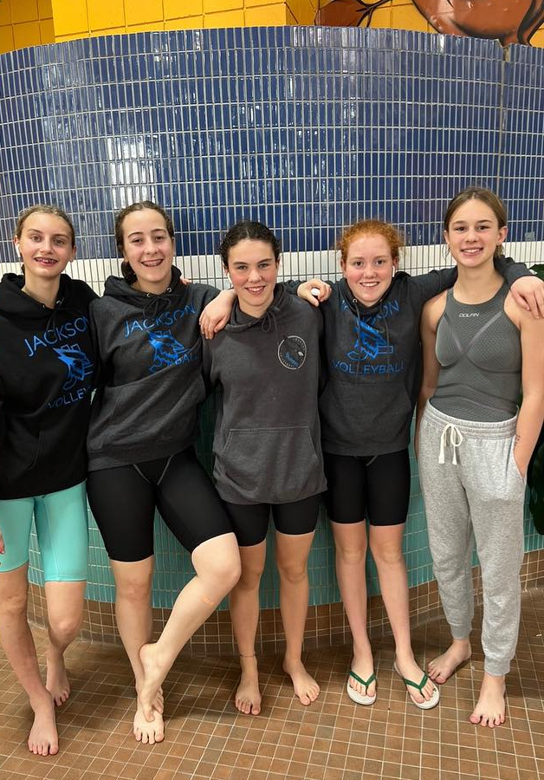
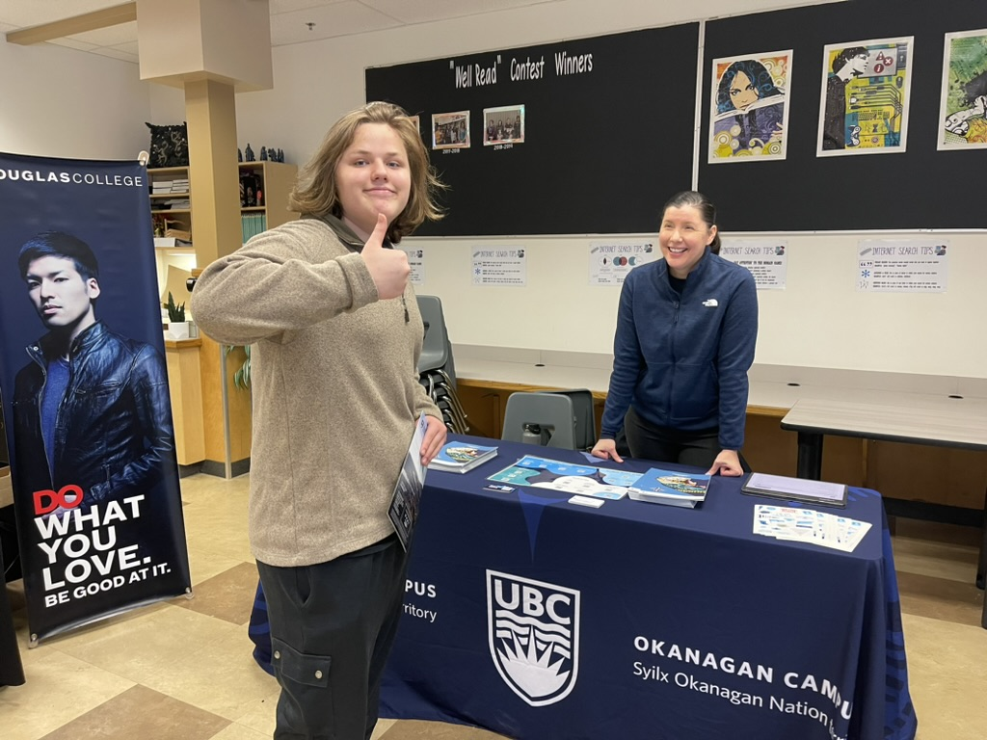
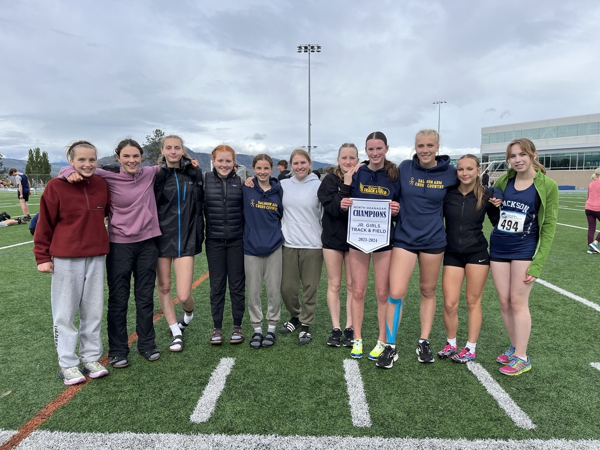
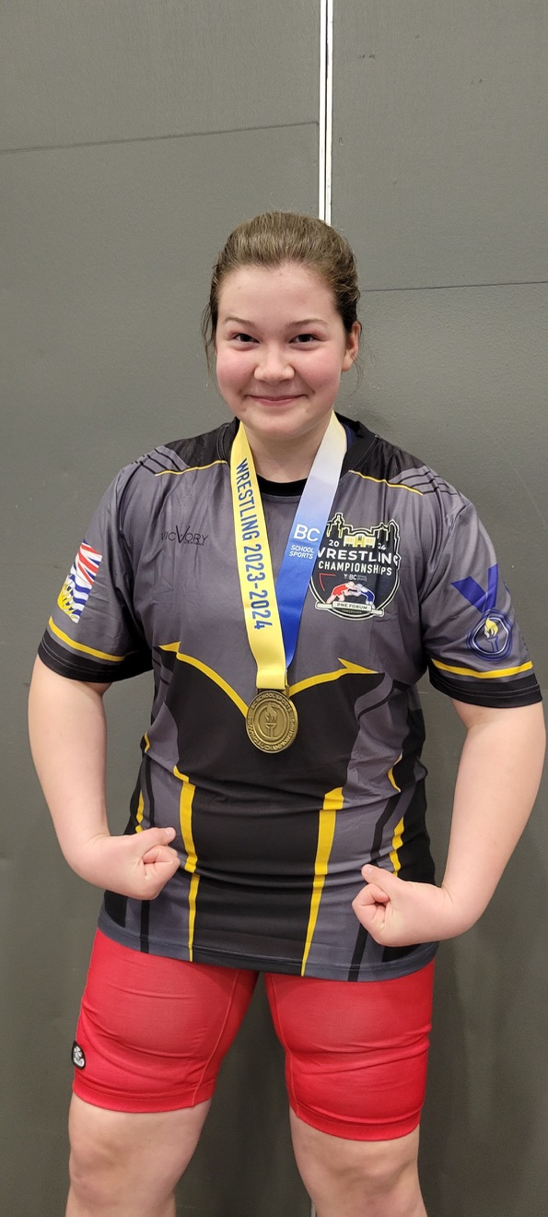
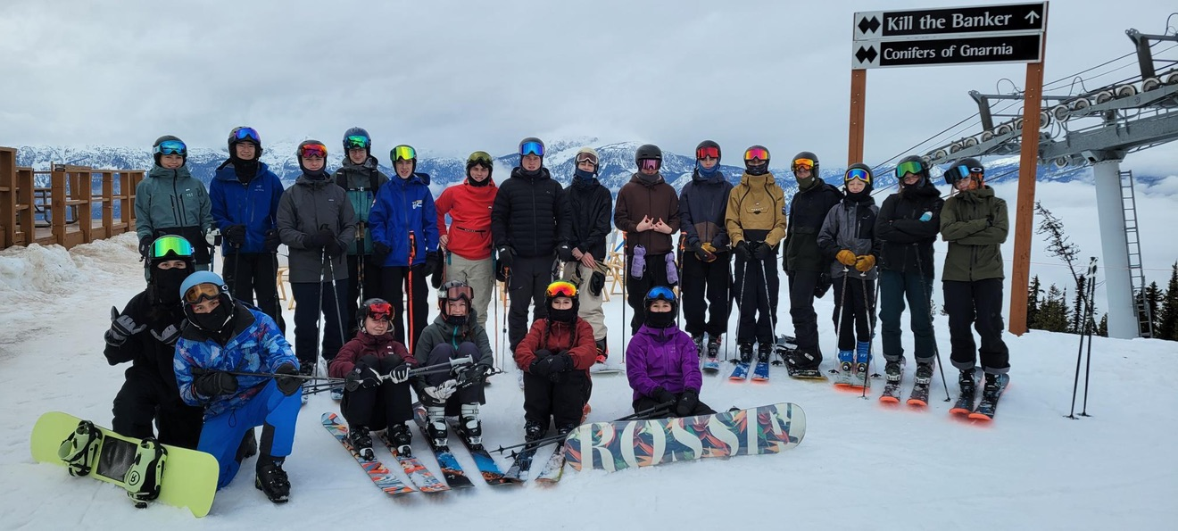
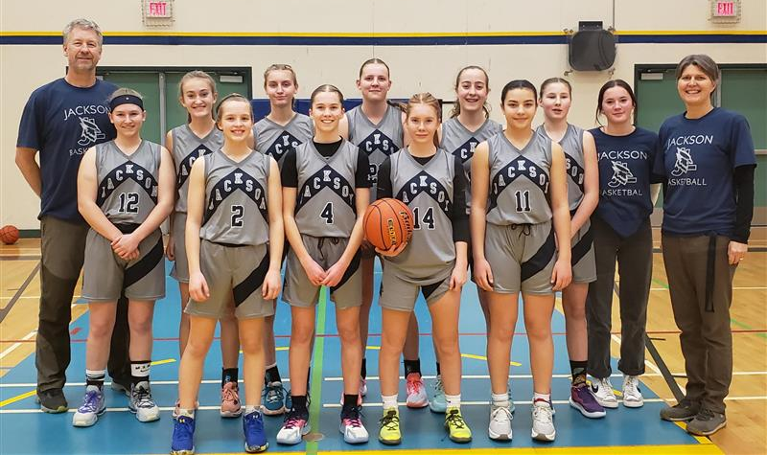
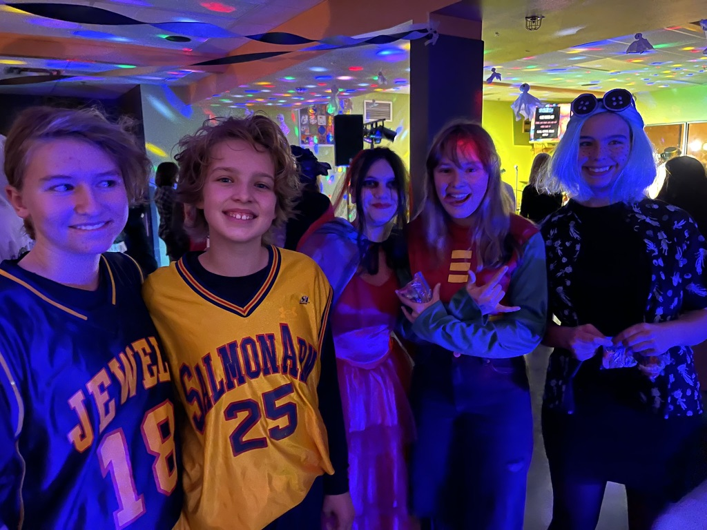
Make the most of your high school experience!

Slide 5
Course Selection TIMELINe
February 23-27
Course Selection Presentations
March 6
Grade 8 Open House (Family Night)
Course Selection Forms Due
February 25

Slide 6
A Comparison
Middle School
High School
Core Teacher(s)
Exploration Teachers
50-minute classes
Linear classes
Academic teachers
Elective teachers
80-minute classes
Semester based classes (few linear classes)
Responsibility…
Accountability…
Expectations…
Transitioning from
Adult Monitored…
to Student Managed

Slide 7
RISING TO THE CHALLENGE!
You are in charge of your ATTITUDE,
your EFFORT,
and your ATTENDANCE!
WE BELIEVE IN YOU!

Slide 8
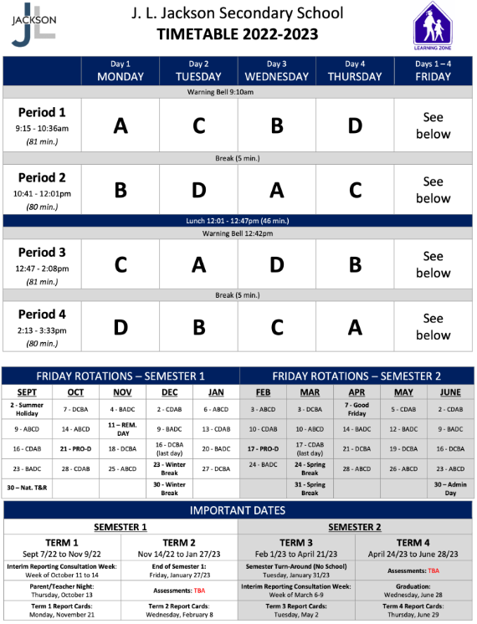
Sample Student Schedule
Science
French
Math
PHE
Term 1: September- November
  A → Science 9
  B → Math 9
  C → French 9
  D → PHE 9
Math
PHE
Science
French
French
Science
PHE
Math
PHE
Math
French
Science

Slide 9
English Track – Required Courses
1. English 9
2. Social Studies 9
3. Science 9
4. Math 9
5. Careers 9
6. PHE 9
PHE 9
or
Active for Life 9

Slide 10
French Immersion Track – Required Courses
1. English 9
2. Science Humaines 9
3. Francais Langue 9
4. Science Naturelles 9
5. Math 9
6. Careers 9
7. PHE 9
PHE 9
or
Active for Life 9
or
Ed Phys 9

Slide 11
PE Options
PHE 9
-Offered to students who enjoy a more traditional PHE program
-Mainstream sports skills are a focus for evaluation of fundamental movement skills (e.g. basketball, volleyball, football, rugby, ultimate frisbee, badminton, pickleball, etc.)
-More focus on competition and group/team games
Active for Life 9
-Offered to students who are looking for an alternative to a traditional PHE program
-Some mainstream sports are still covered, but typically ones that require less complex skills, such as volleyball, badminton, ultimate frisbee, pickleball etc.
-Alternative lifelong activities are also introduced such as disc golf, bocce, tennis baseball, low organizational games, etc.
-In general, the course is not less intense, it’s just less competitive
Notes:
Similarities:
-Both Active for Life 9/10 and PHE 9/10 meet all curriculum requirements
-Approximately ¼ time spent developing fitness
-Approximately ½ time spent on developing fundamental movement skills and physical literacy
-Approximately ¼ time spent learning curricular based health topics
One main difference in the courses is the make-up of the students who choose to be in each program. Although the actual make-up of the courses isn’t all that different, it’s typically the more competitive students who choose PHE, and the less competitive who choose AFL. This makes the culture of each course better suited to the students who choose to be there.

Slide 12

Careers 9
Drop-in presentations during regular classes
Some work to be completed outside class time
Uses MyBlueprint for Career Exploration and Portfolio
Sign up for careers spotlight sessions, field trips, etc.
Take your kid to work day (November)

Slide 13
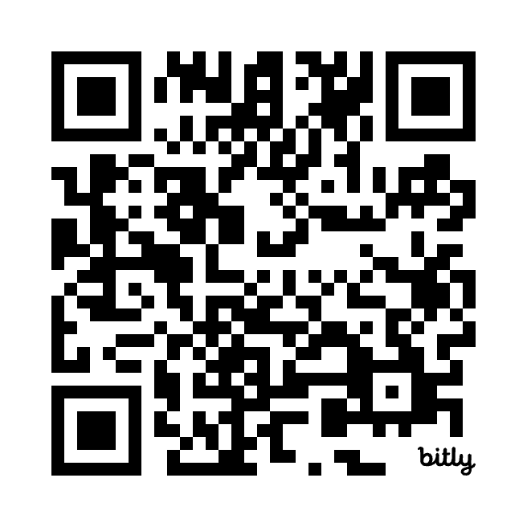
Choosing Electives
Make Individual Choices based on Personal Interest
Choosing the same elective as a friend does not mean you will be in their class
Students will be scheduled in up to 3 electives
Ranking all the electives will help us determine the courses that can be offered.
Do you research by reading the course descriptions and coming to the Family Information night on Feb 25
Scan the QR Code above
to see descriptions of
each Elective Course
https://jlj.sd83.bc.ca/grade-9-course-catalogue

Slide 14
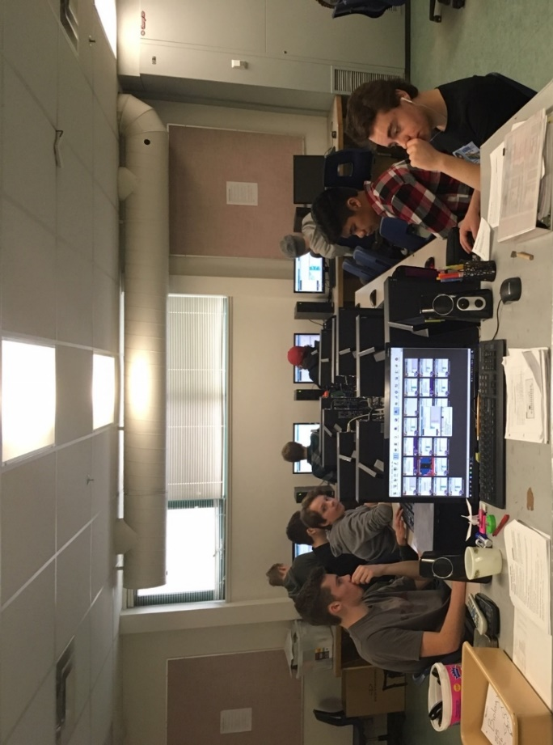
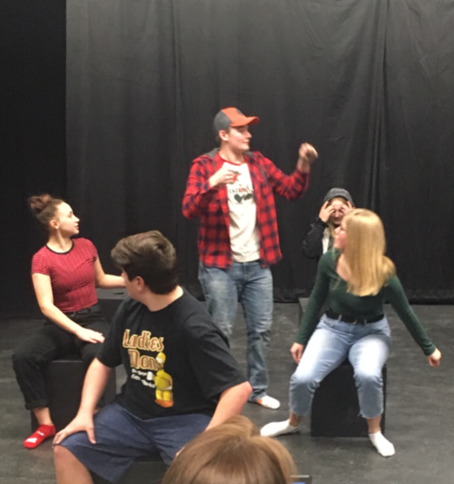
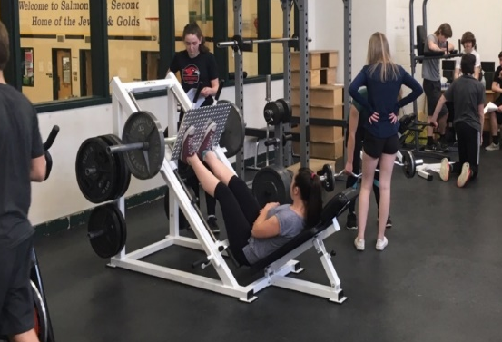
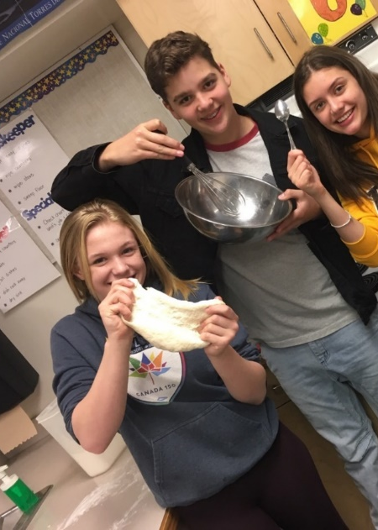
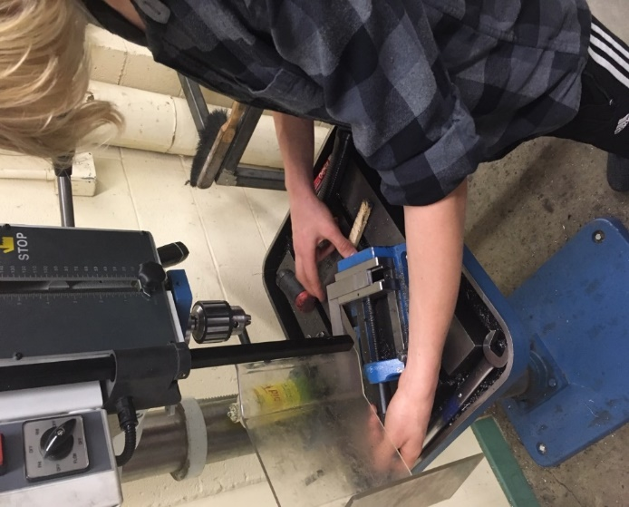
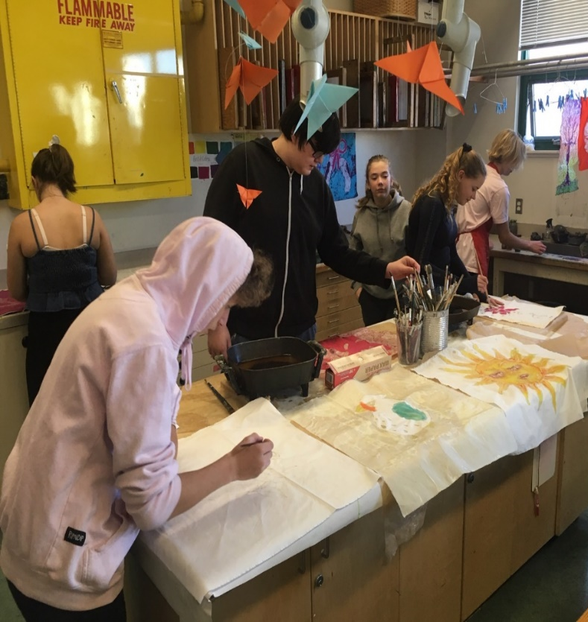
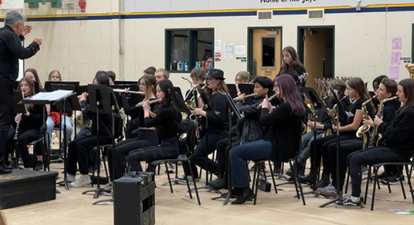
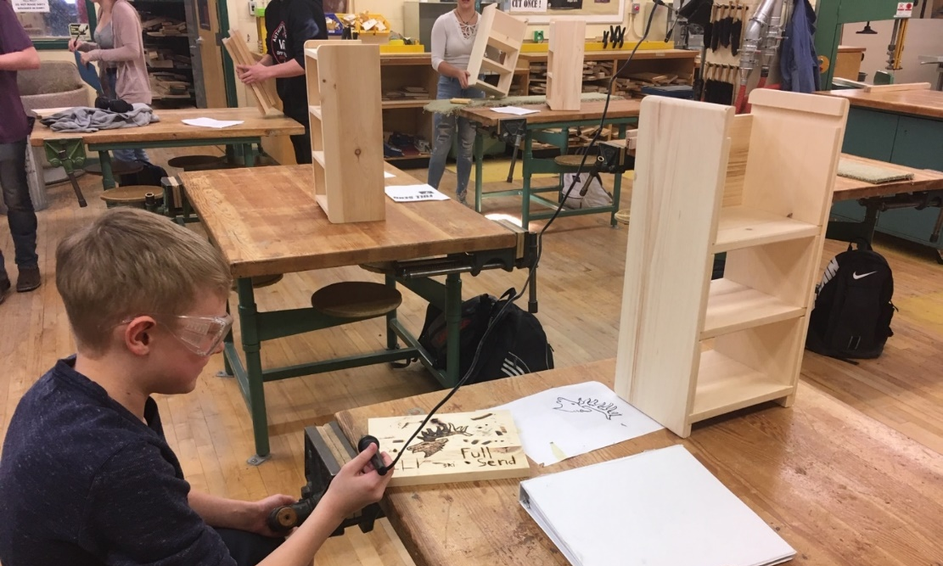
Electives

Slide 15
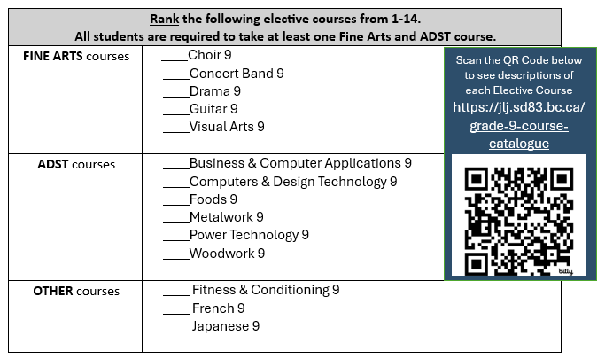

Slide 16
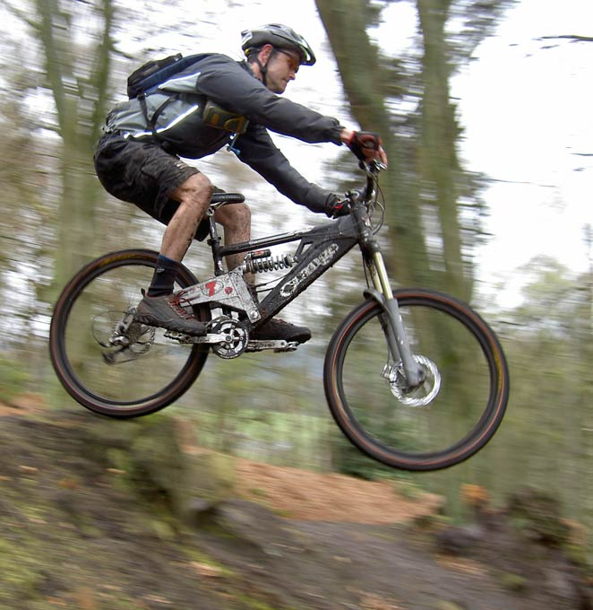
Mountain Biking Academy
Half Day Program (8 Credits)
PE and Mountain Bike Skills Credit
Fee is around $450
Spring Semester
Expression of interest form online

Slide 17
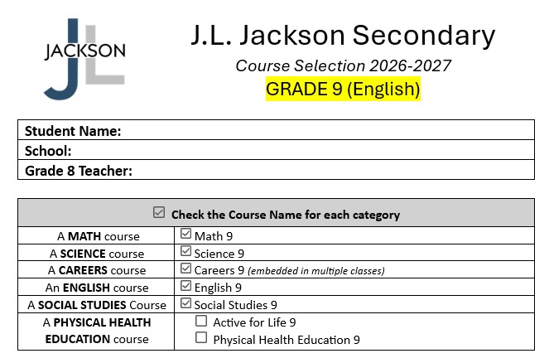
Step 1:
Choose your Physical & Health Education class

Slide 18
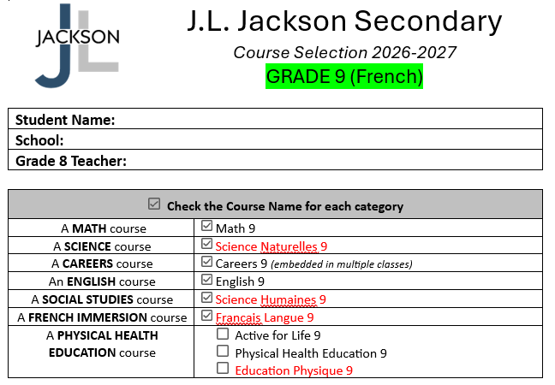
Step 1:
Choose your Physical & Health Education class

Slide 19
Step 2:
Rank the electives in order of preference

Slide 20
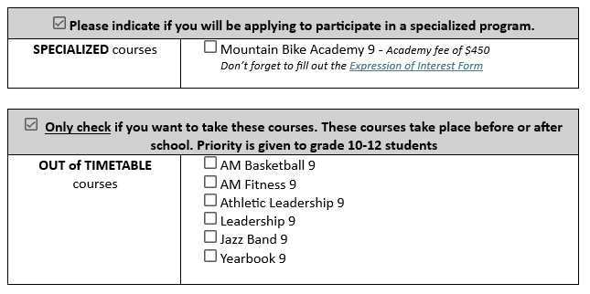
Step 3:
Indicate if you will be applying to a Specialized Course
Step 4:
Check any Out of Timetable Courses you would like to take

Slide 21

Sign and return the form by
Friday March 6

Slide 22
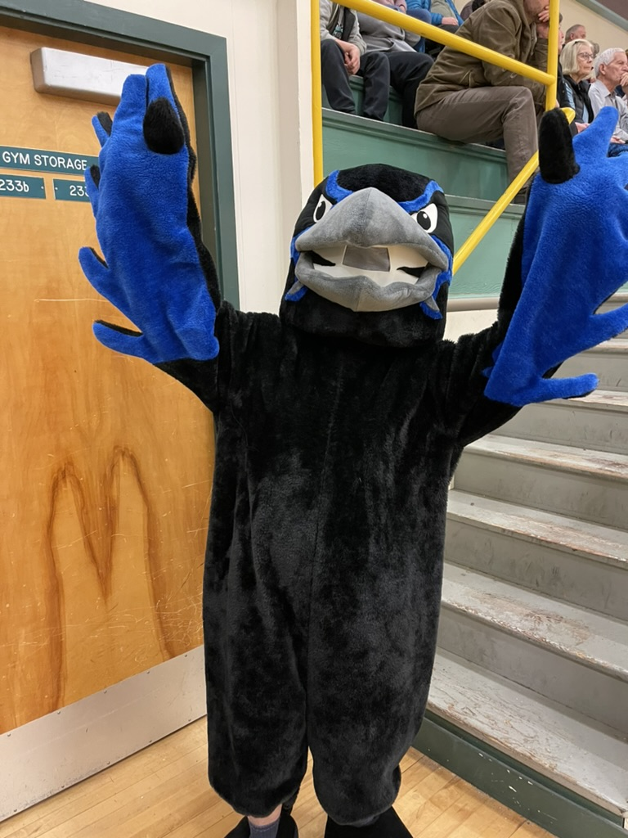
Extra-Curriculars
Sports
Clubs
Field Trips
Leadership
School Play
Etc.

Slide 23
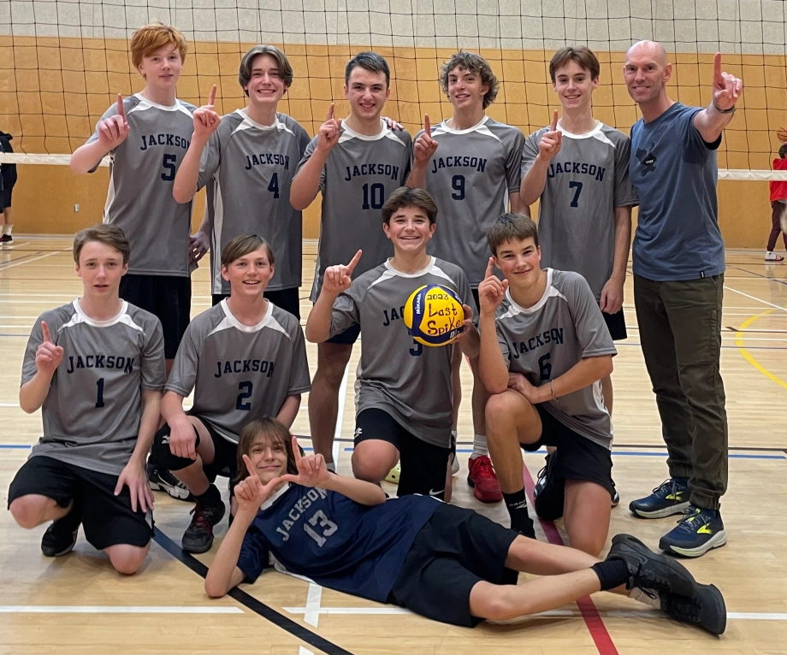
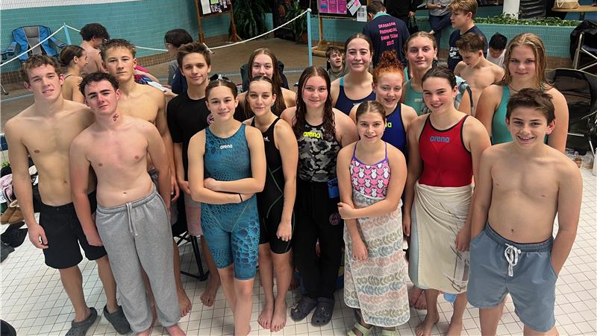
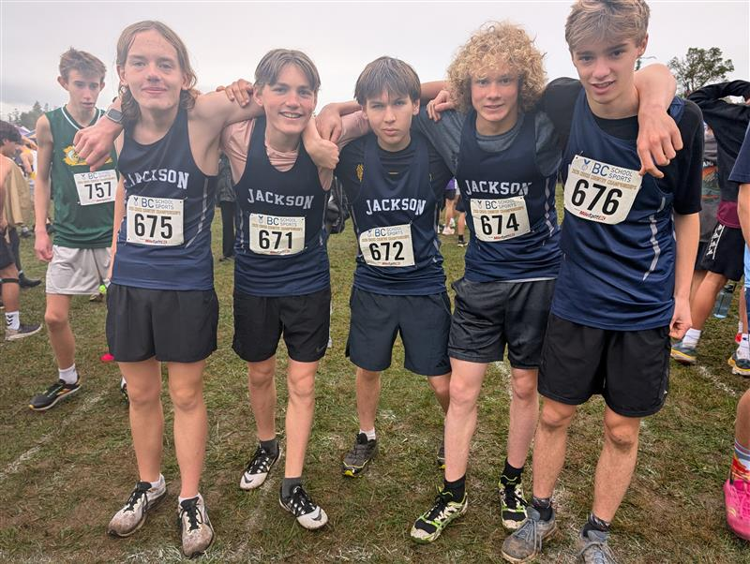
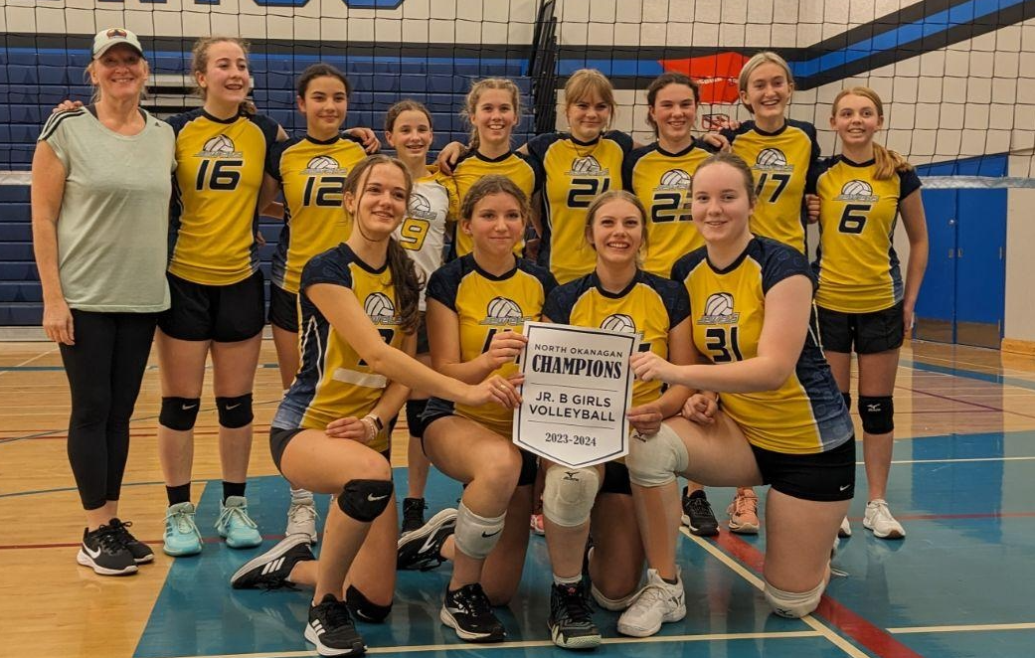
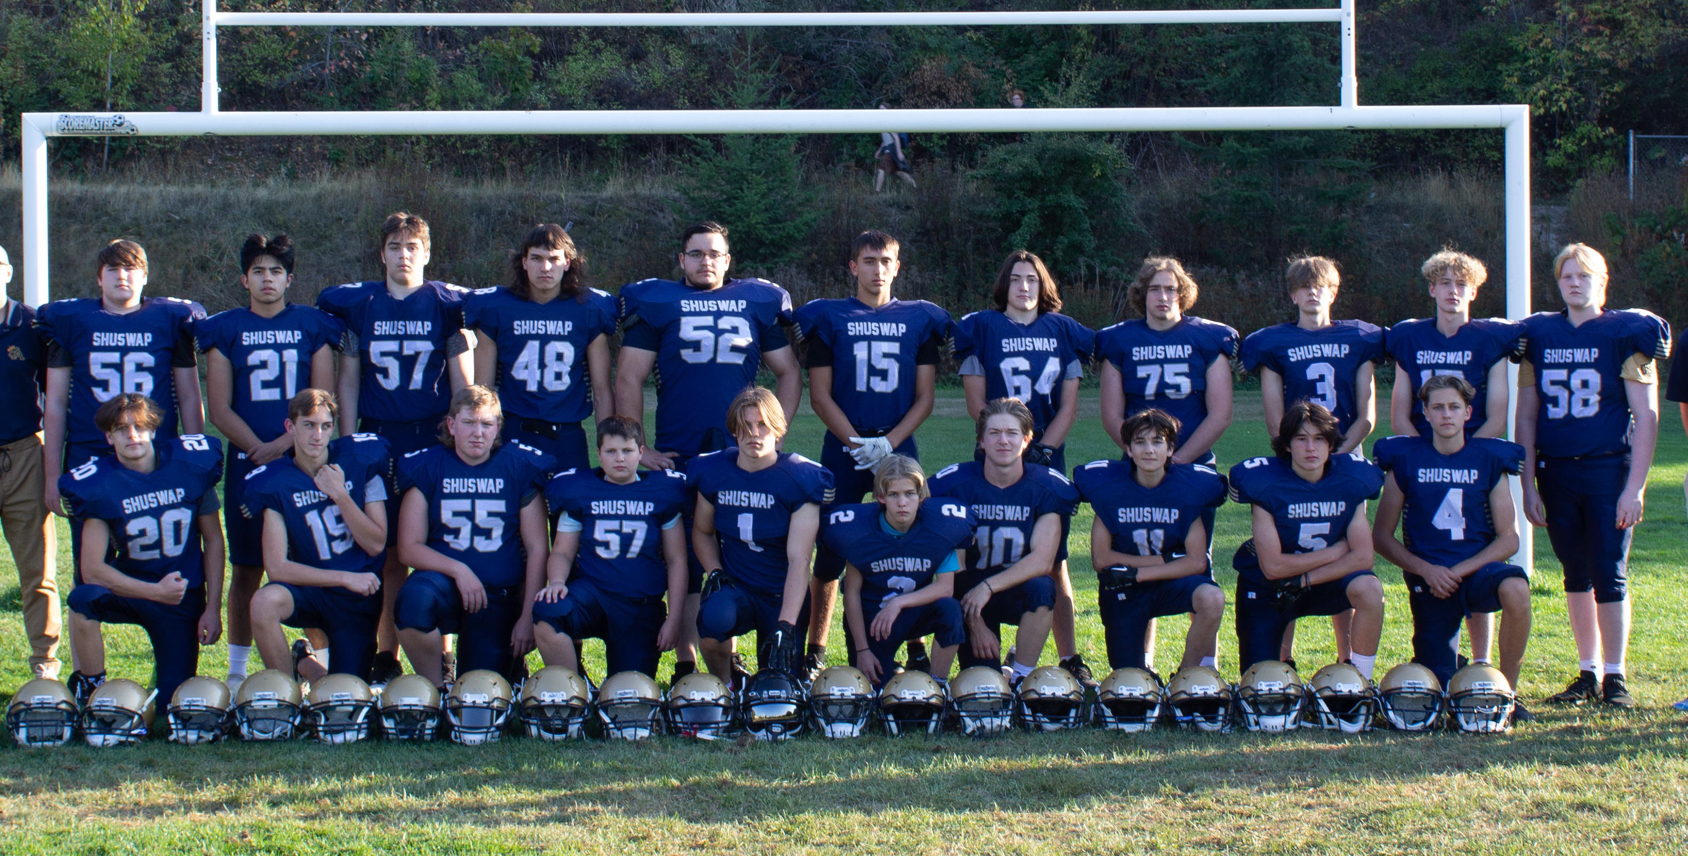
Fall Sports

Slide 24
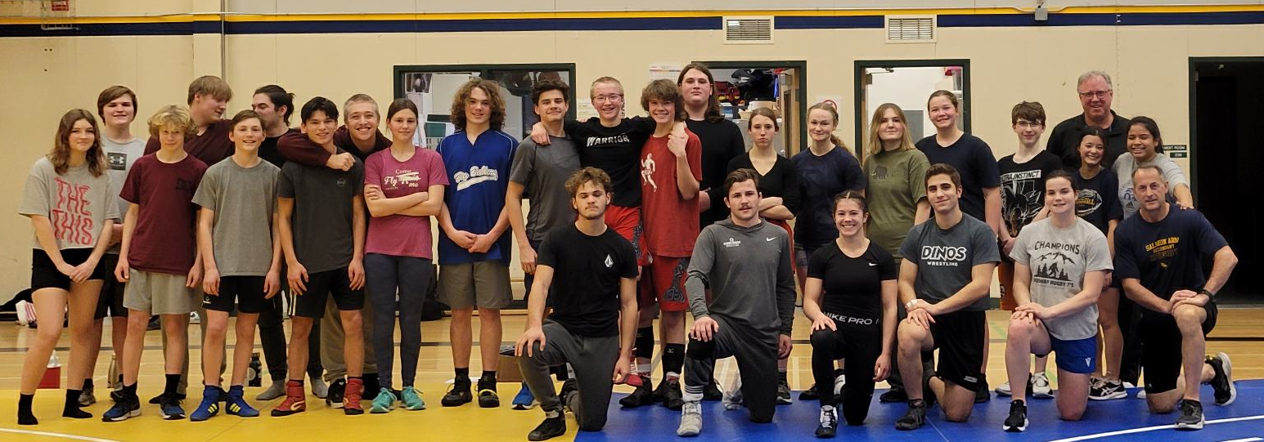
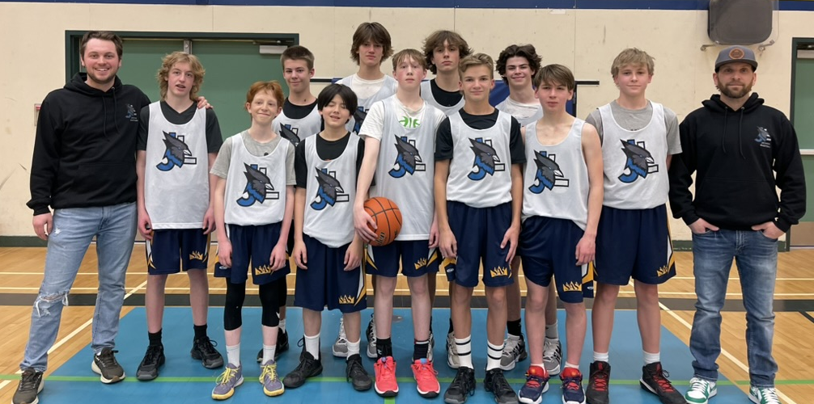
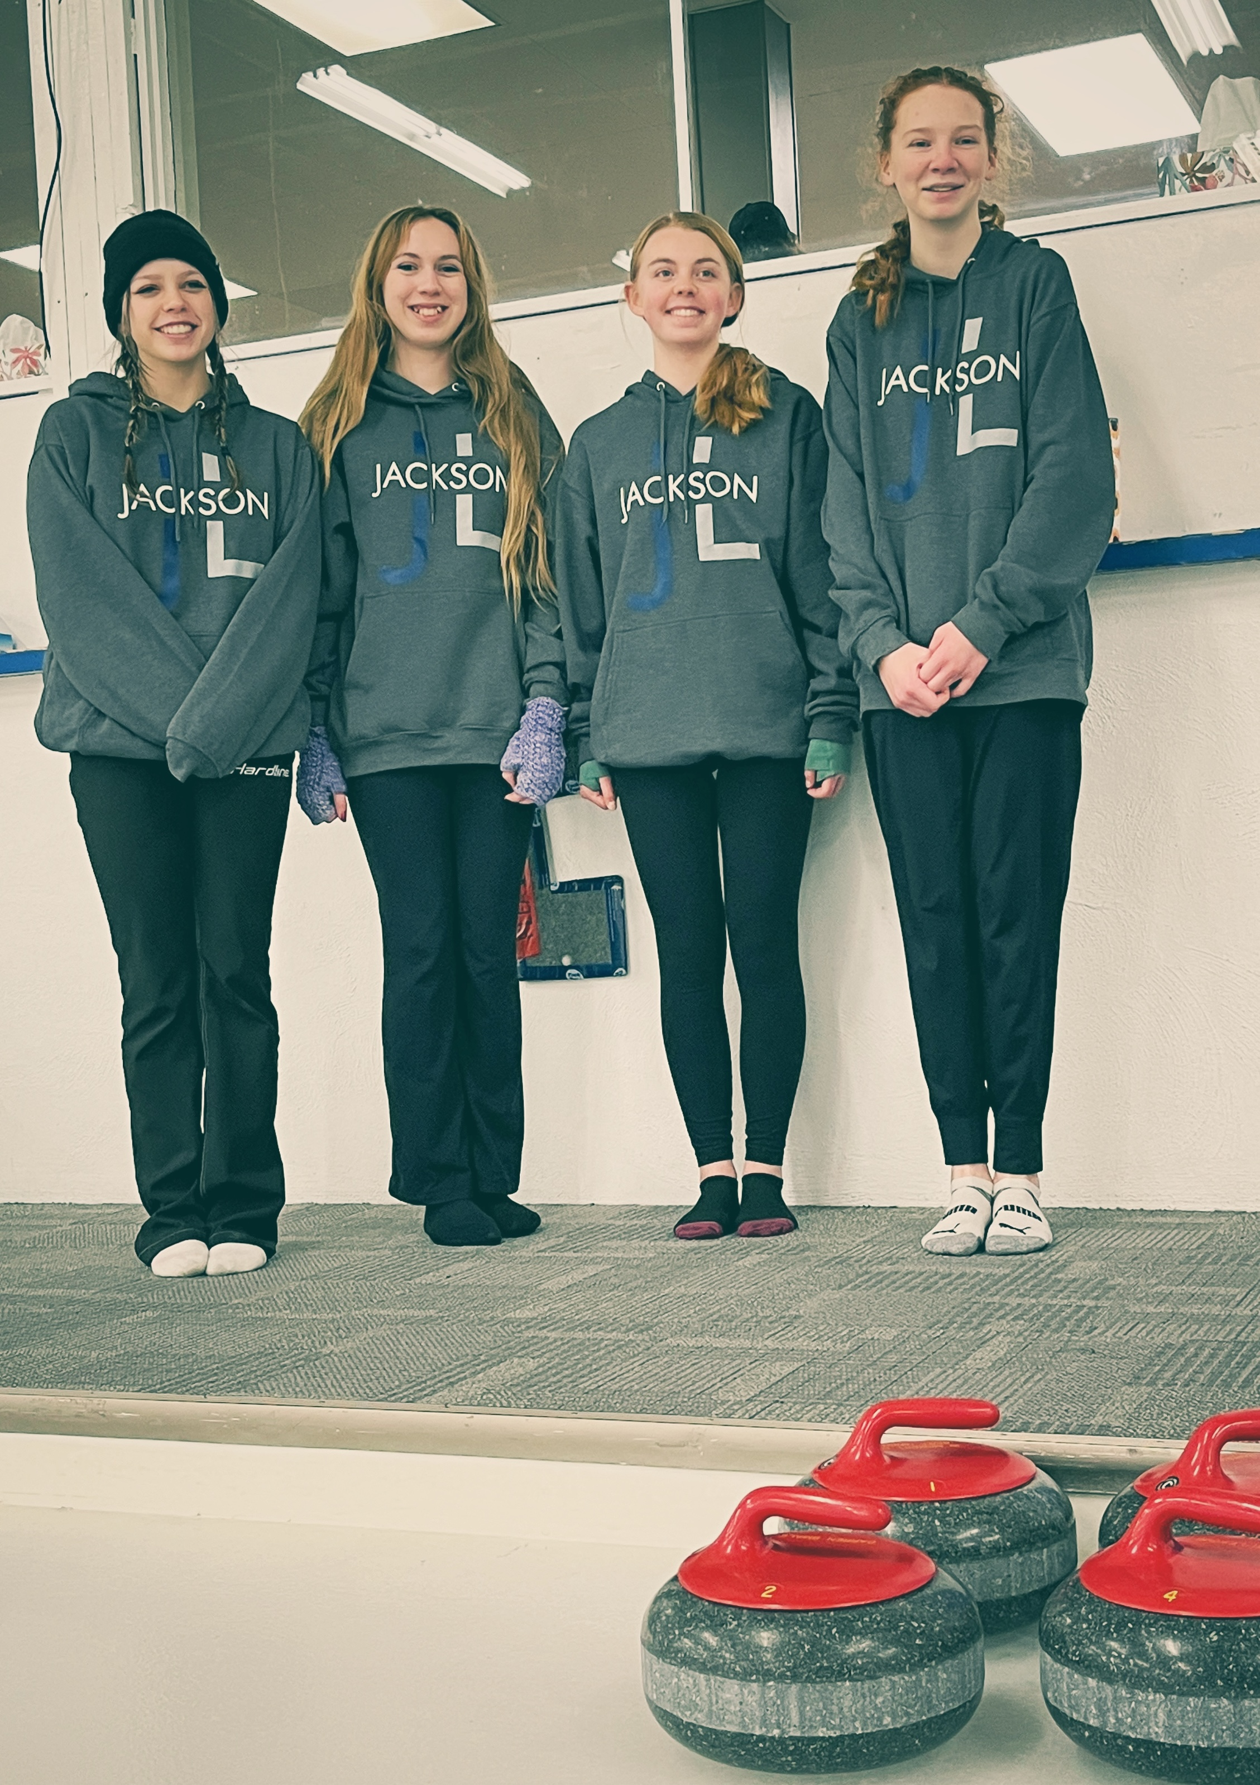
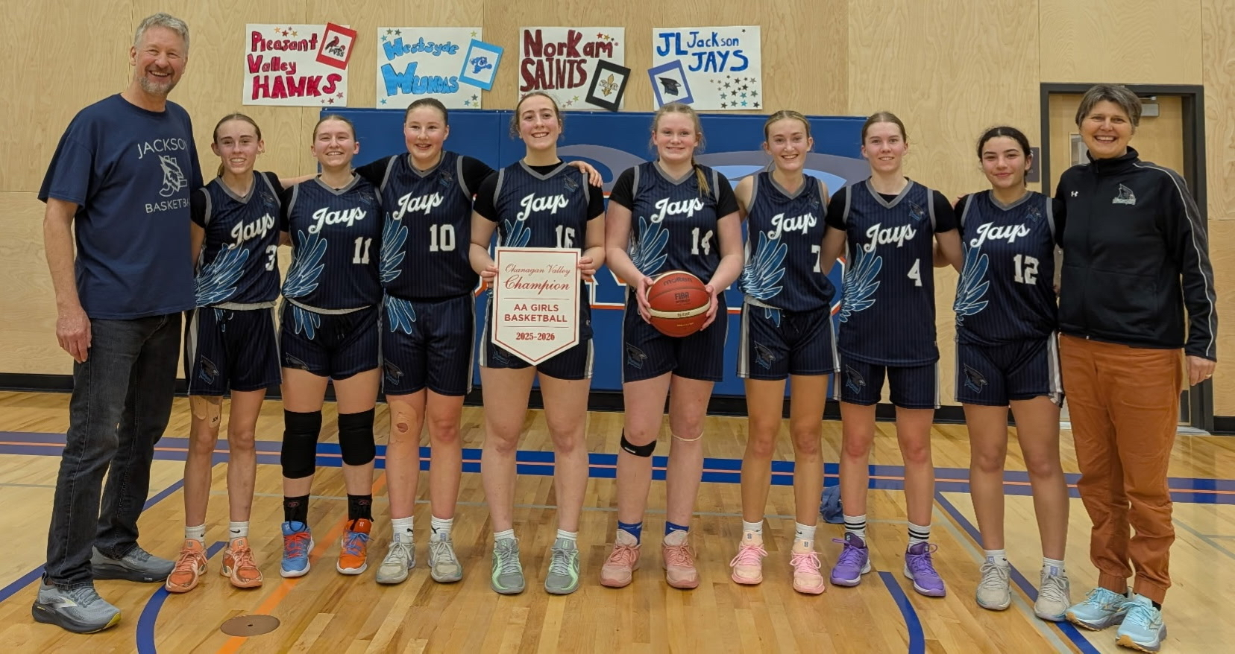
Winter Sports

Slide 25
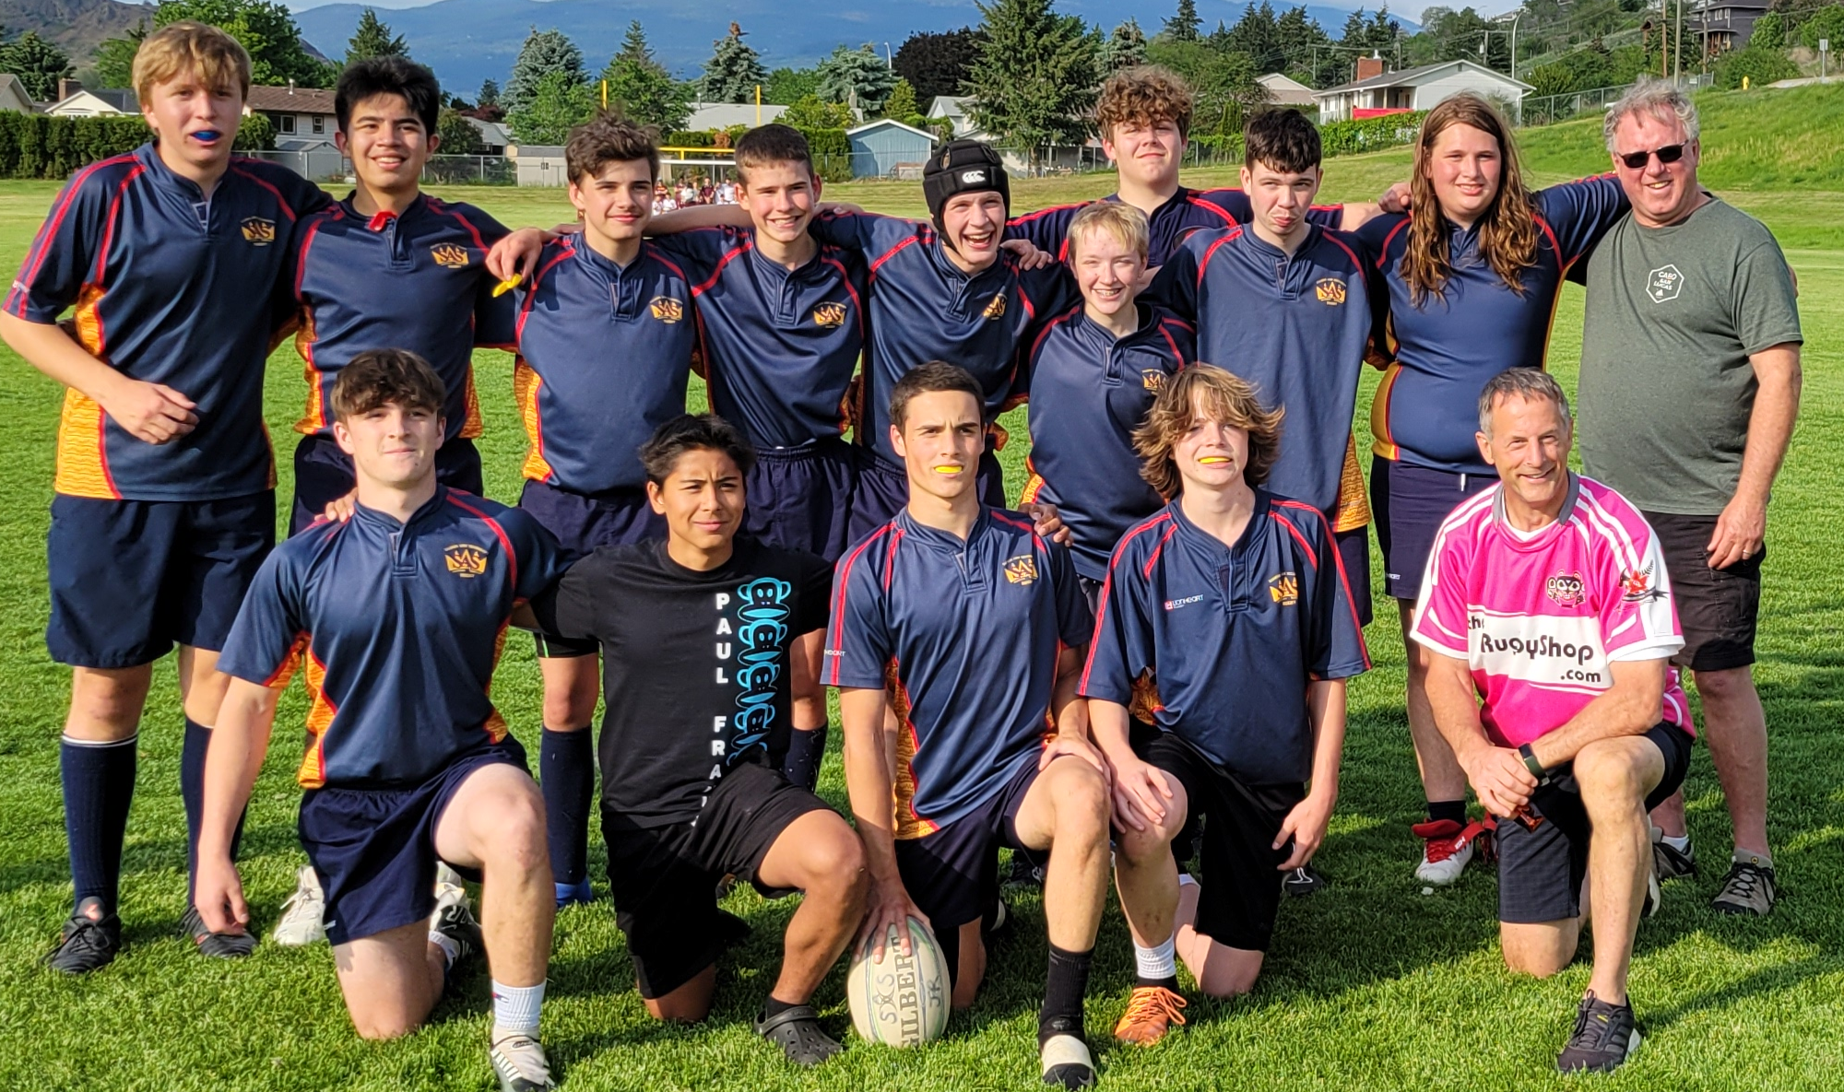
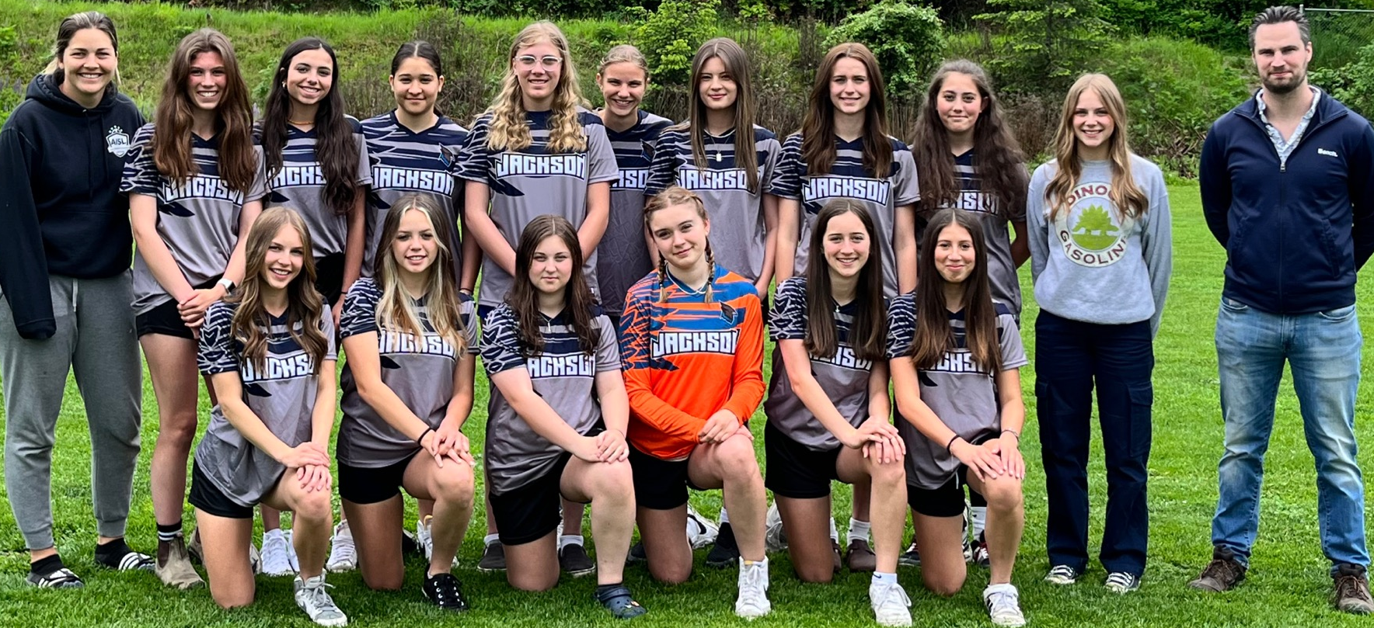
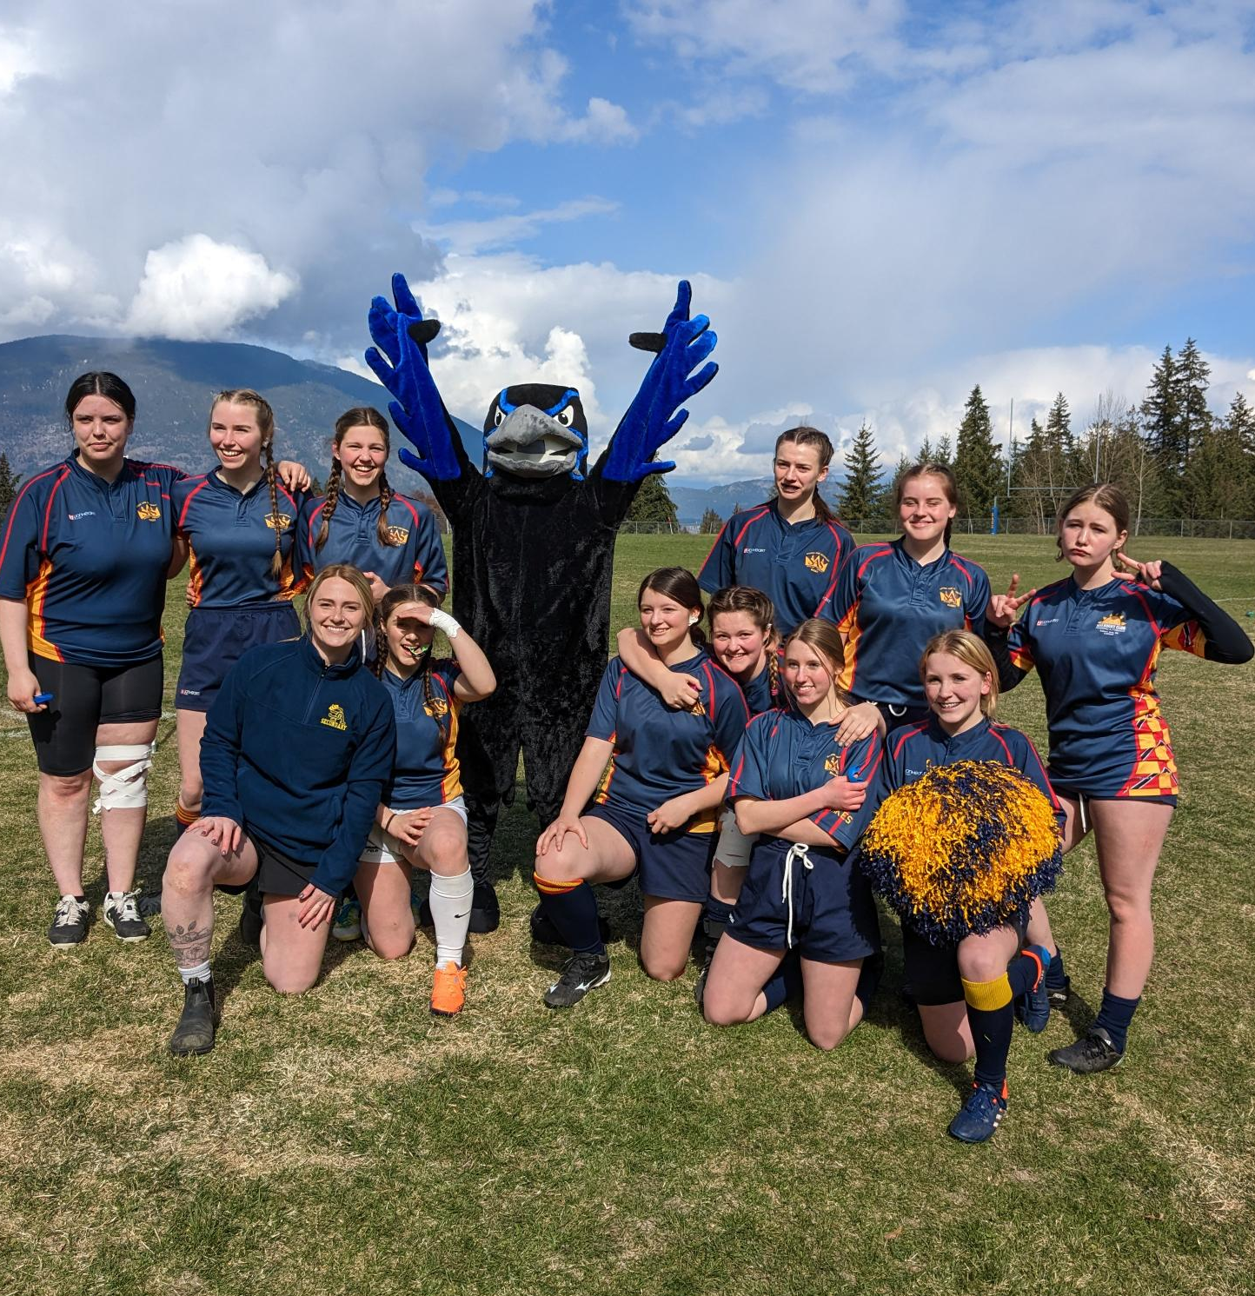
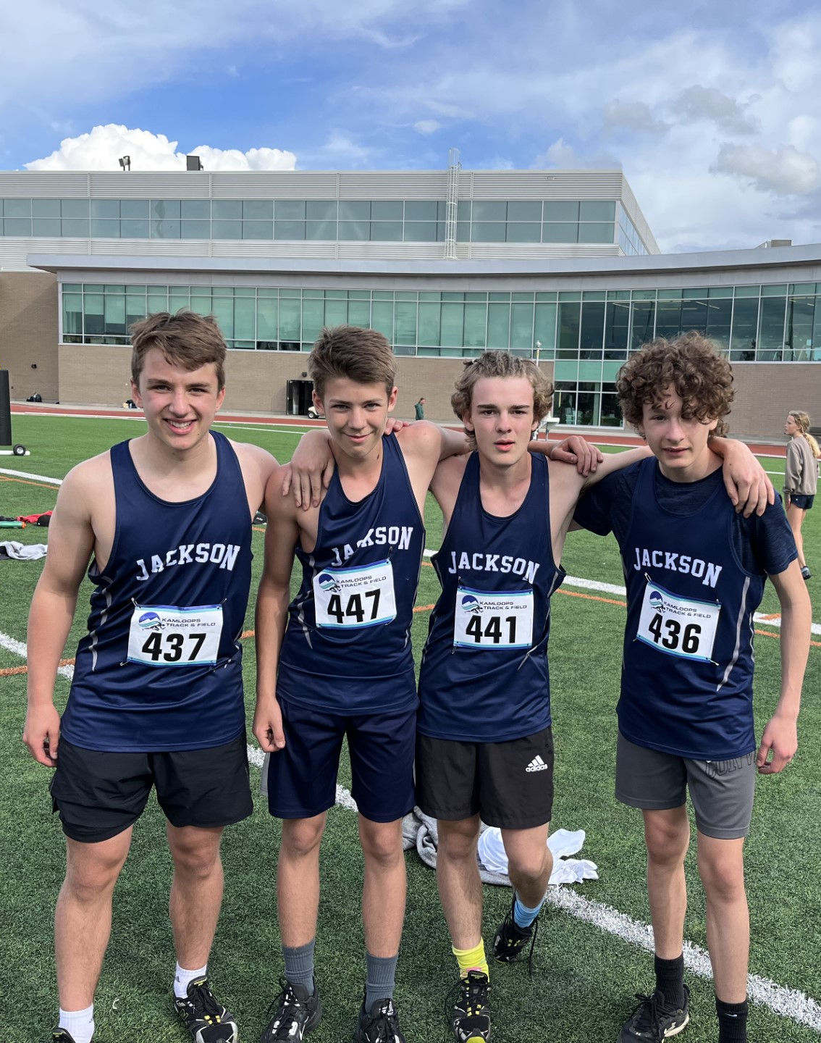
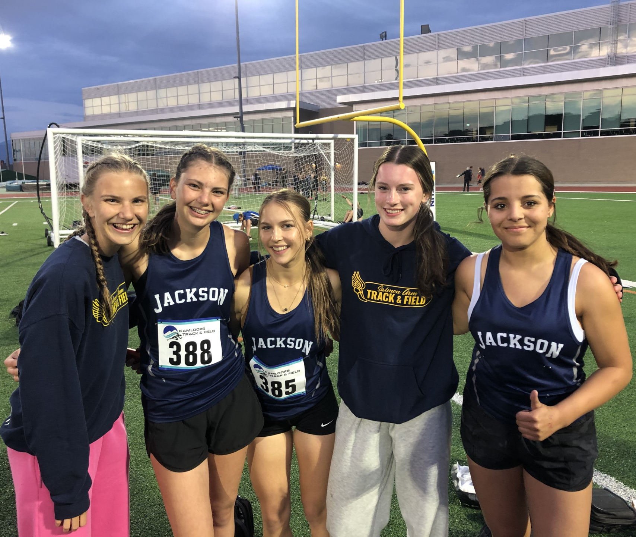
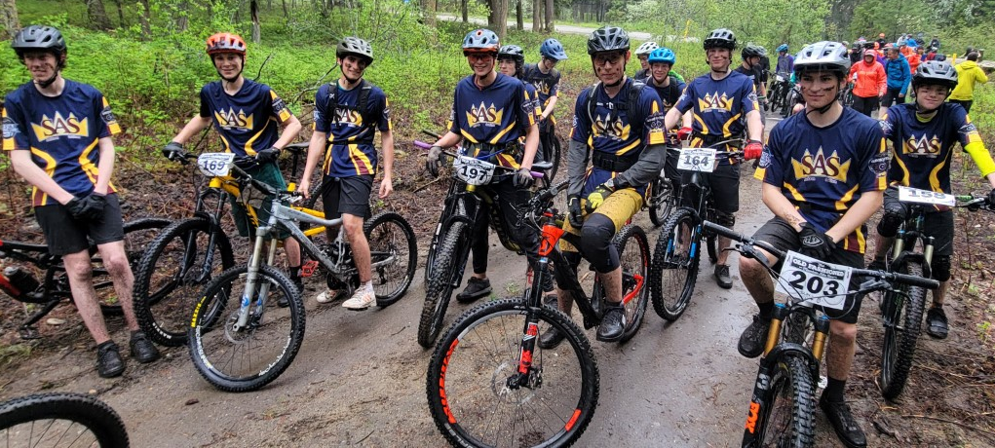
Spring Sports

Slide 26
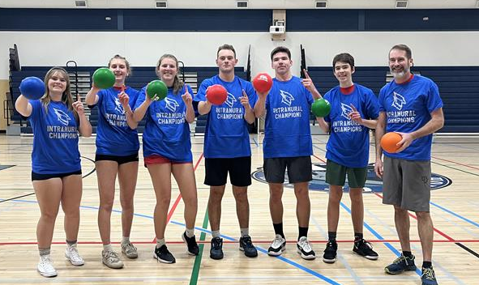

Lunchtime
Intramurals
Volleyball
Handball
Basketball (3 on 3)
Bocce
Etc.
LIBRARY
Clubs
Indigenous Drumming Group
Fitness Fridays
Chess Club
Art Club
Leadership
Maker Club
Pride Club
Ski and Snowboard Club
Board Game Club
ECO Club
CAFETERIA
BREAKFAST
PROGRAM

Slide 27


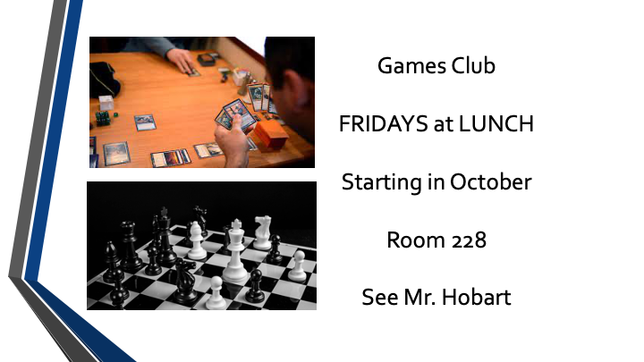


Clubs

Slide 28




Clubs

Slide 29





Cultural Activities

Slide 30

Questions?

Slide 31
SELF-Guided Tour
Feel free to enter any unlocked space
Staff are positioned throughout the building to answer questions
Please do not touch any classroom materials/projects/etc.
An announcement will signal the end of the tour

