Slide 1


Grade 8 Transitions Spring 2025
JL Jackson Secondary School

Slide 2
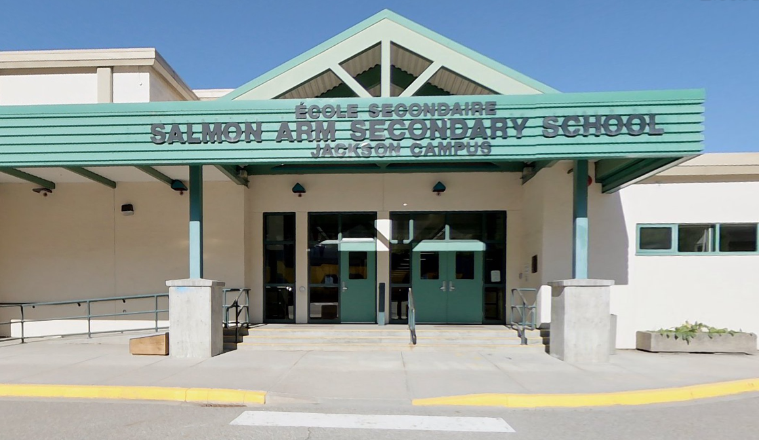

Slide 3


Slide 4
Grade 8 Transition TIMELINe
18–21 Feb.
Grade 8 Course Presentations
19 Feb.
Grade 8 Family Info Night @ 6:30pm
Fri. 7 Mar.
Grade 8 Course Selection Forms Due
10 June
Grade 8 Family Night Welcome & Tour @ 6:30pm

Slide 5
A Comparison
Middle School
High School
Core Teacher(s)
Exploration Teachers
50-minute classes
Linear classes
Academic teachers
Elective teachers
80-minute classes
Semester based classes (few linear classes)
Responsibility…
Accountability…
Expectations…
Transitioning from
Adult Monitored…
to Student Managed

Slide 6
RISING TO THE CHALLENGE!
You are in charge of your ATTITUDE,
your EFFORT,
and your ATTENDANCE!
WE BELIEVE IN YOU!

Slide 7
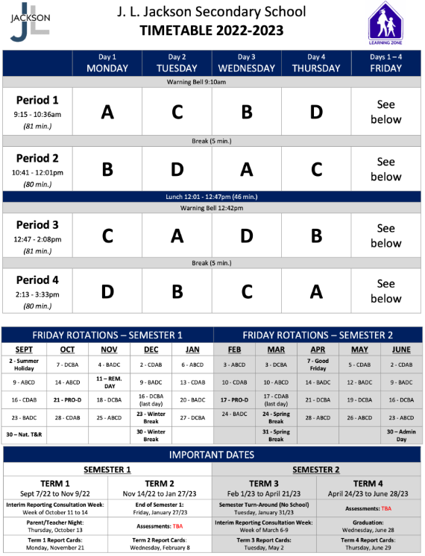
Sample Student Schedule
Science
French
Math
PHE
Term 1: September- November
A → Science 9
B → Math 9
C → French 9
D → PHE 9
Math
PHE
Science
French
French
Science
PHE
Math
PHE
Math
French
Science

Slide 8
English Track – Required Courses
1. English 9
2. Social Studies 9
3. Science 9
4. Math 9
5. Careers 9
6. PHE 9
PHE 9
or
Active for Life 9

Slide 9
French Immersion Track – Required Courses
1. English 9
2. Science Humaines 9
3. Francais Langue 9
4. Science Naturelles 9
5. Math 9
6. Careers 9
7. PHE 9
PHE 9
or
Active for Life 9
or
Ed Phys 9

Slide 10
PE Options
PHE 9
-Offered to students who enjoy a more traditional PHE program
-Mainstream sports skills are a focus for evaluation of fundamental movement skills (e.g. basketball, volleyball, football, rugby, ultimate frisbee, badminton, pickleball, etc.)
-More focus on competition and group/team games
Active for Life 9
-Offered to students who are looking for an alternative to a traditional PHE program
-Some mainstream sports are still covered, but typically ones that require less complex skills, such as volleyball, badminton, ultimate frisbee, pickleball etc.
-Alternative lifelong activities are also introduced such as disc golf, bocce, tennis baseball, low organizational games, etc.
-In general, the course is not less intense, it’s just less competitive
Notes:
Similarities:
-Both Active for Life 9/10 and PHE 9/10 meet all curriculum requirements
-Approximately ¼ time spent developing fitness
-Approximately ½ time spent on developing fundamental movement skills and physical literacy
-Approximately ¼ time spent learning curricular based health topics
One main difference in the courses is the make-up of the students who choose to be in each program. Although the actual make-up of the courses isn’t all that different, it’s typically the more competitive students who choose PHE, and the less competitive who choose AFL. This makes the culture of each course better suited to the students who choose to be there.

Slide 11

Careers 9
Monthly presentations in scheduled classes
Some work to be completed outside class time
Uses MyBlueprint for Career Exploration and Portfolio
Sign up for careers spotlight sessions, field trips, etc.
Take your kid to work day (November)

Slide 12
Student Support Services
A Culture that Cares!
Counselling
Learning Resource Centre
Indigenous Support Workers
Certified Education Assistants

Slide 13
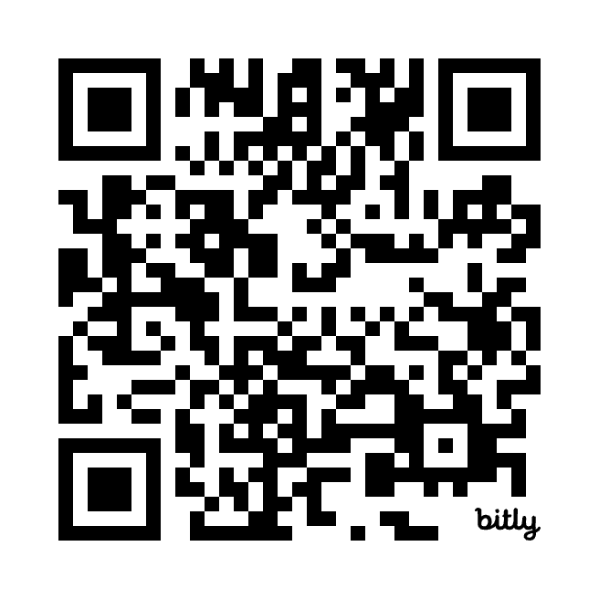
Choosing Electives
Make Individual Choices based on Personal Interest
Choosing the same elective as a friend does not mean you will be in their class
Students will be scheduled in up to 6 electives
Ranking all the electives will help us determine the courses that can be offered.
Some courses (ie. Band, French, Mountain Bike Academy, etc.) count as 2 electives
Do you research by reading the course descriptions and coming to the Family Information night on Feb 19
Scan the QR Code above
to see descriptions of
each Elective Course
https://jlj.sd83.bc.ca/grad
e-9-course-catalogue/

Slide 14
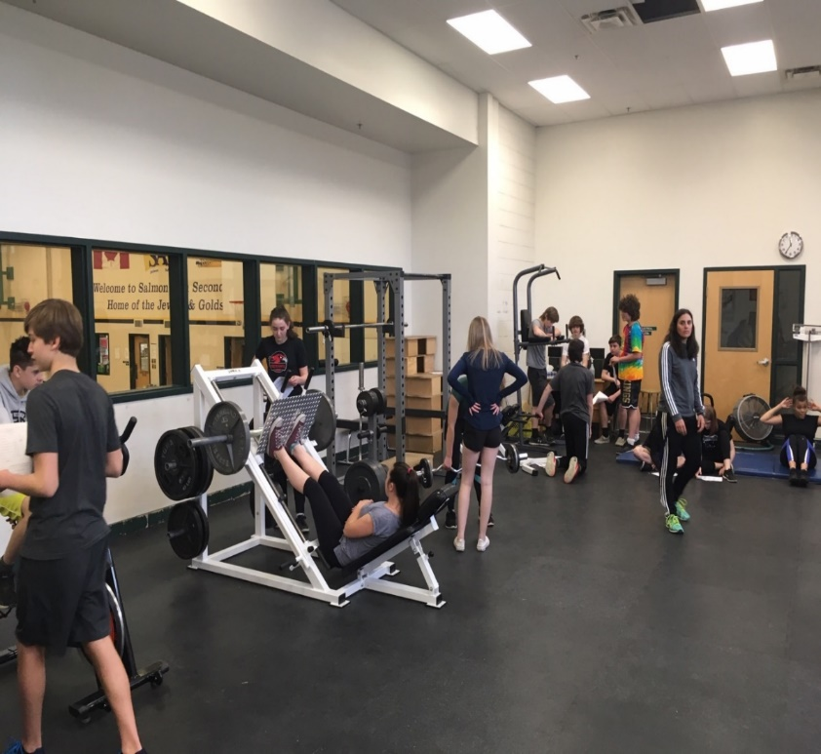
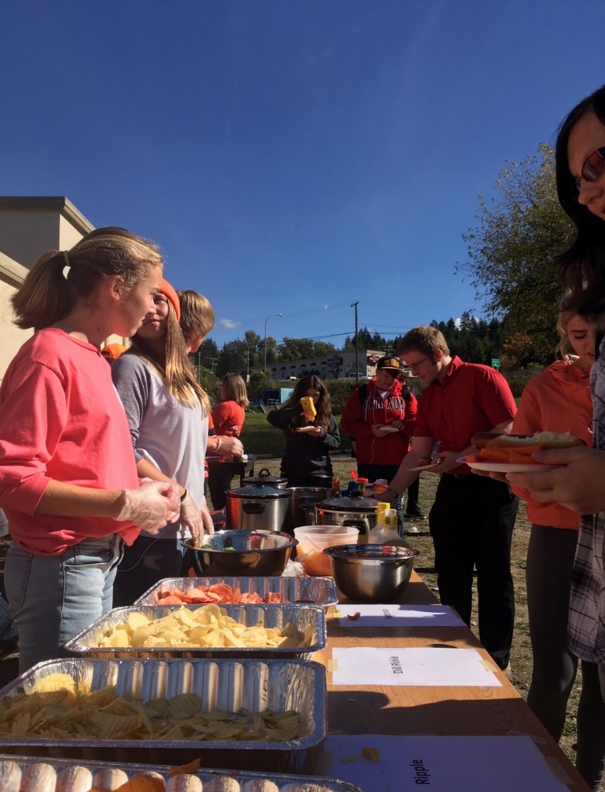
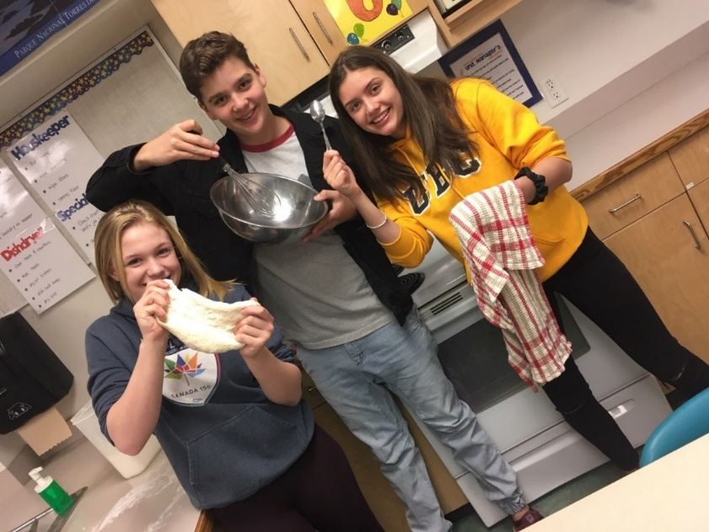
Fitness
Leadership
Foods

Slide 15
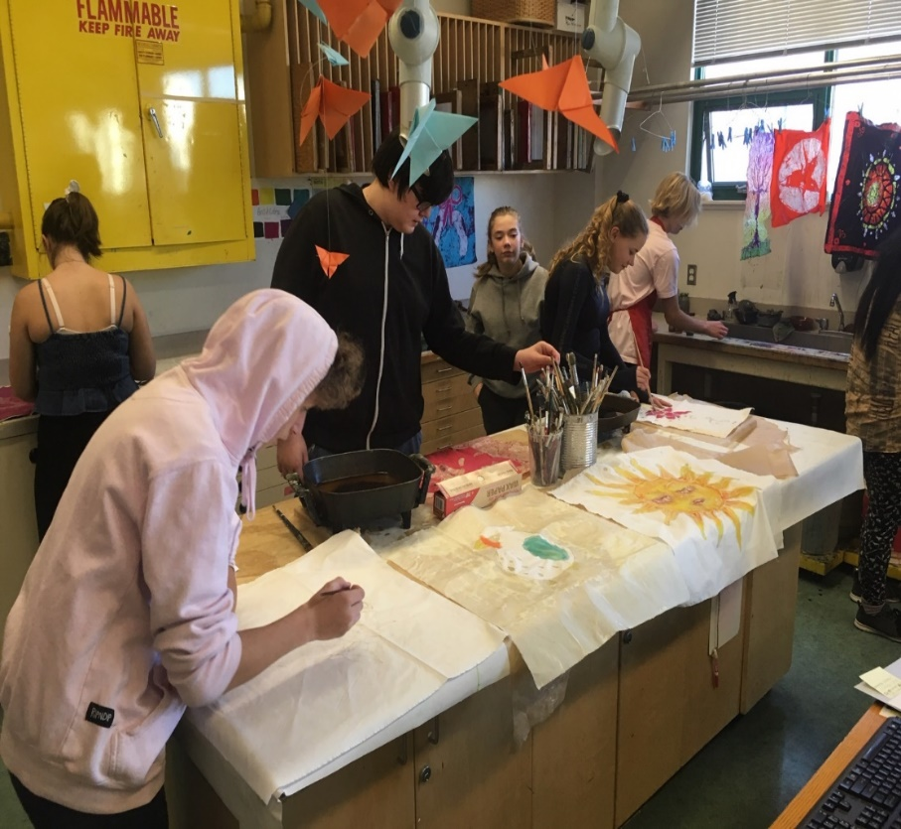
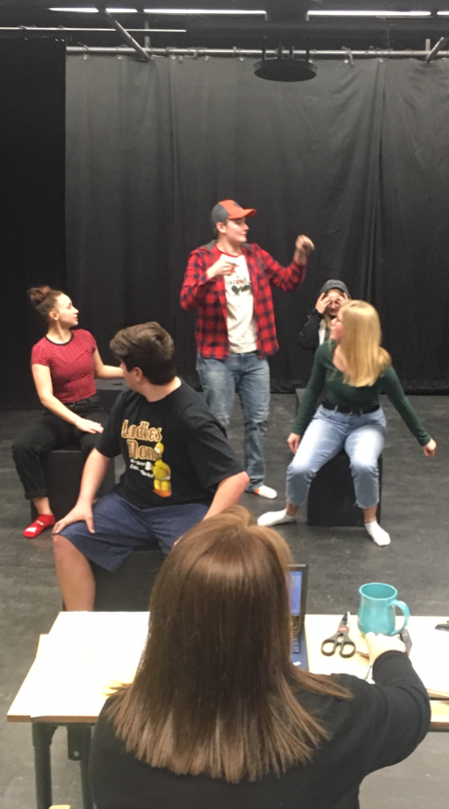
Drama
Art

Slide 16
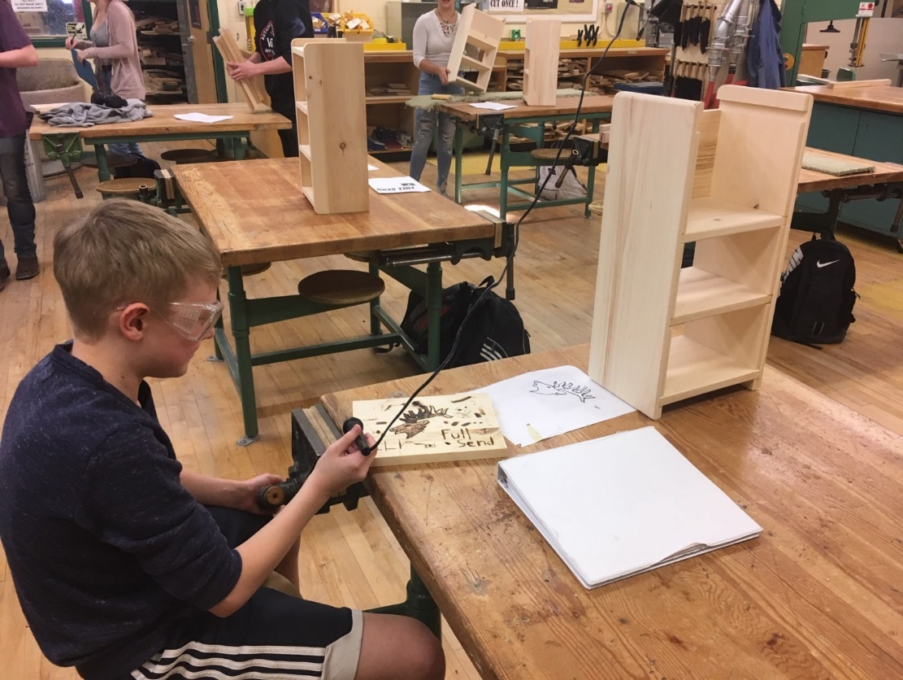
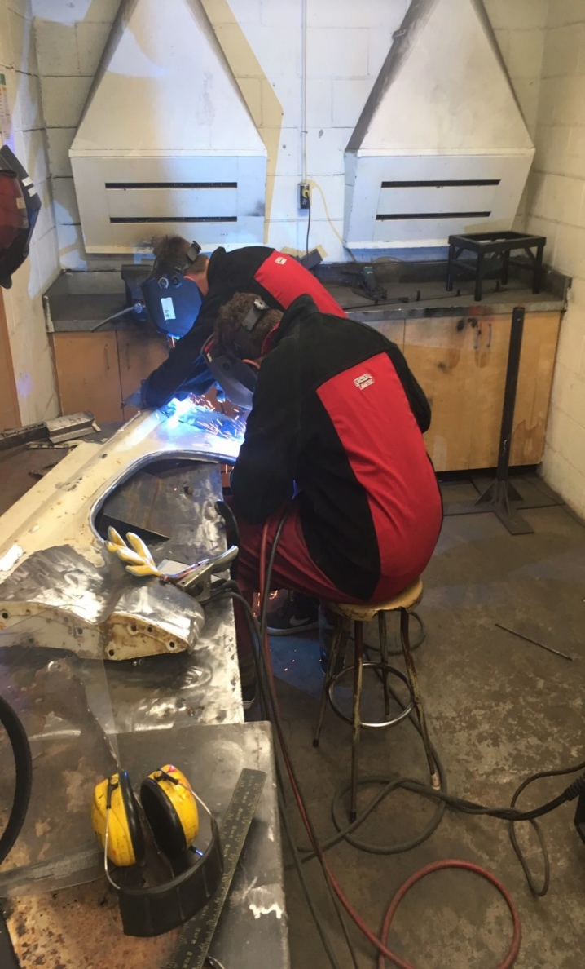
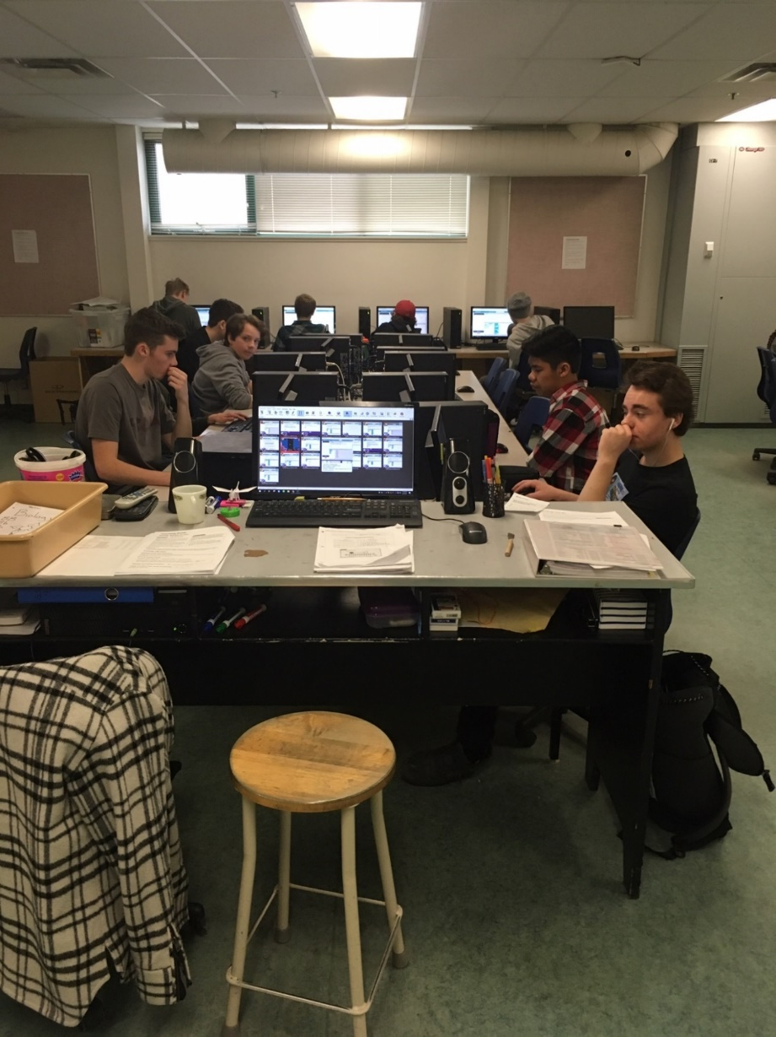
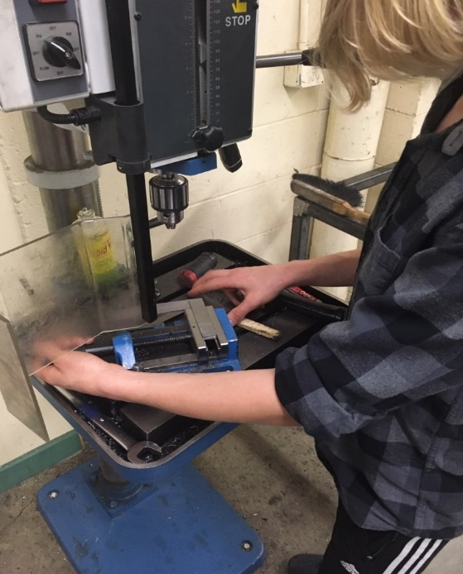
Woodwork
Computers
Metalwork

Slide 17
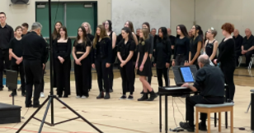
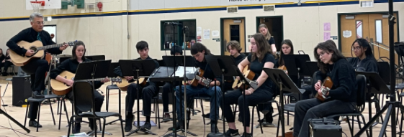
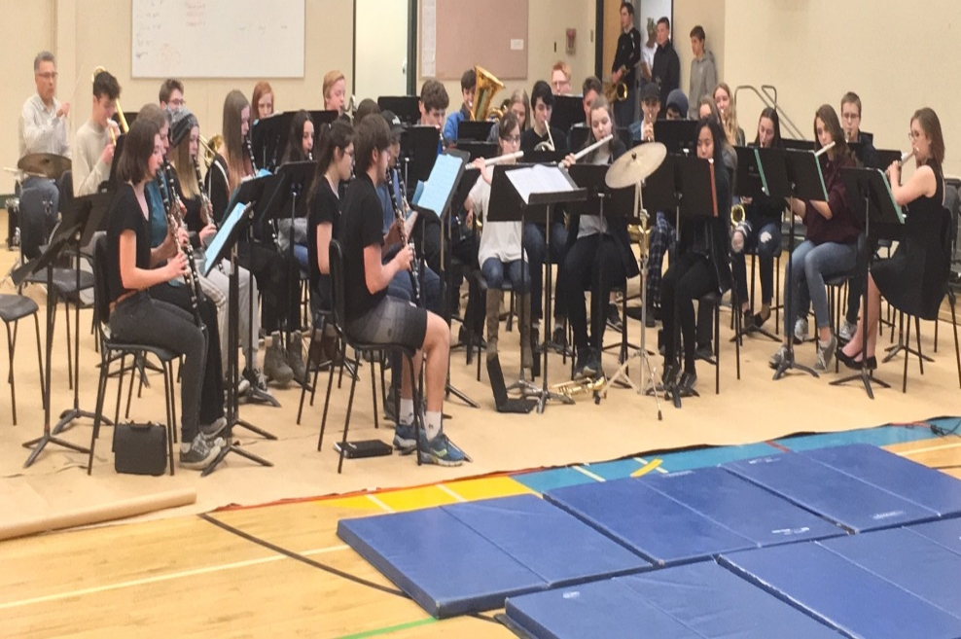
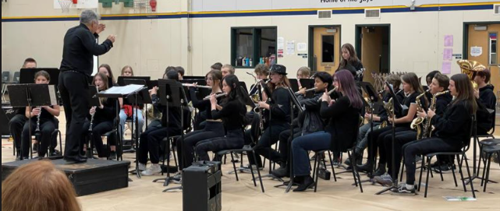
Guitar
Choir
Concert Band
Jazz Band

Slide 18
French
Japanese
Tech & Design
Entrepreneurship & Marketing
Power Tech
Robotics

Slide 19
Specialized Courses
Mountain Bike Academy
(Course fee of approximately $500)
Outdoor Adventure and Design
(Course fee of approximately $350)
*An online Expression of Interest Form must be completed for Specialized Courses.

Slide 20
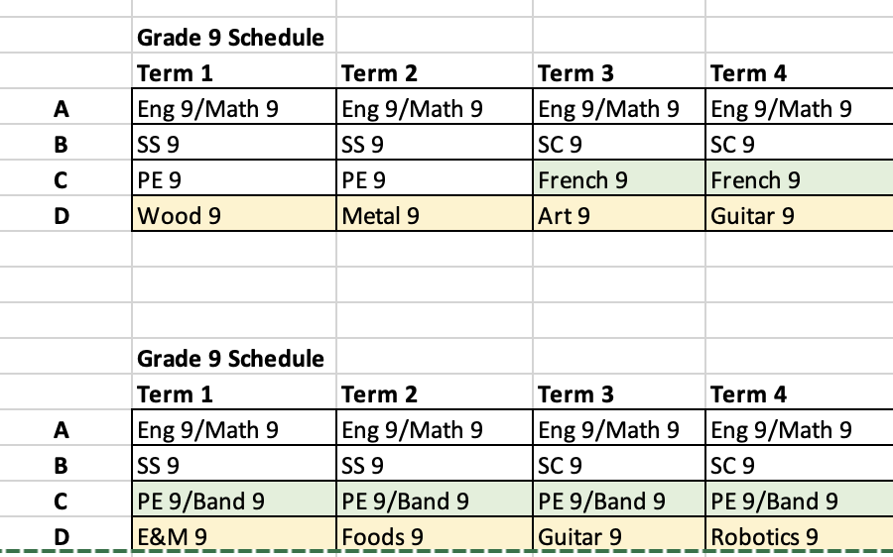
Example English Track Schedules

Slide 21
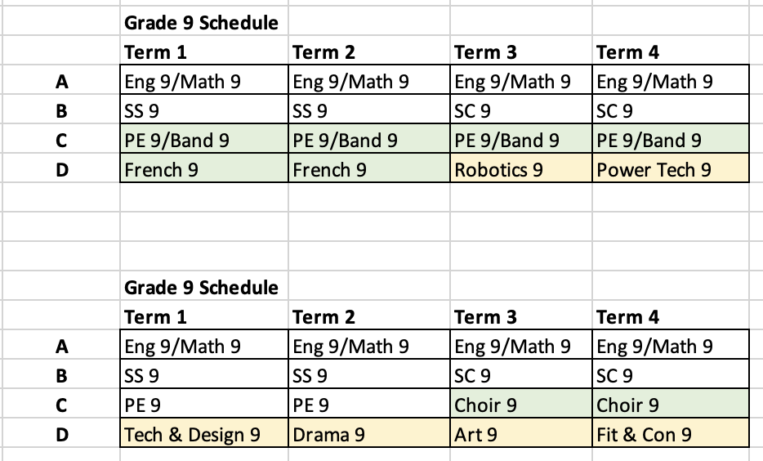
Example English Track Schedules

Slide 22
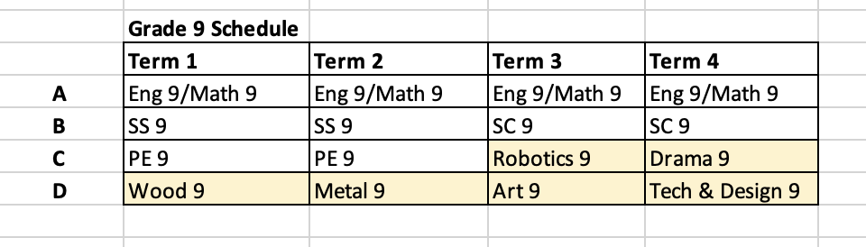
Example English Track Schedules

Slide 23
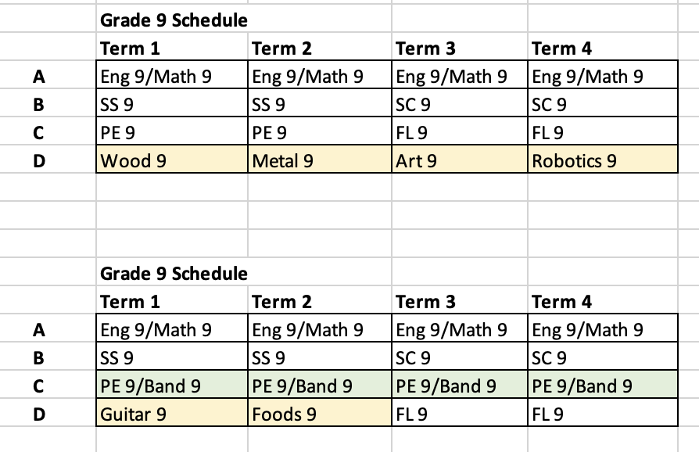
Example French Immersion Track Schedules

Slide 24
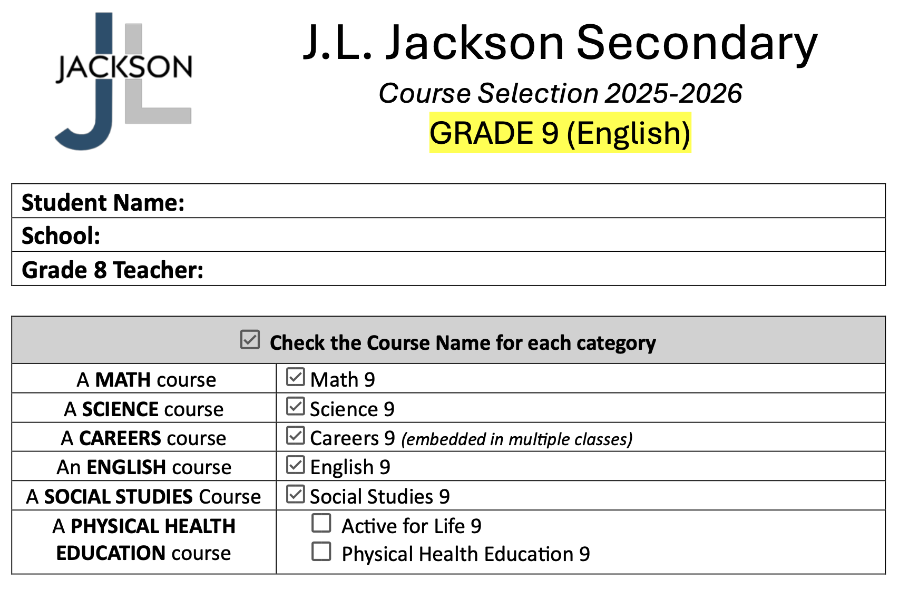
Step 1: Choose your Physical & Health Education class

Slide 25
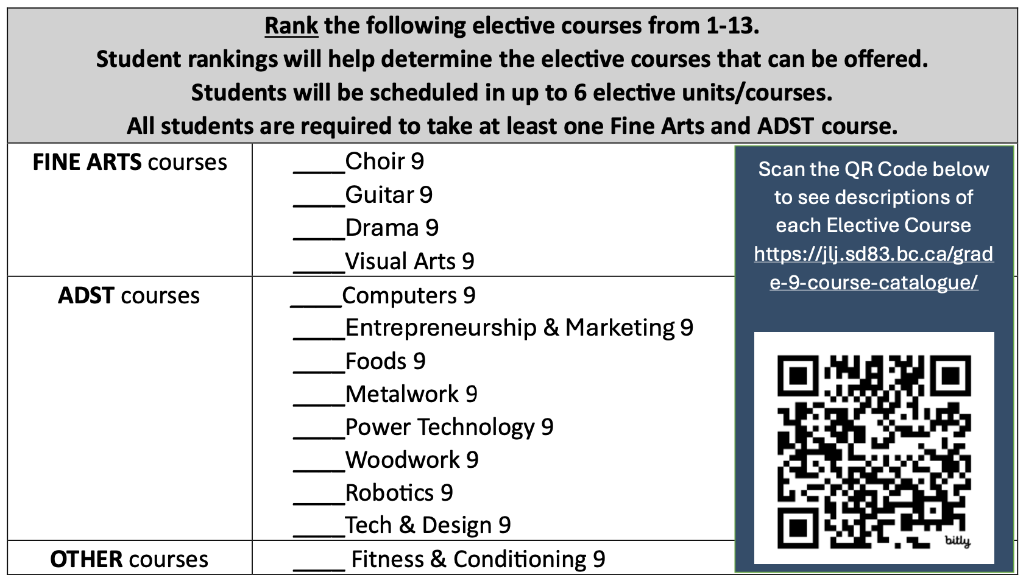
Step 2: Rank the electives in order of preference

Slide 26
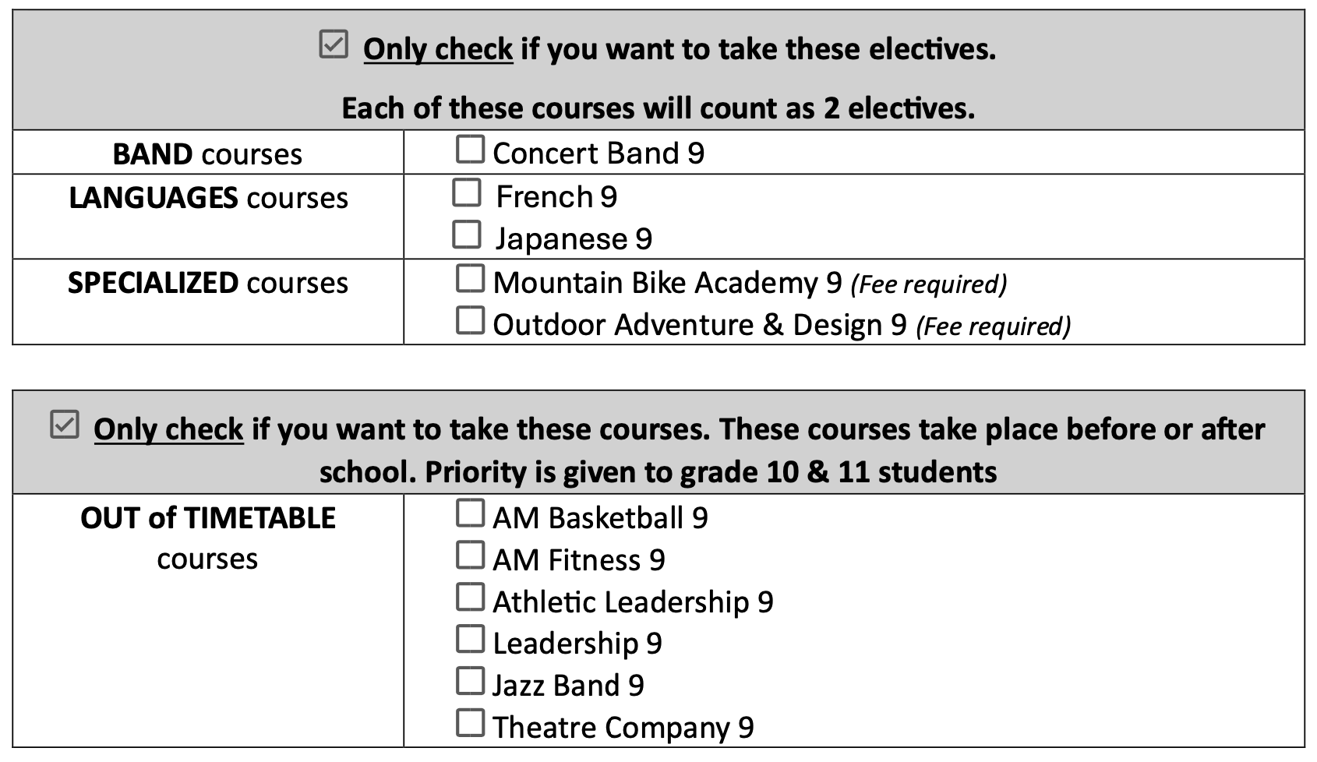
Step 3: Check the 2 Term or Linear electives you would like to take Step 4: Check any Out of Timetable Courses you would like to take

Slide 27

Sign and return the form by Friday March 7

Slide 28
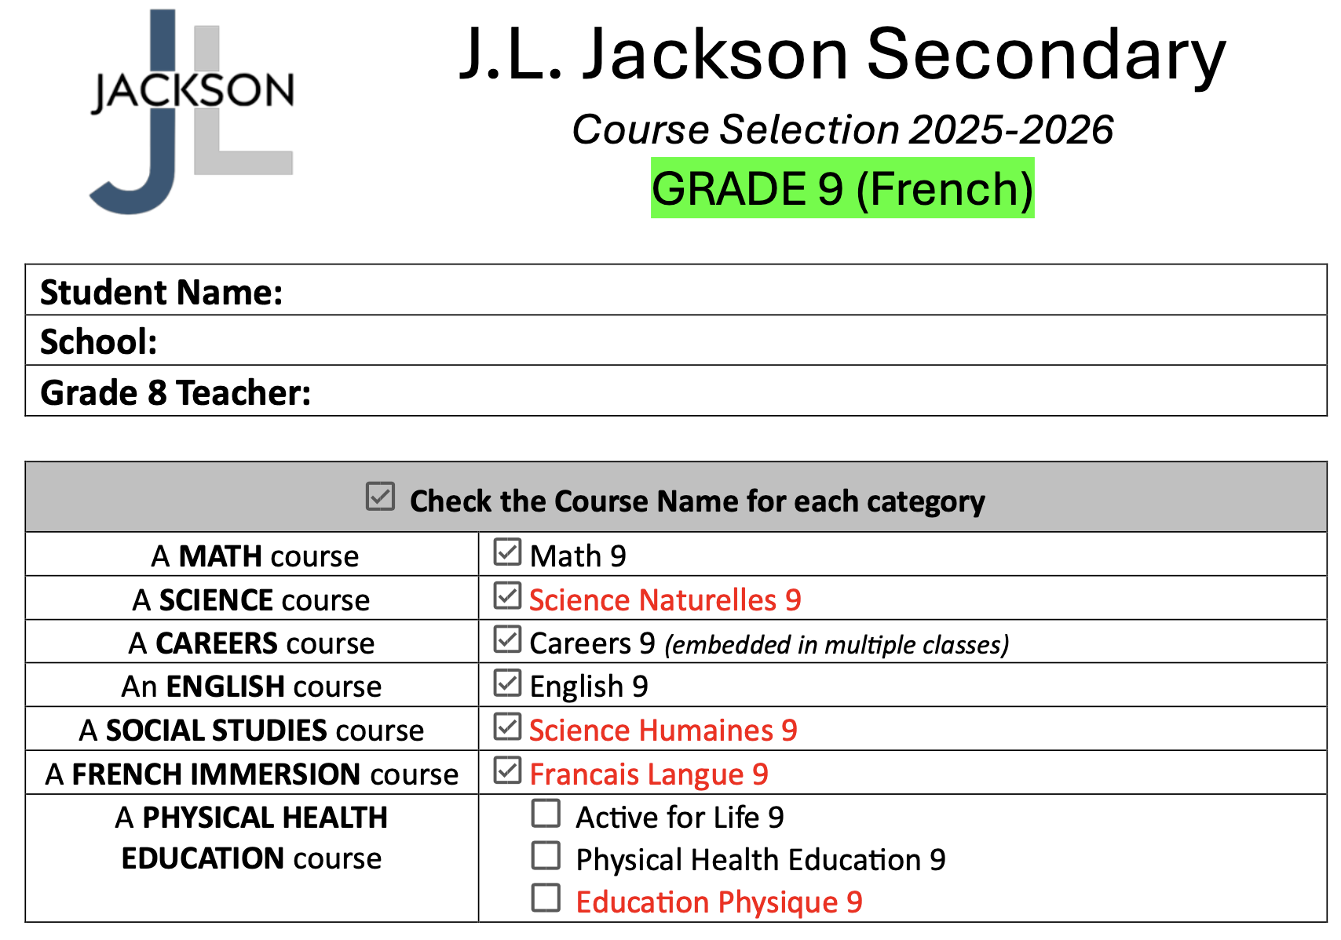
Step 1: Choose your Physical & Health Education class

Slide 29
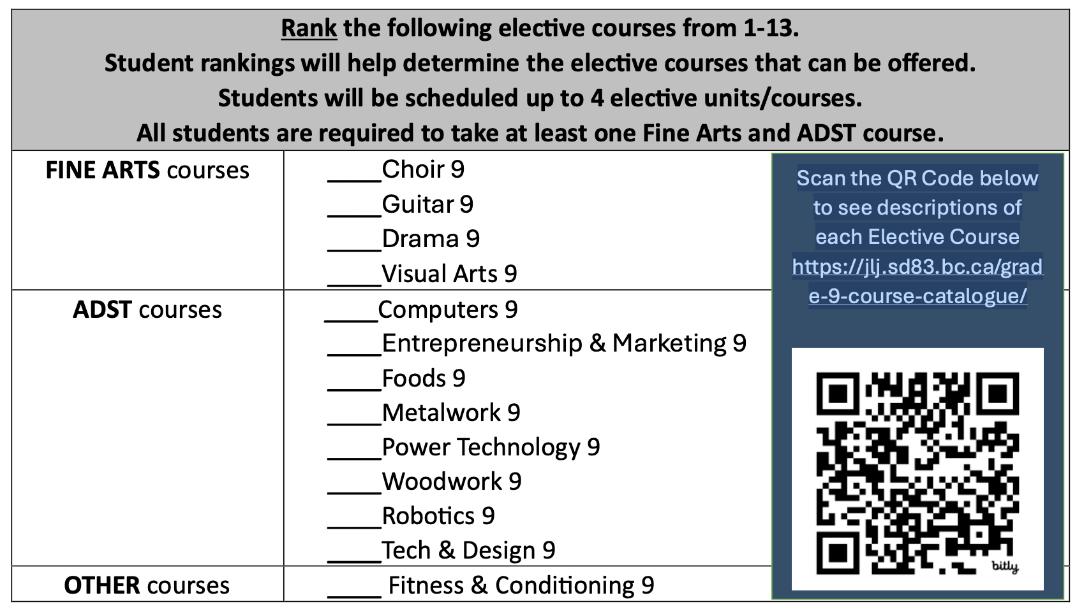
Step 2: Rank the electives in order of preference

Slide 30
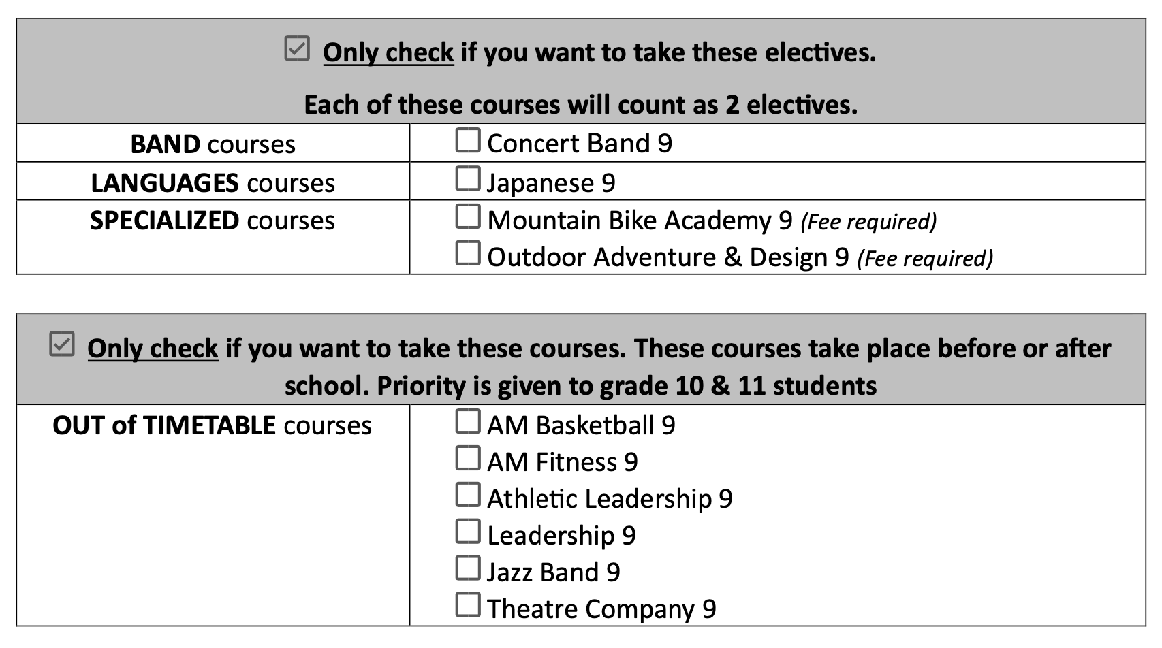
Step 3: Check the 2 Term or Linear electives you would like to take Step 4: Check any Out of Timetable Courses you would like to take

Slide 31
Sign and return the form by Friday March 7

Slide 32
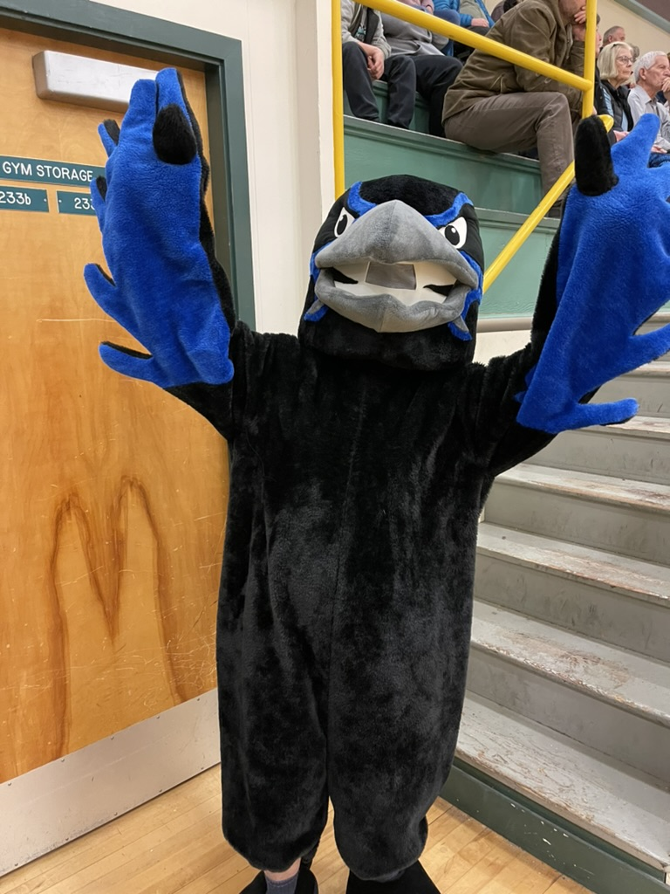
Extra-Curriculars
Sports
Clubs
Field Trips
Leadership
School Play
Etc.

Slide 33
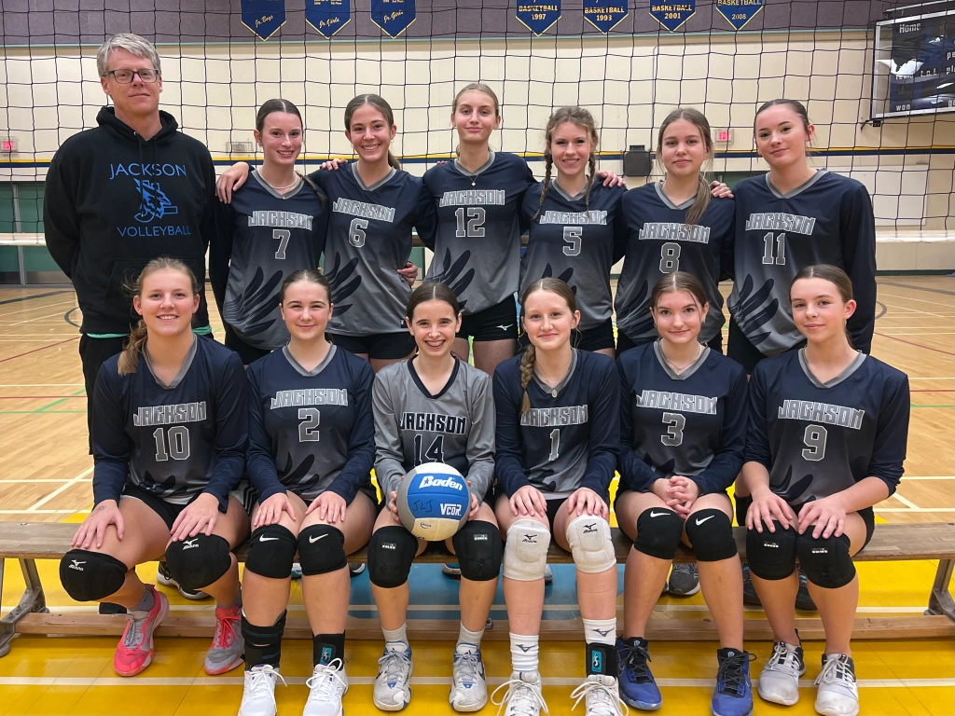
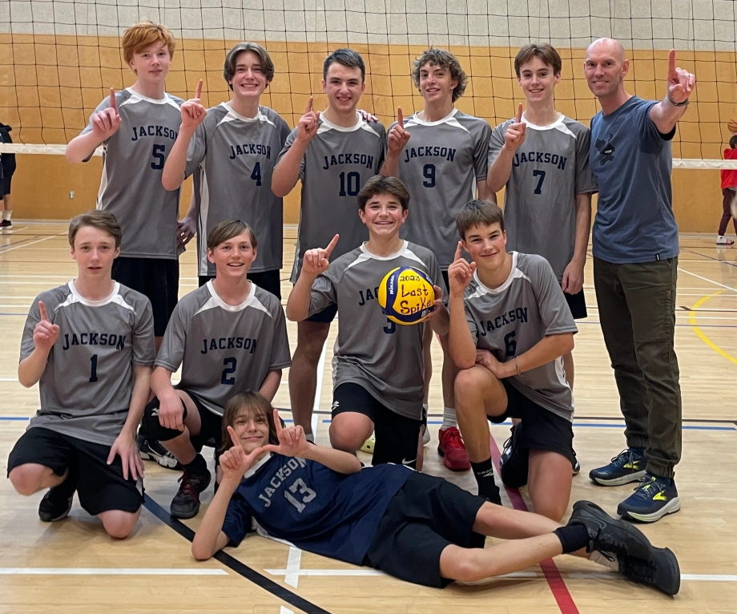
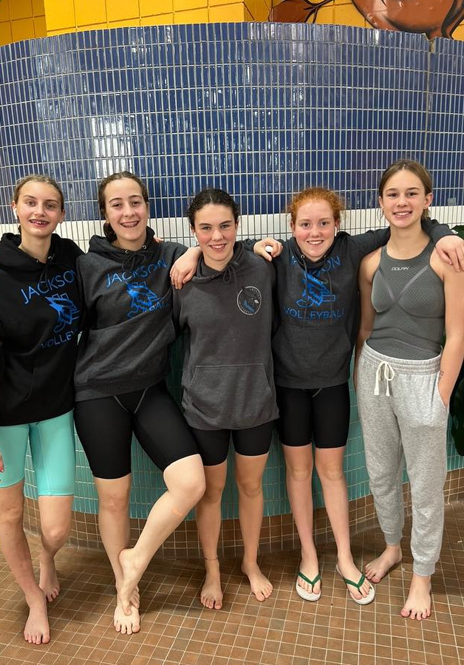
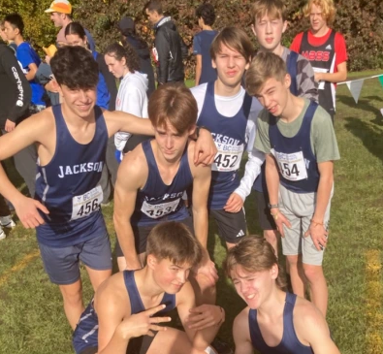
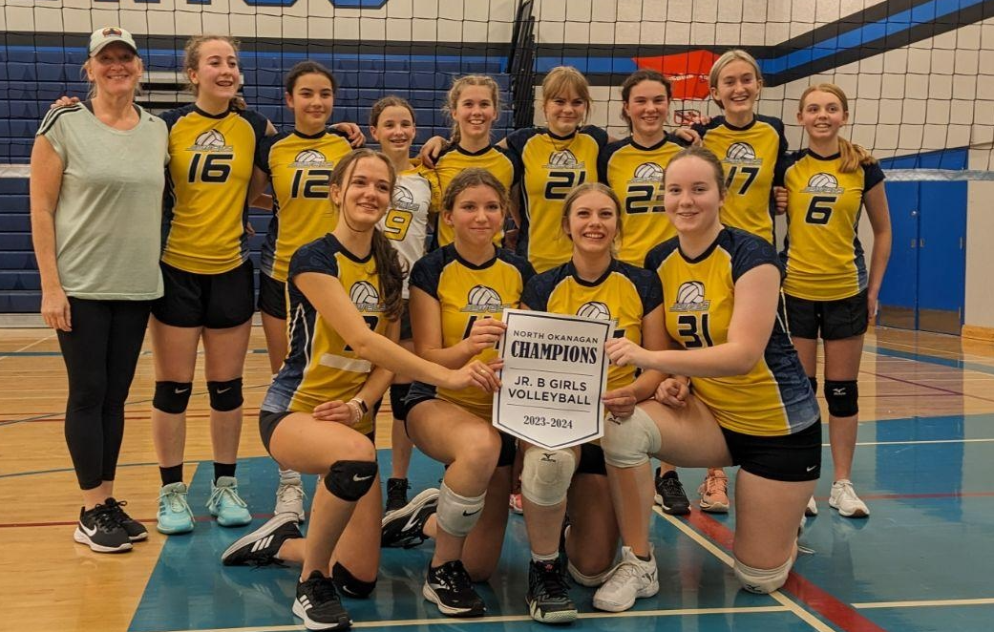
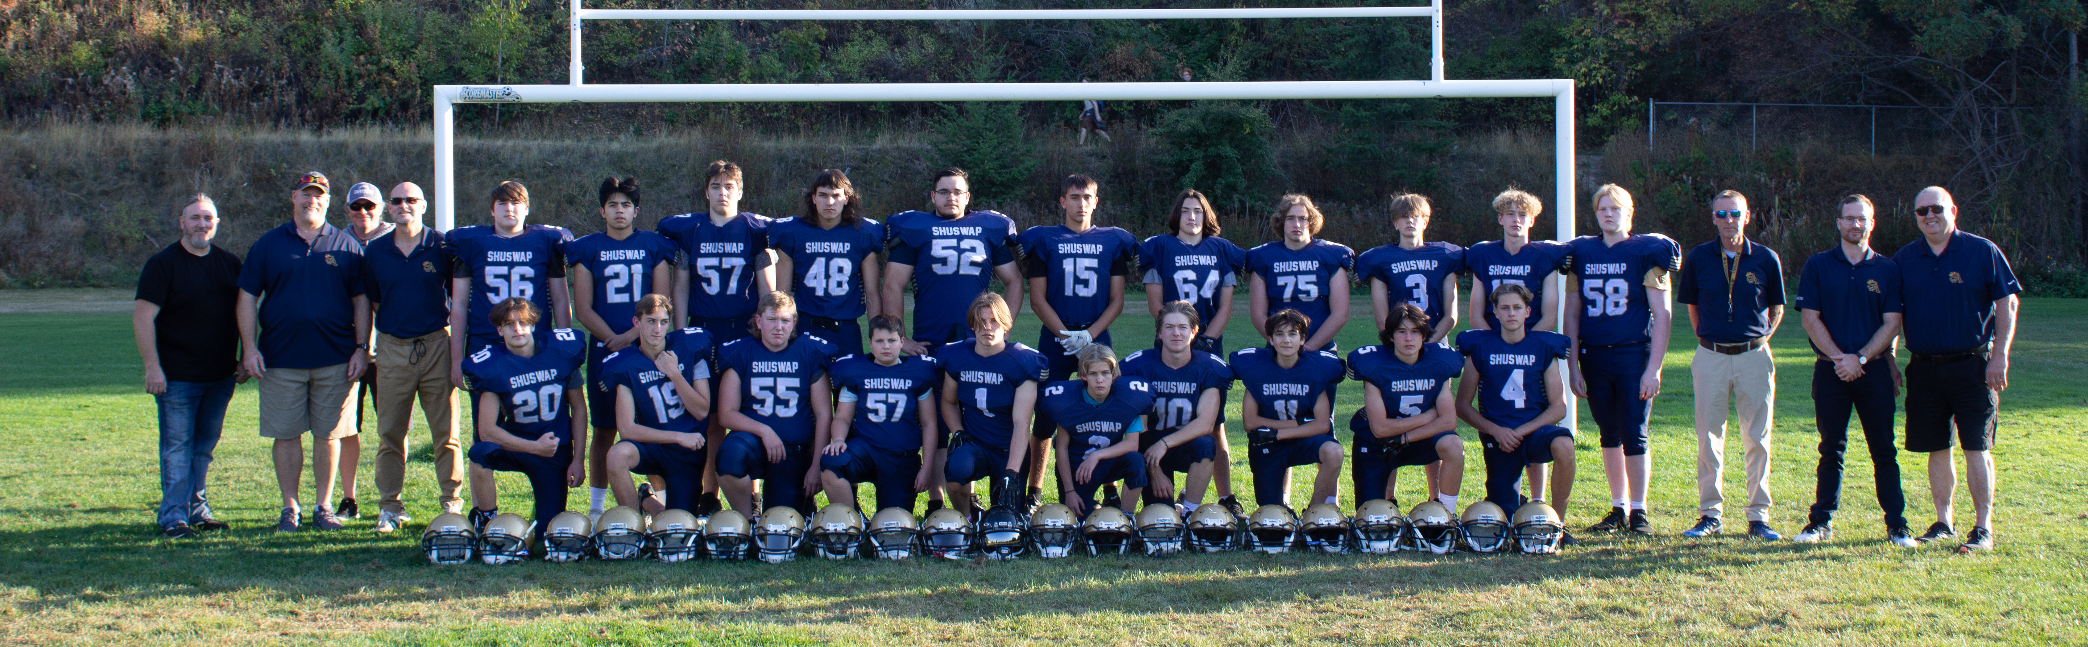
Fall Sports

Slide 34
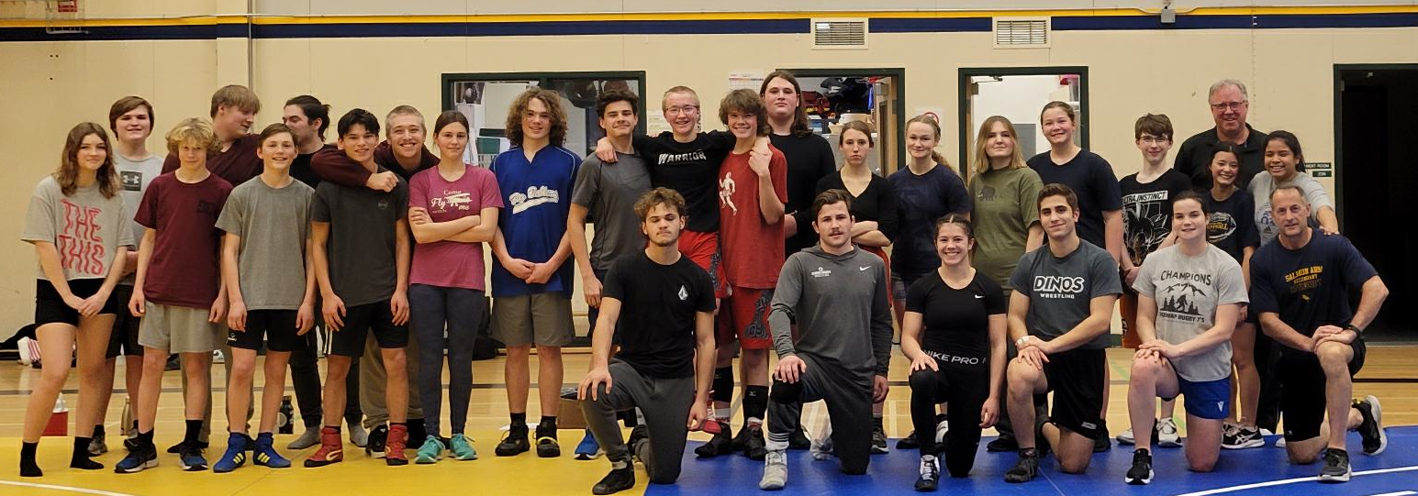
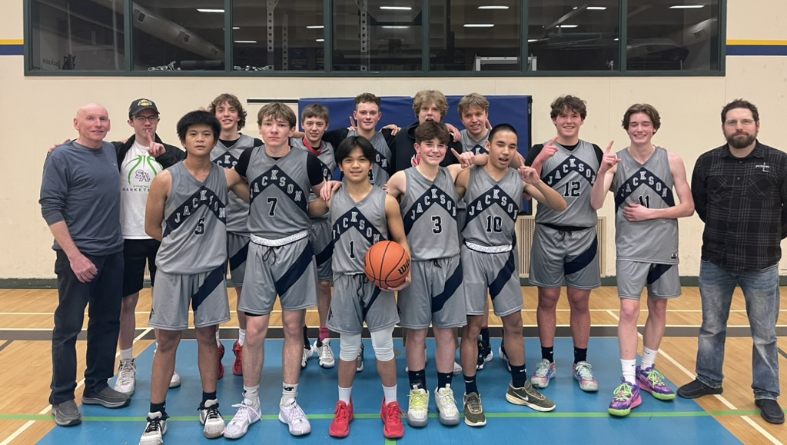
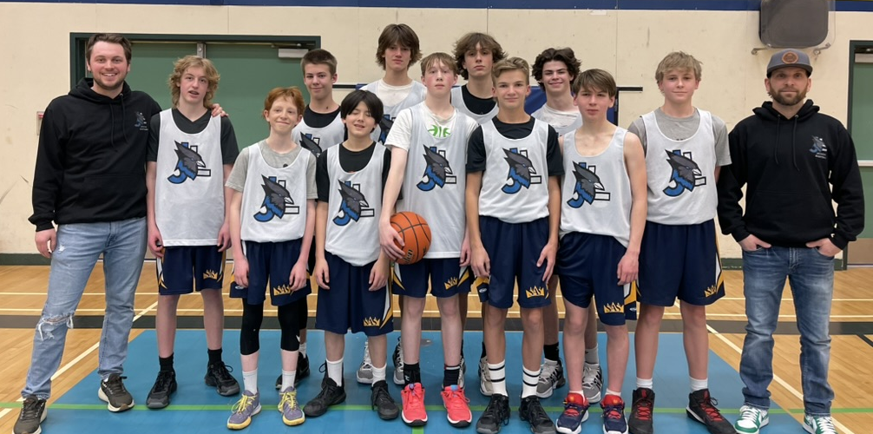
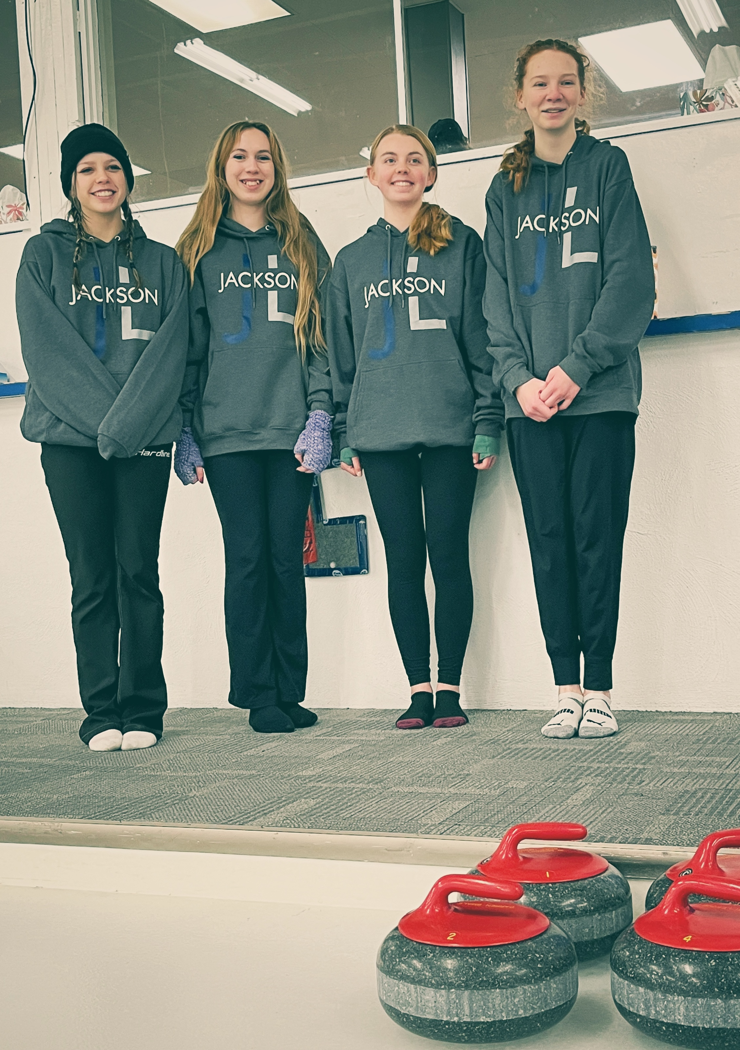
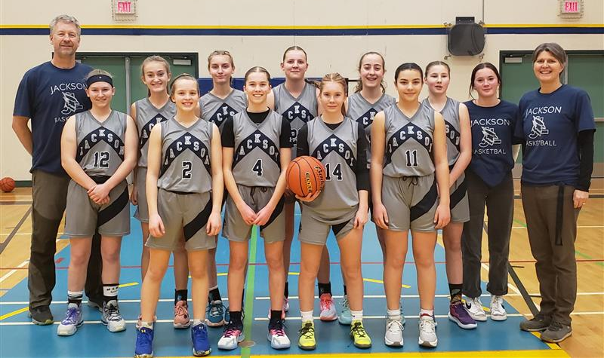
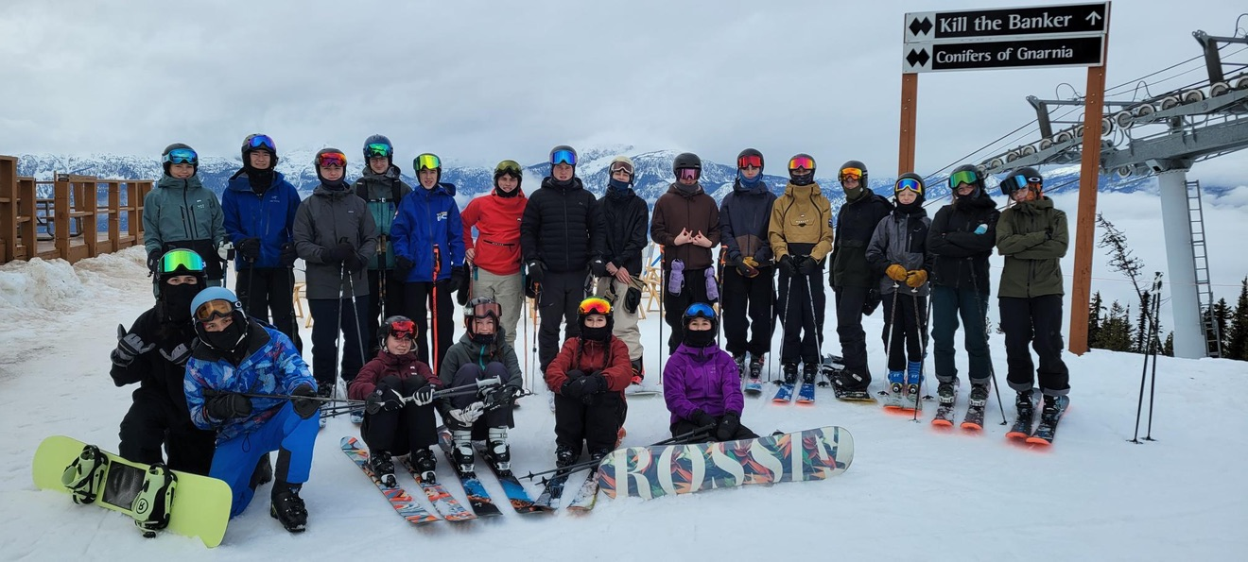
Winter Sports

Slide 35
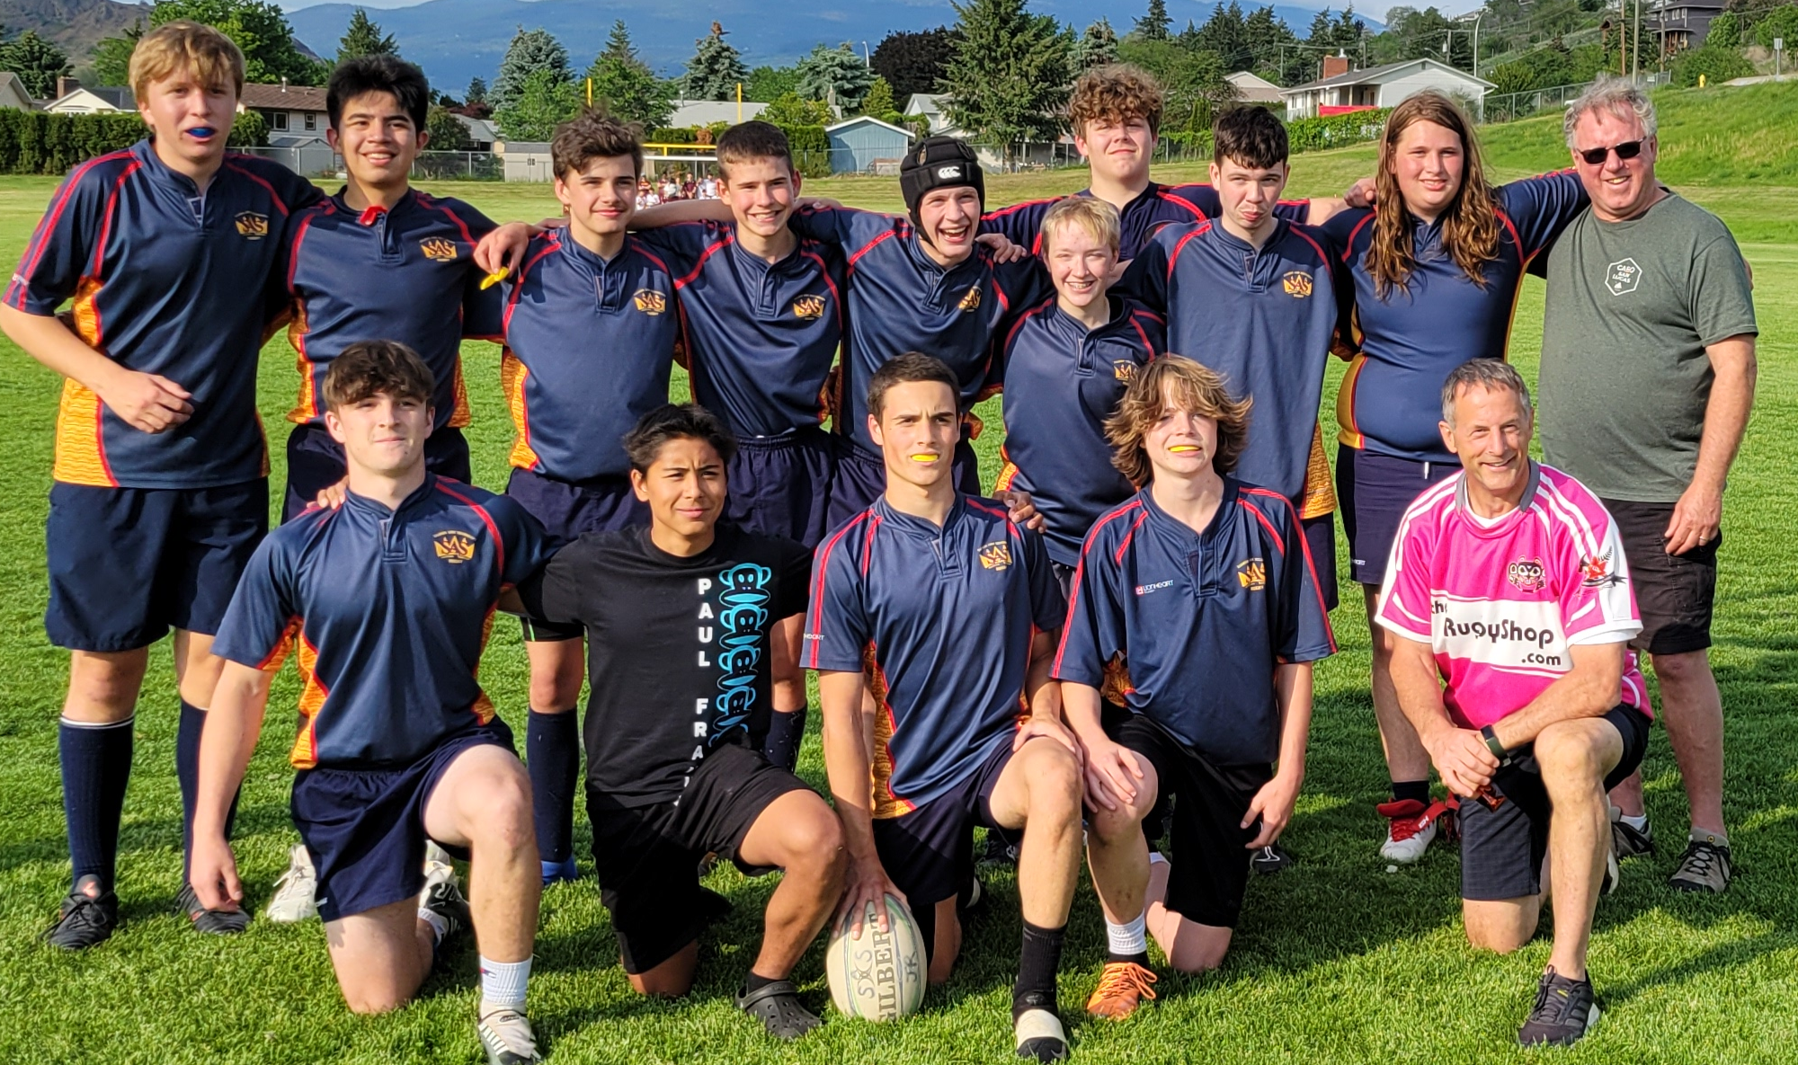
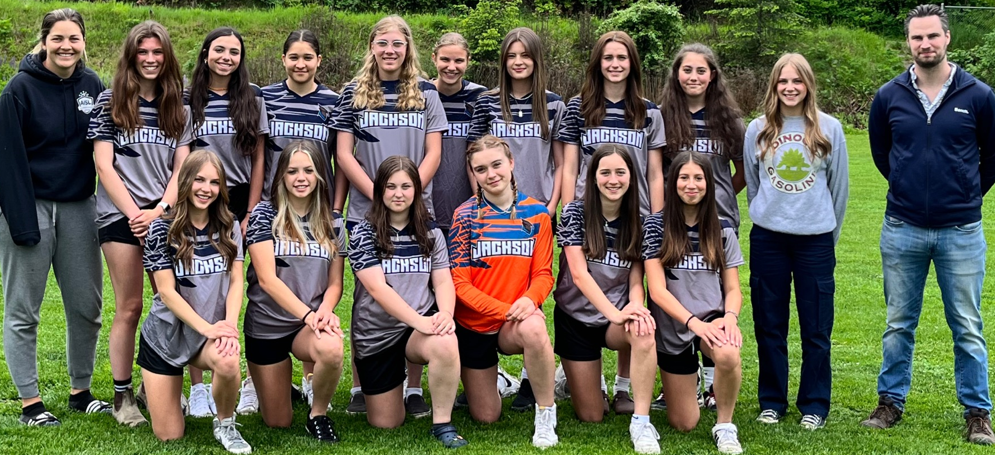
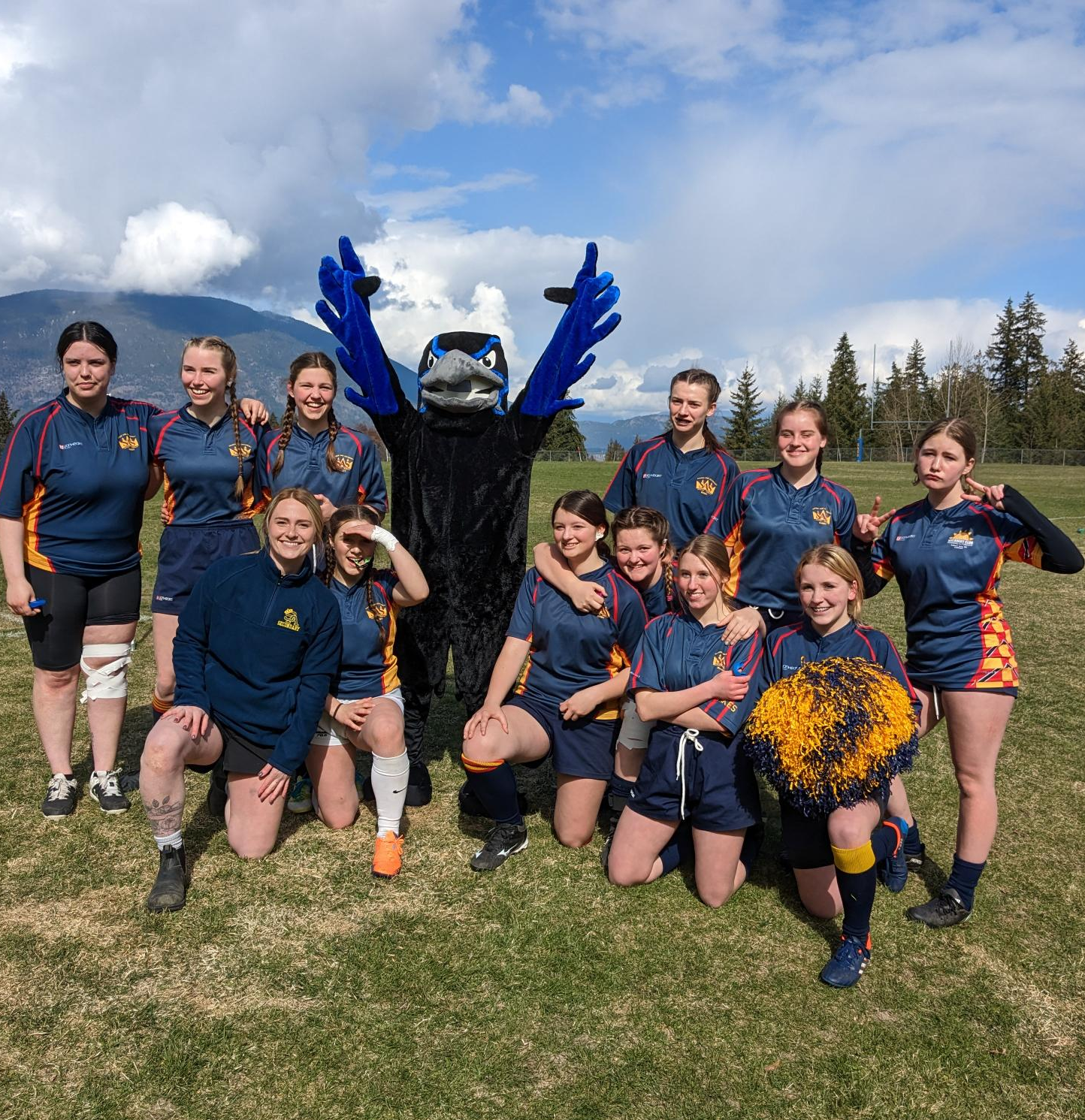
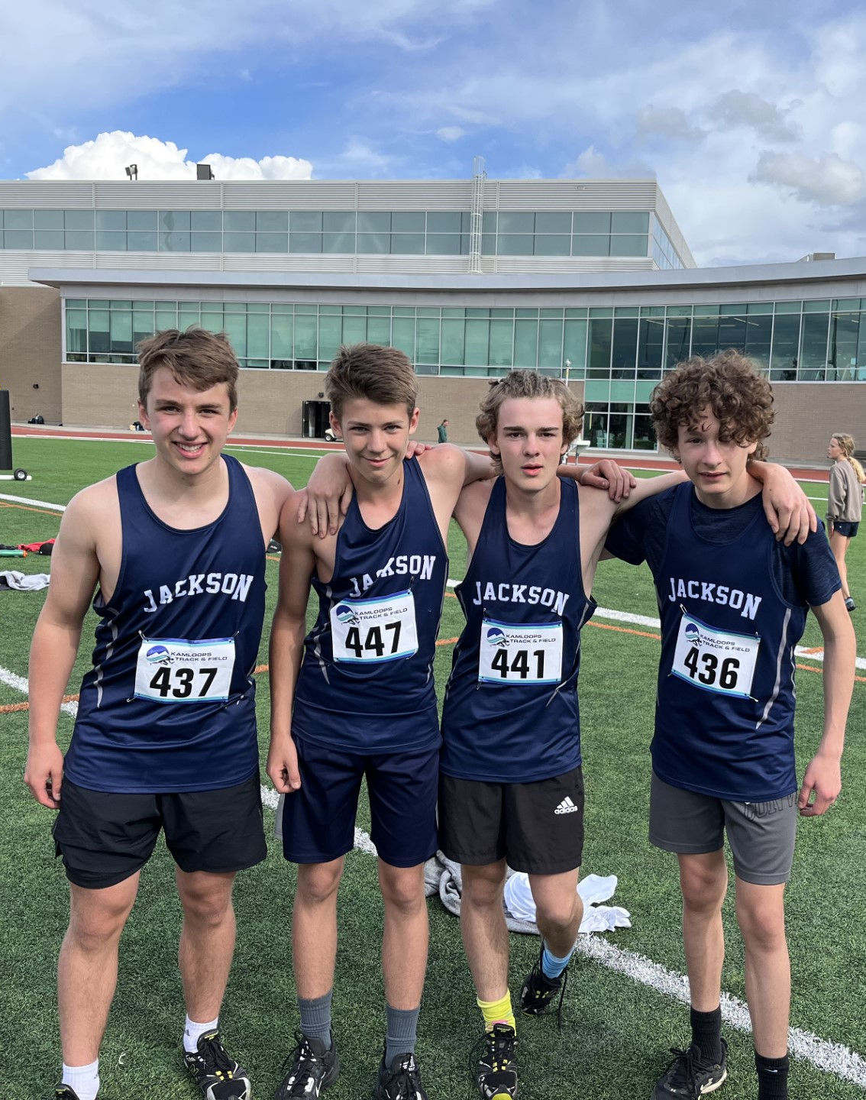
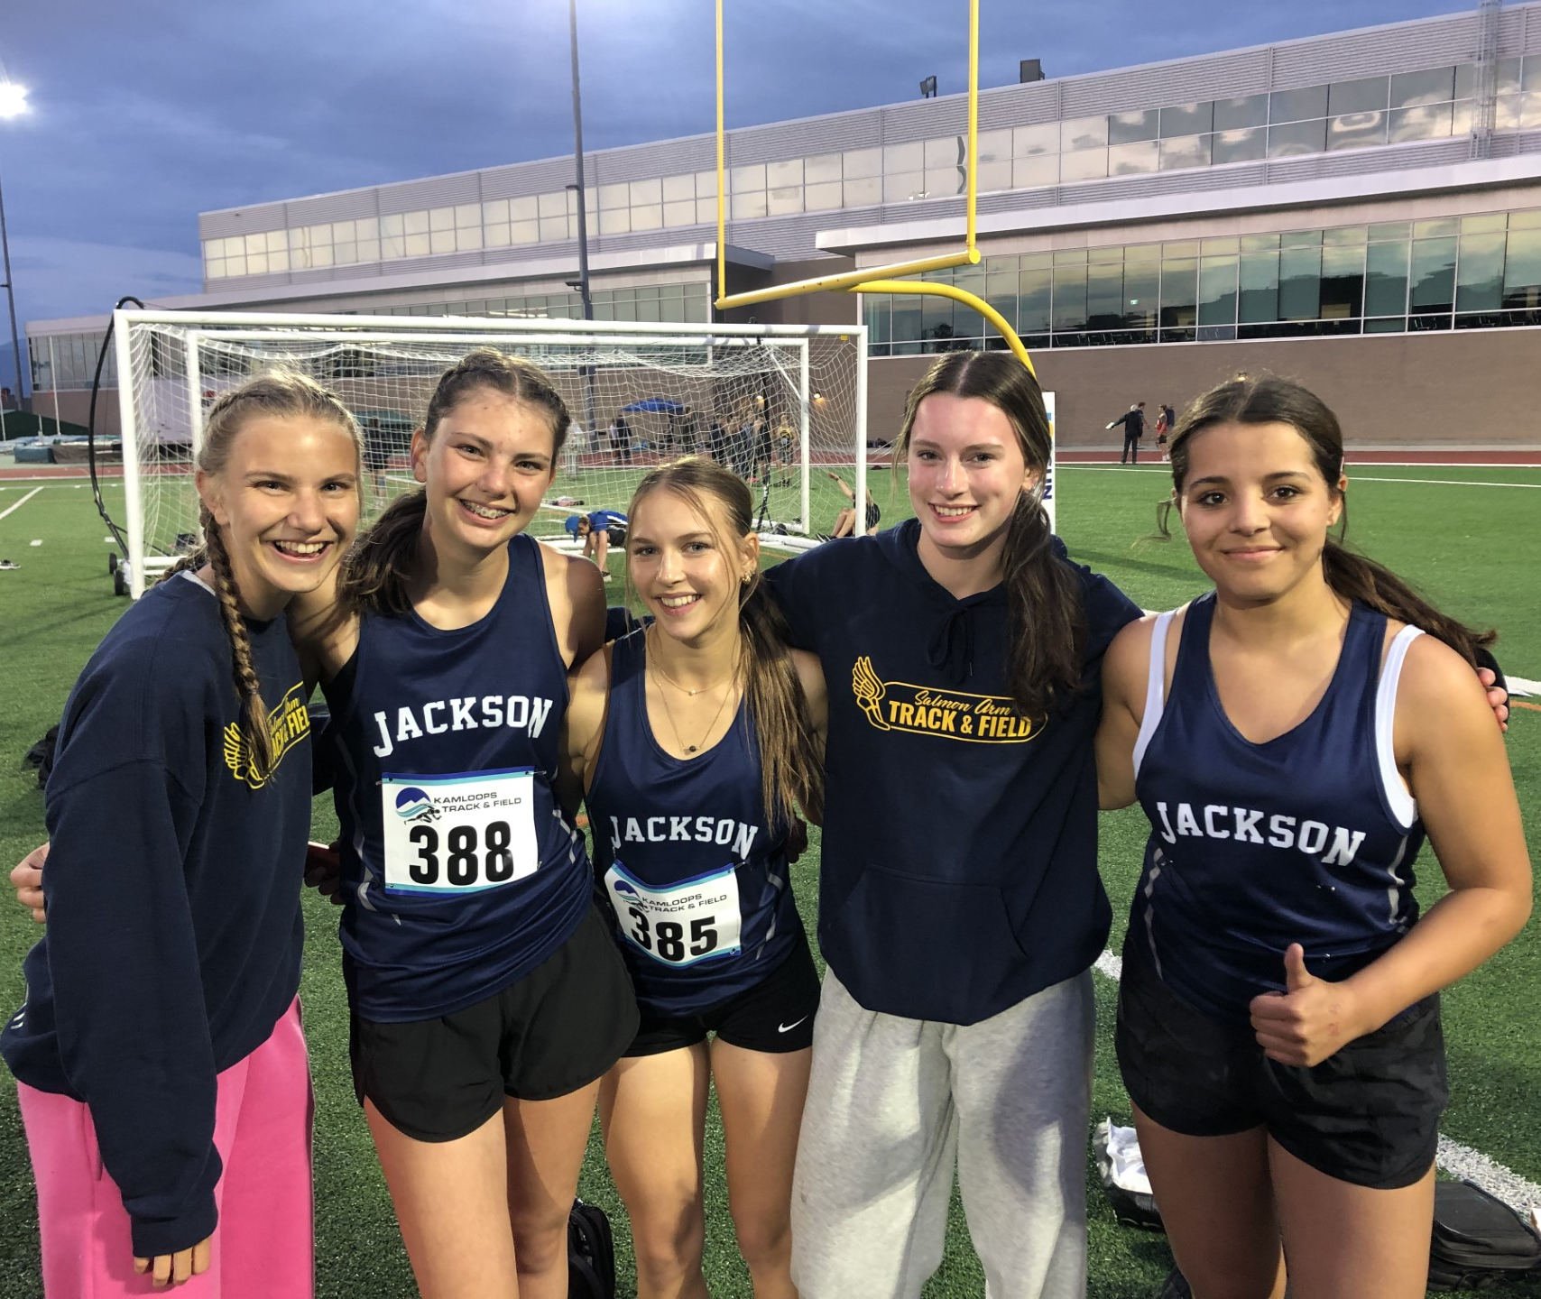
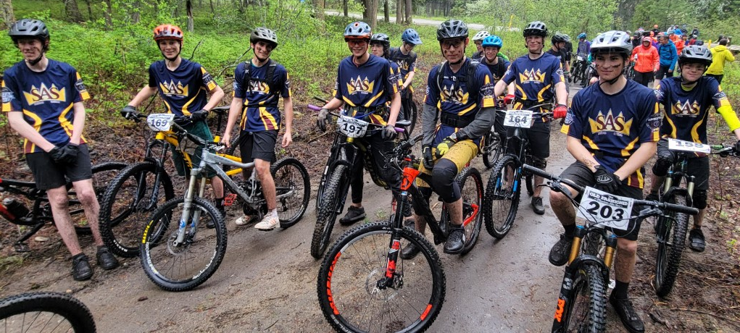
Spring Sports

Slide 36
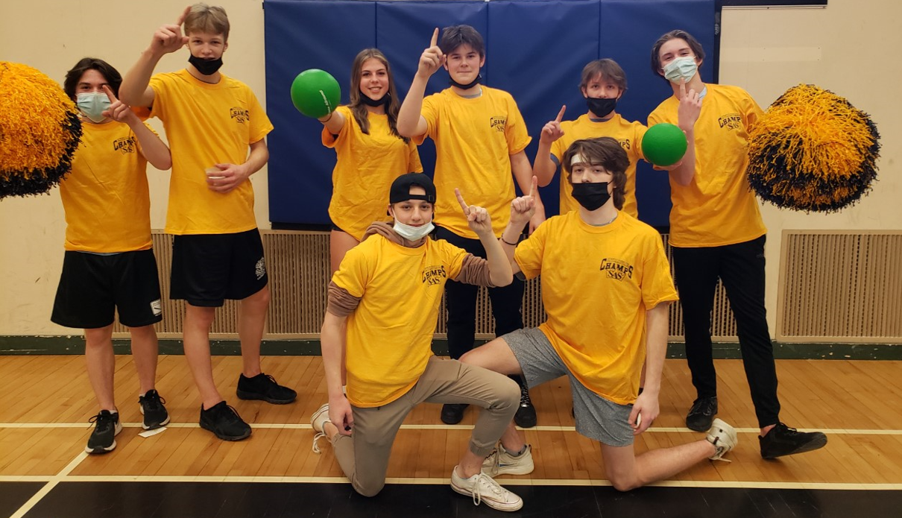

Lunchtime
Intramurals
Volleyball
Handball
Basketball (3 on 3)
Bocce
Etc.
LIBRARY
Clubs
Indigenous Drumming Group
Fitness Fridays
Chess Club
Art Club
Leadership
Mountain Bike Club
Pride Club
Ski and Snowboard Club
D&D Club
ECO Club
CAFETERIA
BREAKFAST
PROGRAM

Slide 37


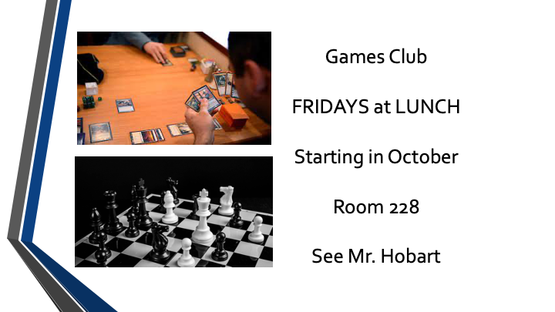


Clubs

Slide 38
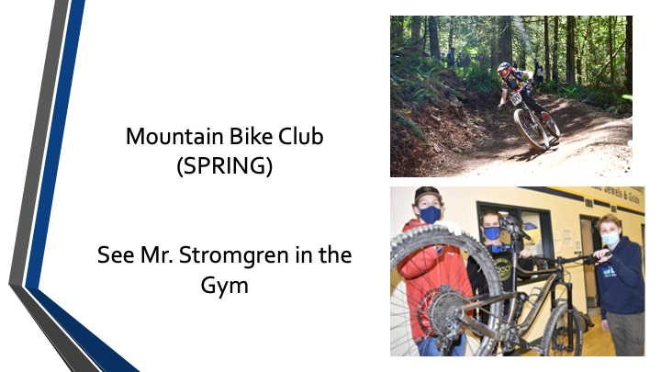



Clubs

Slide 39

Questions?

Slide 40
SELF-Guided Tour
Feel free to enter any unlocked space
Staff are positioned throughout the building to answer questions
Please do not touch any classroom materials/projects/etc.
An announcement will signal the end of the tour

