Slide 1


Grade 11 Course Selections 2025-2026
JL Jackson Secondary School

Slide 2
Course Selection TIMELINe
5 - 6 March
Grade 11 Course Presentations
10 -14 March
Student Timetable Available
Grade 11 Course Selections
Late June

Slide 3


Where to begin?
What courses do I need to Graduate?
What courses do I need to pursue my career goals?
Can use www.myblueprint.ca or www.educationplannerbc.ca

Slide 4
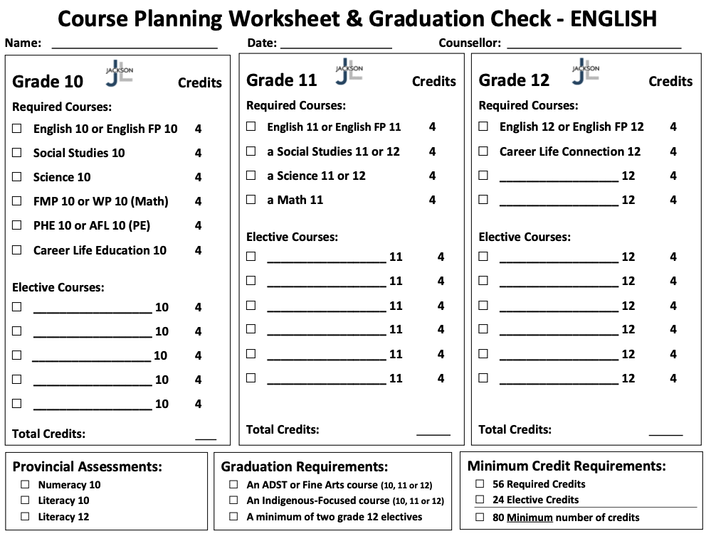
English Graduation Requirements

Slide 5
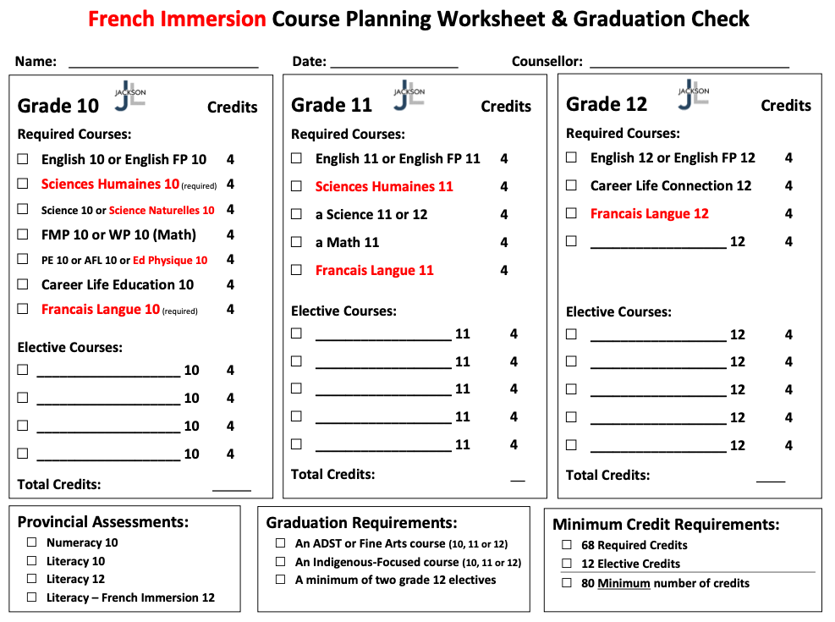
French Immersion Graduation Requirements

Slide 6
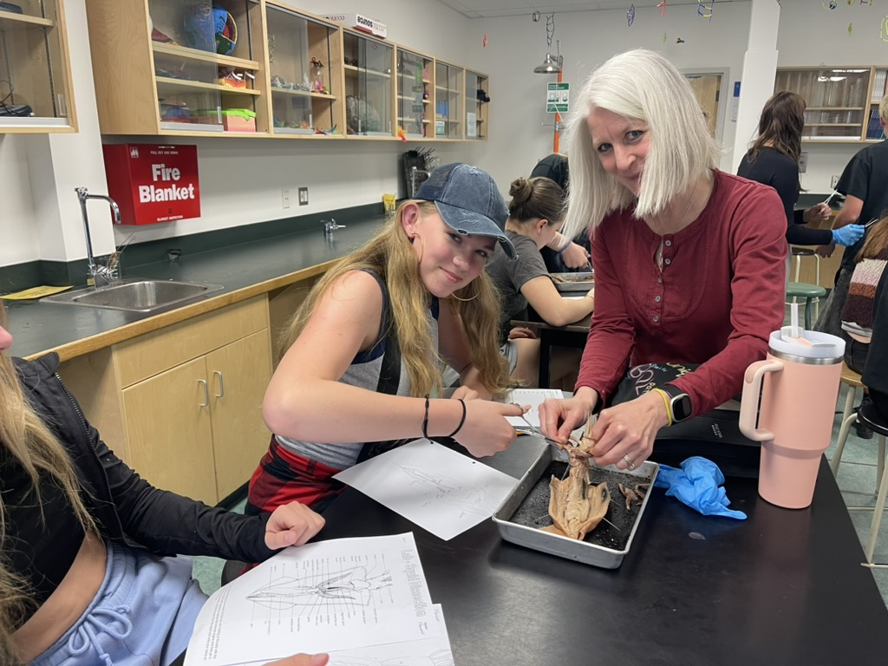
Graduation Requirements
In order to graduate all students must complete…
a minimum of 80 Credits (56 Required + 24 Elective)
an ADST or Fine Arts course (10, 11, or 12)
an Indigenous-Focused course (10, 11, or 12)
a minimum of two grade 12 Electives

Slide 7
Here are a few things to think about wheN Planning your Grade 11 year…

Slide 8
Which English Course Should I take?
English 11 (Literary Studies)
Or
English First Peoples 11 (New Media)
Or
Creative Writing 11

Slide 9
Which Math Course Should I take?
Pre-Calculus Math 11
Or
Foundations of Math 11
Or
Workplace Math 11

Slide 10
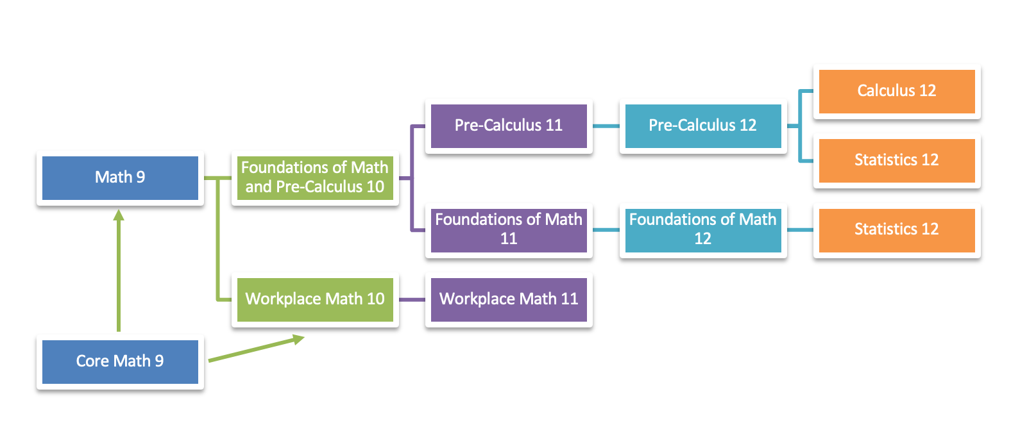

Slide 11
WORKPLACE MATHEMATICS is designed to provide students with the mathematical understandings and critical thinking skills identified for entry into most trades and the work force.
FOUNDATIONS OF MATHEMATICS is designed to provide students with the mathematical understandings and critical-thinking skills identified for most post-secondary programs.
PRE-CALCULUS is designed to provide students with the mathematical understandings and critical-thinking skills identified for entry into specific post-secondary programs, such as sciences and engineering.

Slide 12
Which Science Course Should I take?
Chemistry 11
Or
Earth Science 11
Or
Life Science 11
Or
Physics 11

Slide 13
Which Social Studies Course Should I take?
Explorations in Social Studies 11
Or
20th Century World History 12
Or
BC First Peoples 12
Or
Comparative Cultures 12
Or
Physical Geography 12

Slide 14
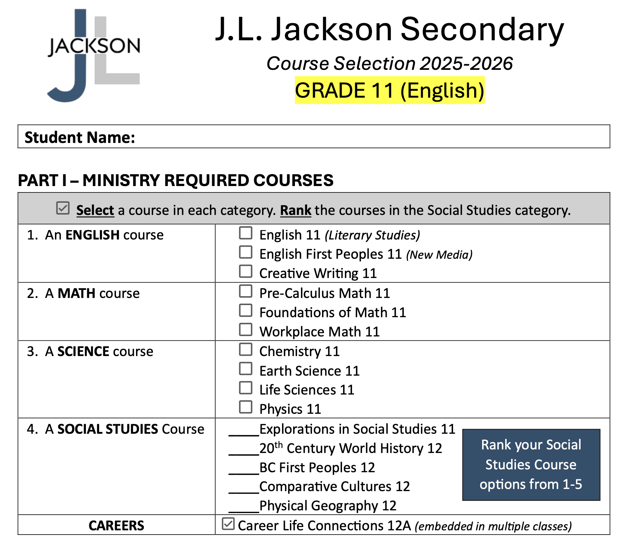

Slide 15
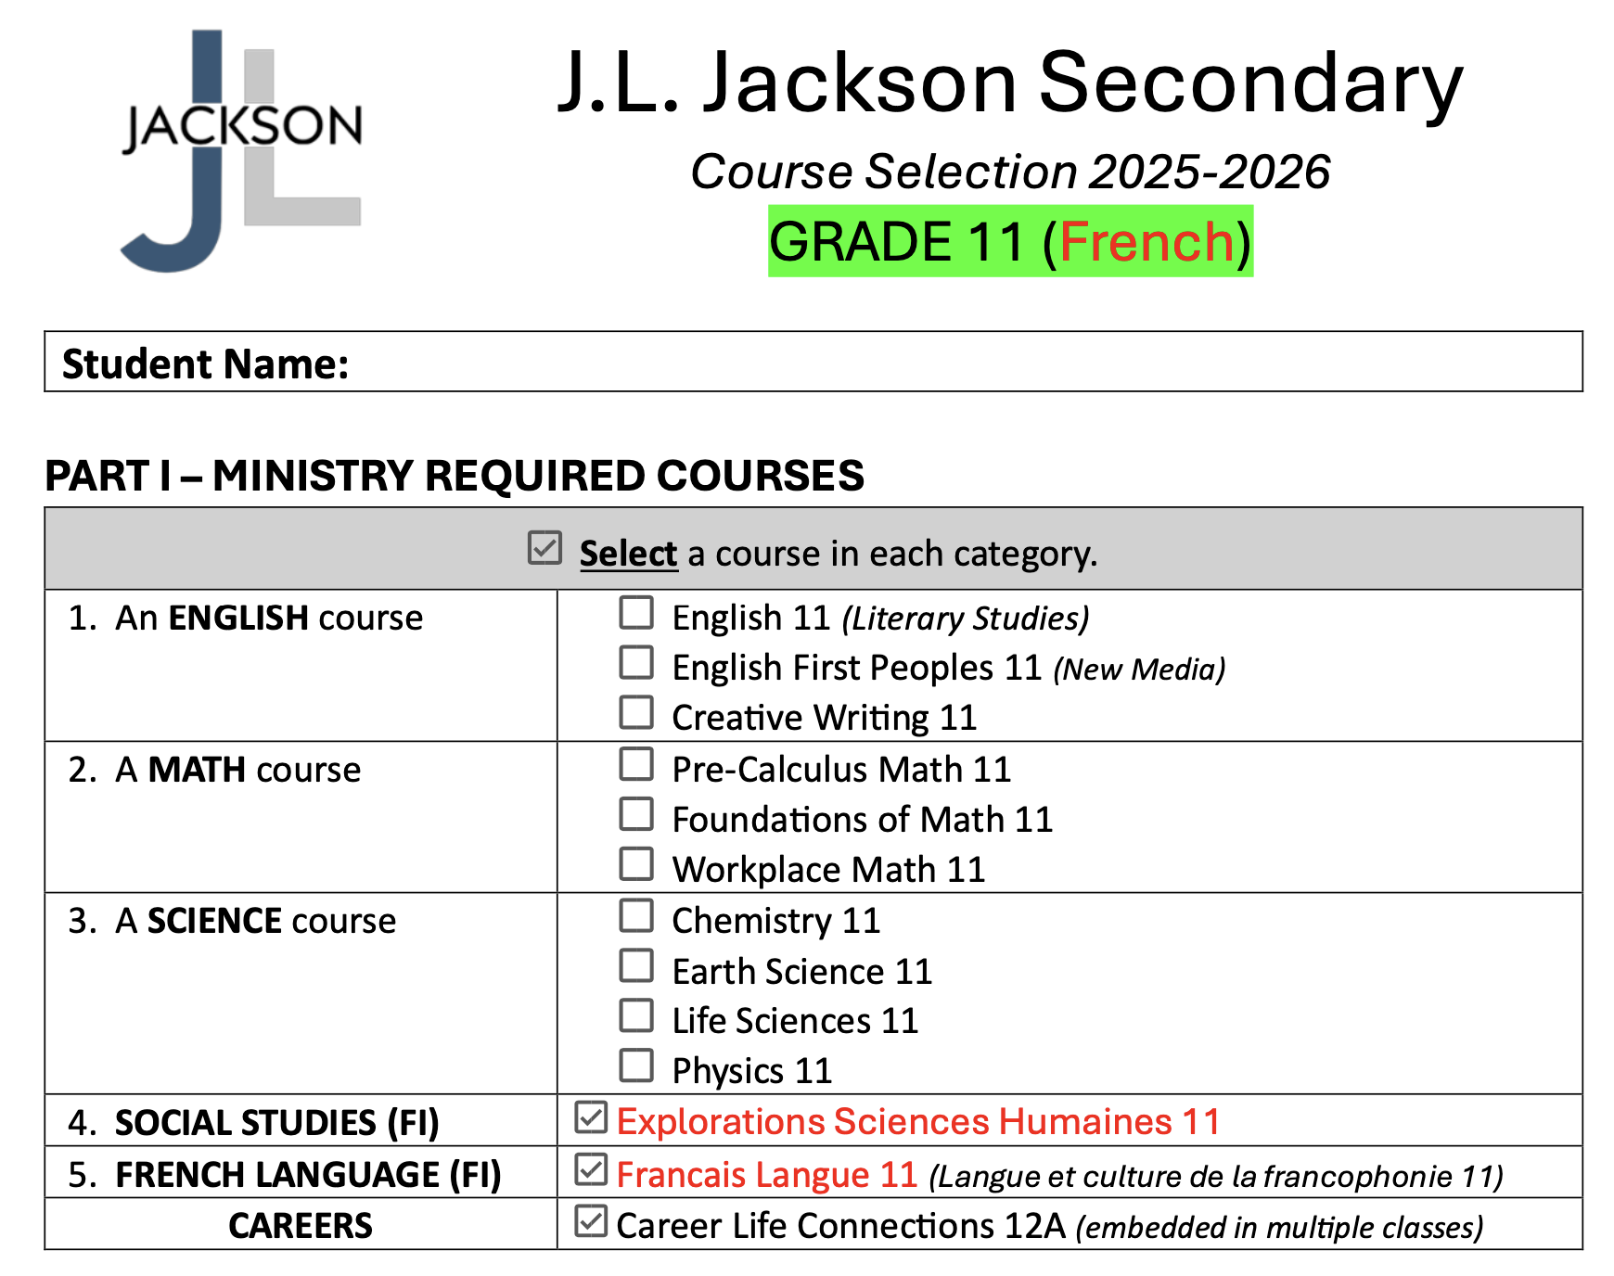

Slide 16
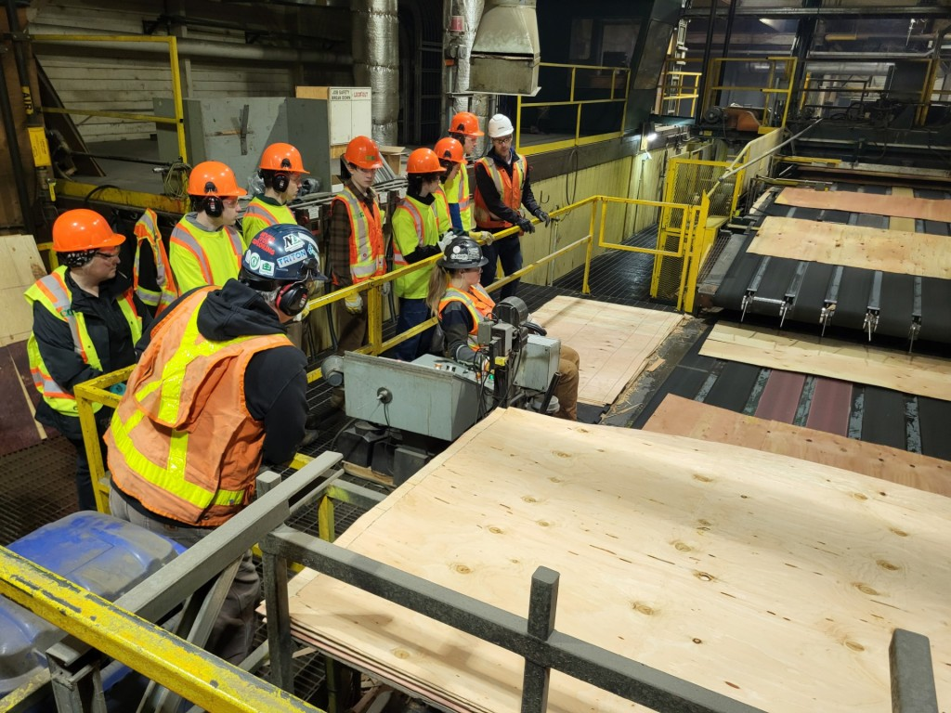
CaReer Life Connections 12A
Career Seminars
My Blueprint
Personal Career Exploration
Work Experience
Post-Secondary Tours and Spotlights

Slide 17
SD83 Career Programs (https://career.sd83.bc.ca/)
Work Experience (120 hrs)
Part- time job? Want 4 credits? Fill out an application with Mr. Seed to
start counting your work hours for credits
Youth WORK in the Trades
Students that work with a qualified tradesperson can sign up for high school credits as an apprentice
Youth TRAIN in Trades
Programs with Trade Training Certification and high school credits
Eg: Auto Service Tech/Auto Collision Tech/Hairstylist/Professional Cook, Gateway to Tech, Early Childhood Educator, Emergency Responders, etc.
See Mr. Seed in the Career Centre for more details about career program options !

Slide 18
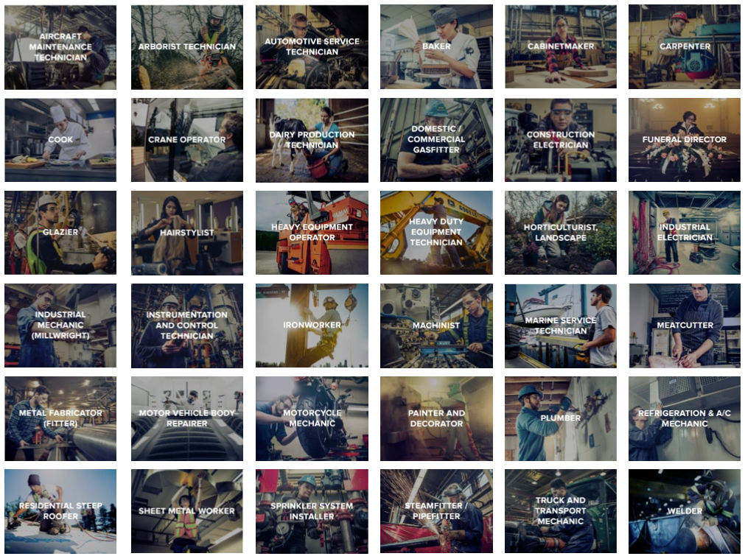

Slide 19

Second Languages
Students may want to continue with a Second Language at the grade 11 level.
French 11
Japanese 11
*A Second Language could be required for entrance into a specific university degree program or be part of degree program once at university.

Slide 20
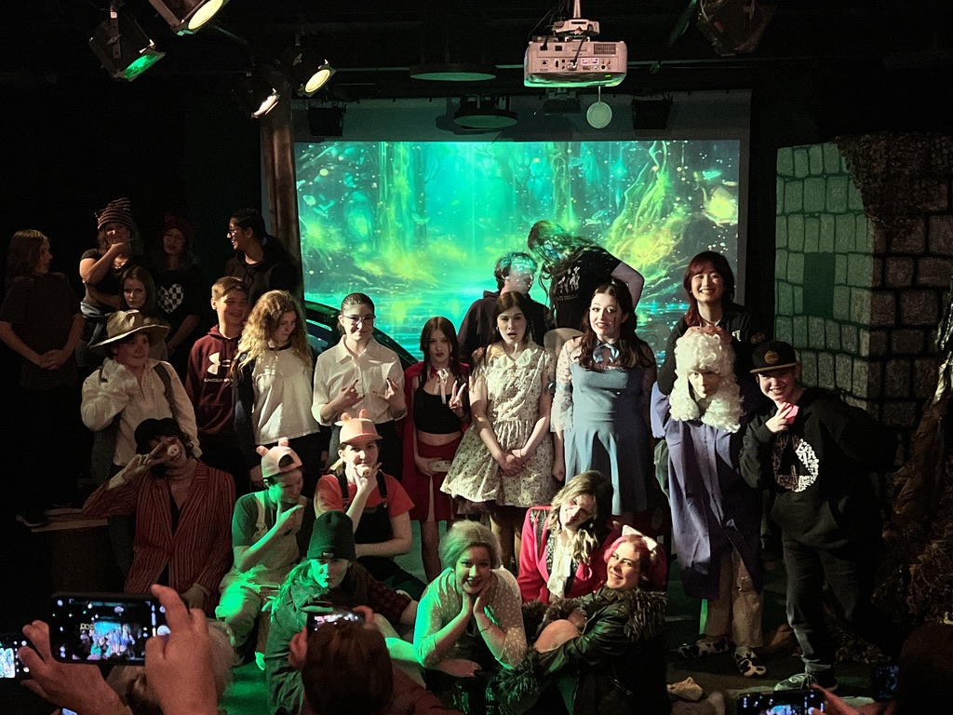
Choosing Electives
Make Individual Choices based on Personal Interest
Choosing the same elective as a friend does not mean you will be in their class
Read through the course catalogue on our website

Slide 21
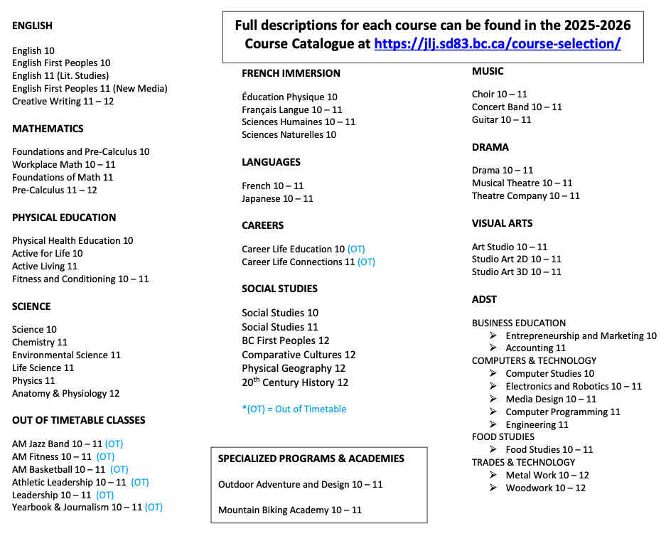

Slide 22
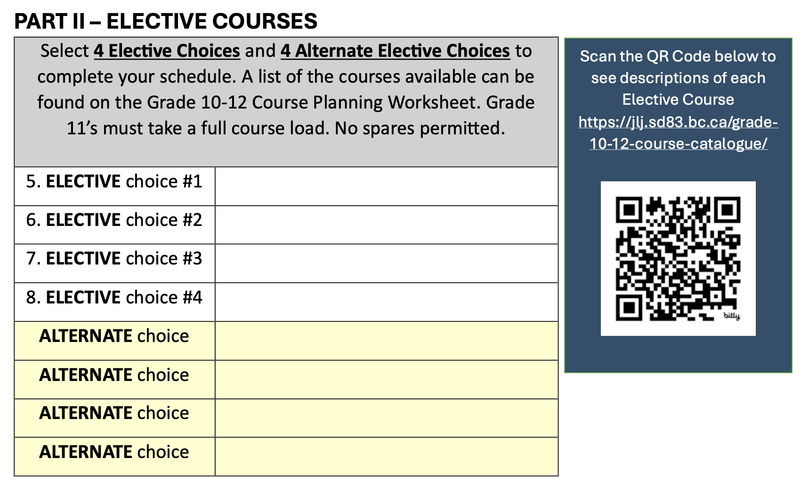

Slide 23
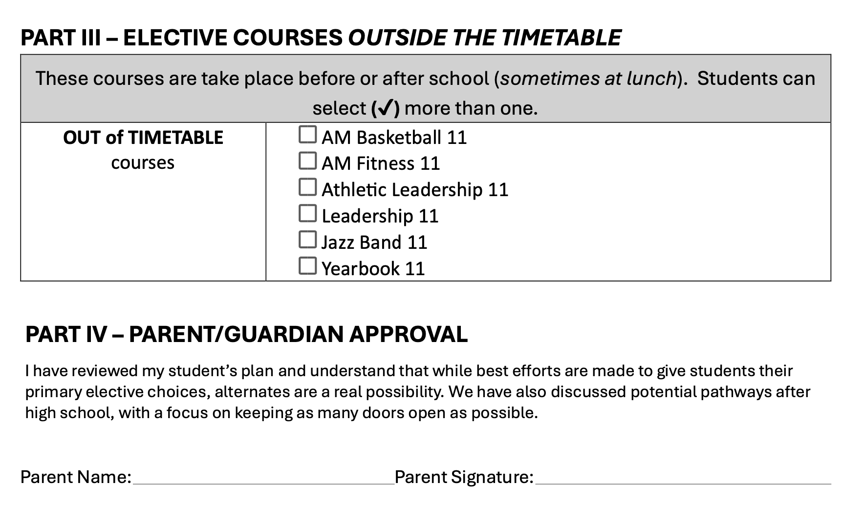

Slide 24
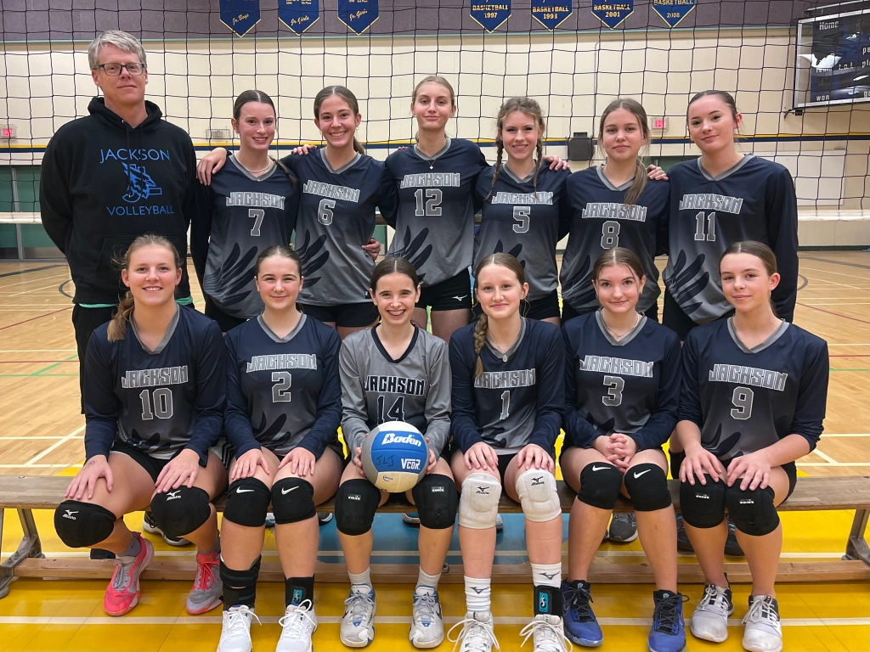
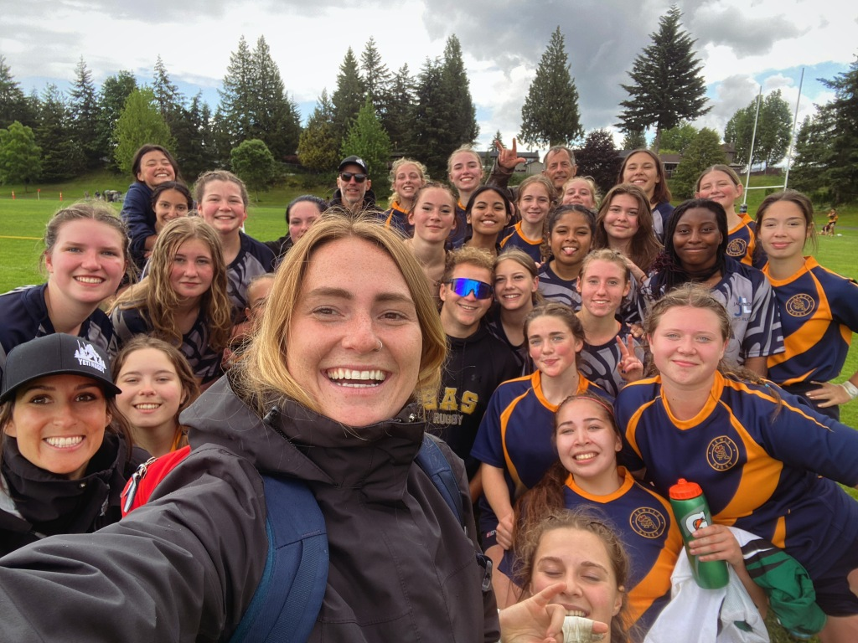
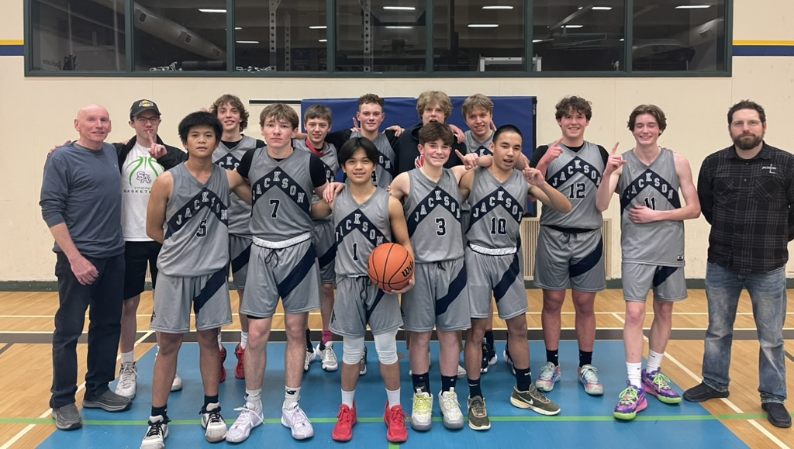
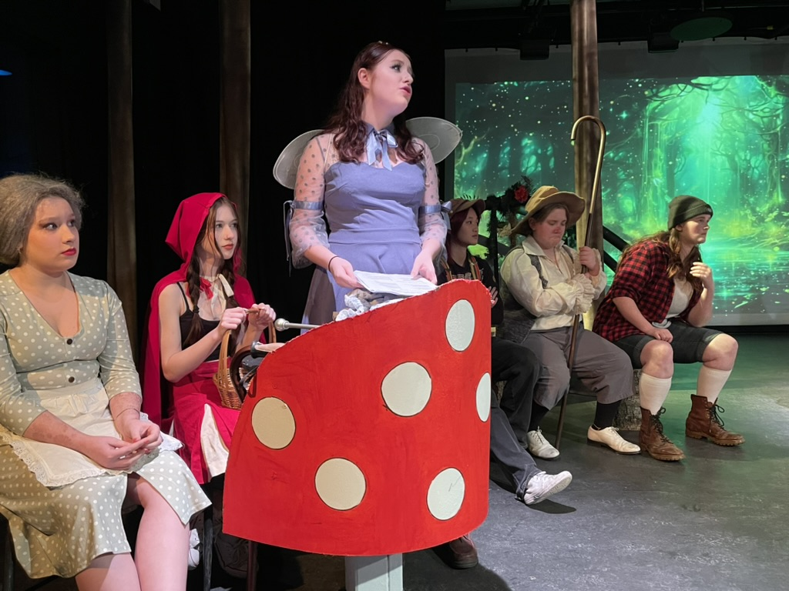
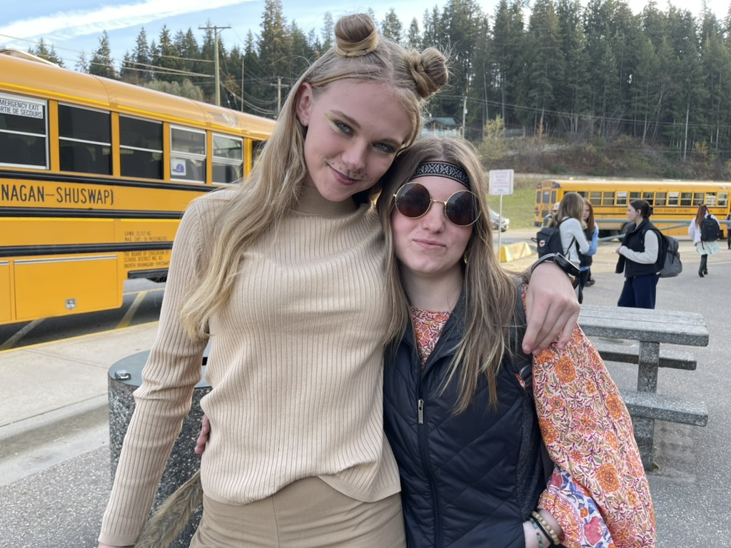
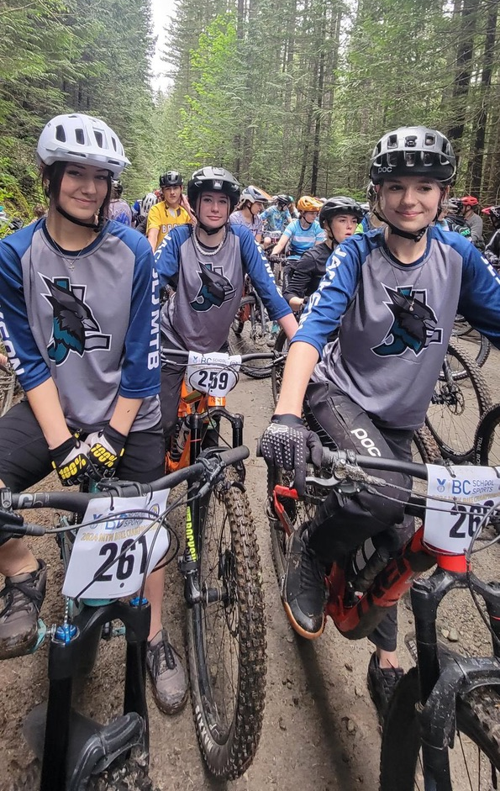
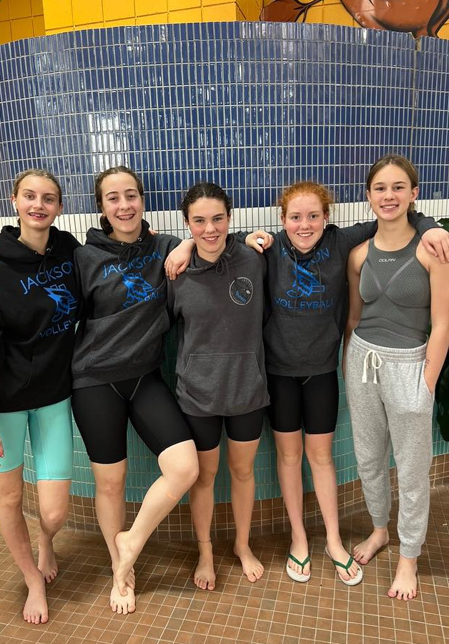
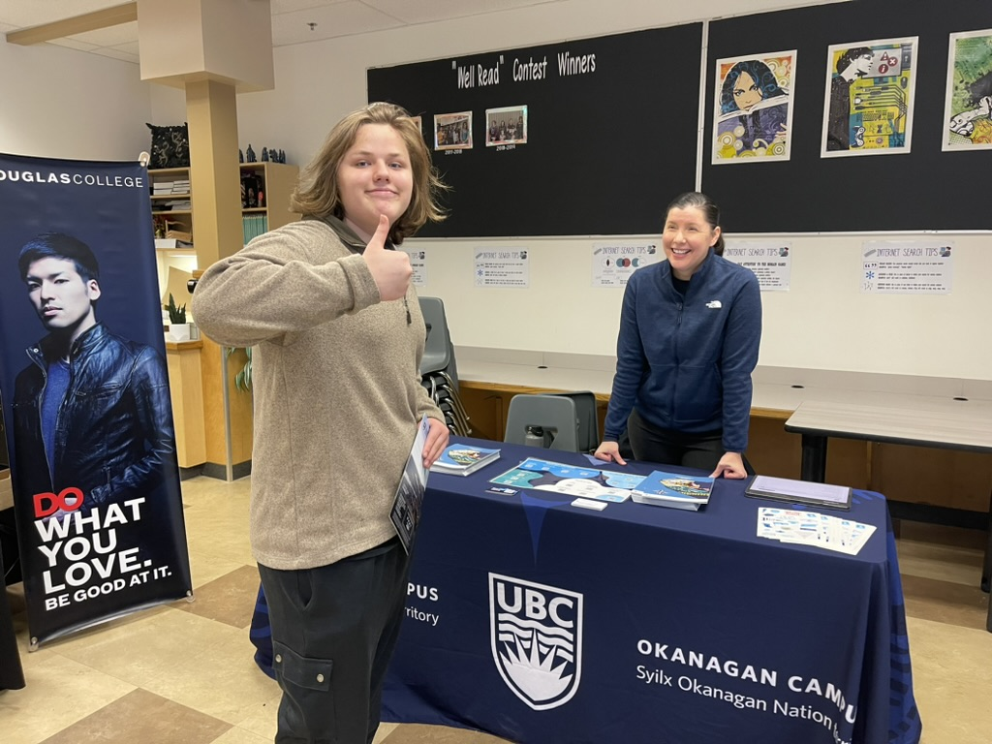

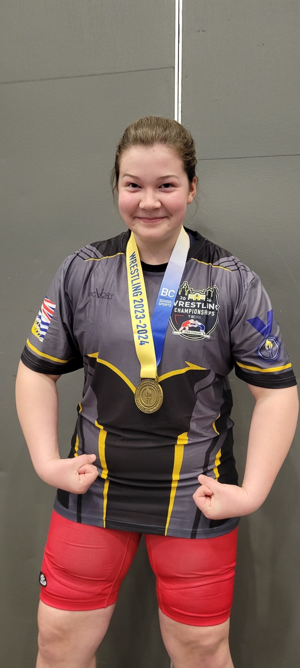
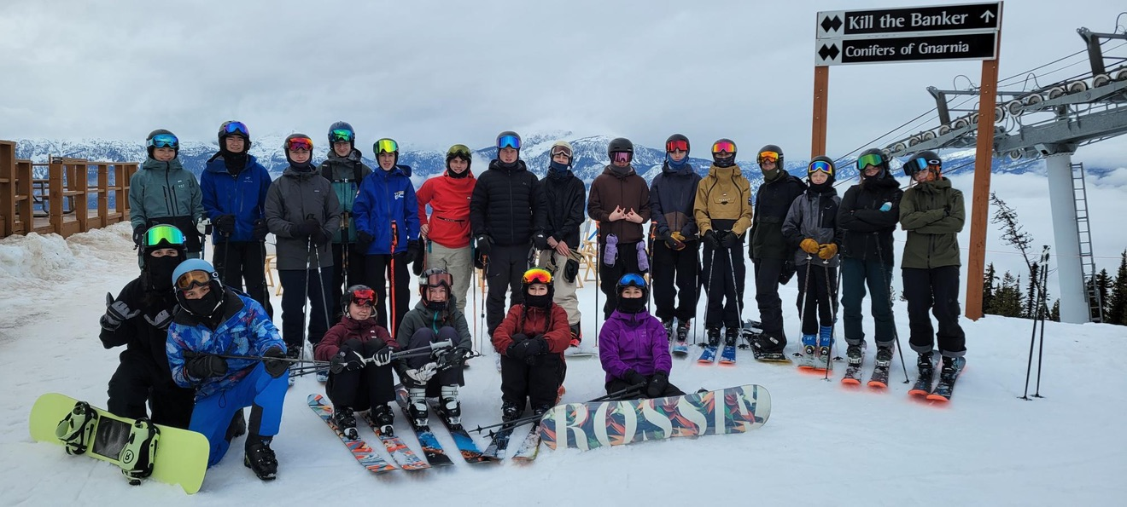
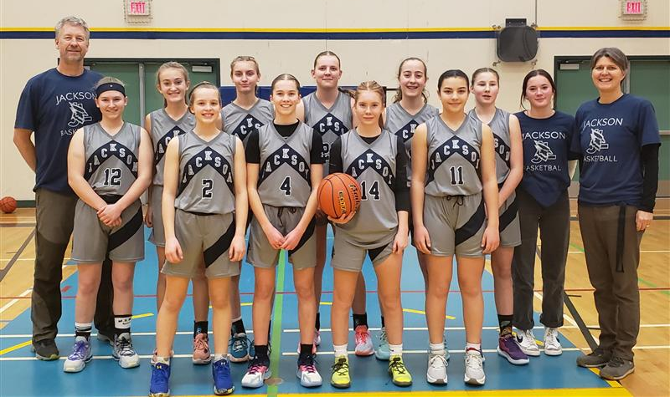
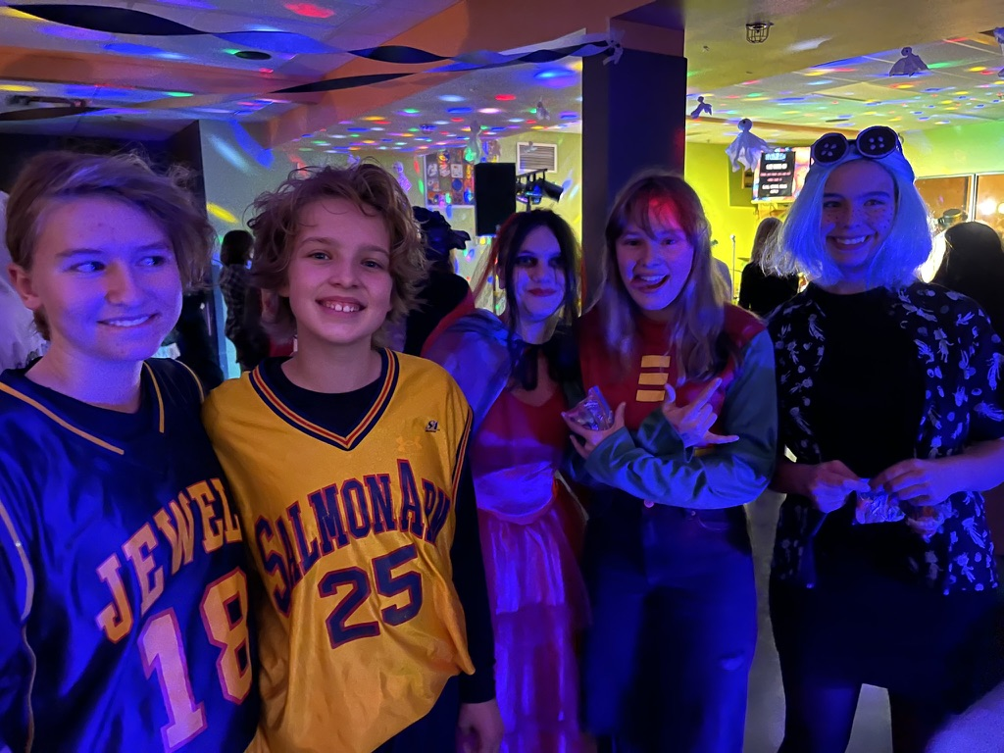
Make the most of your high school experience!

Slide 25
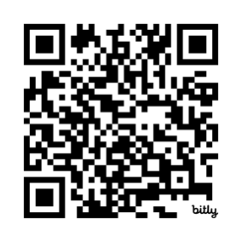
Do your Research!
Scan the QR Code below to see descriptions of each Elective Course
https://jlj.sd83.bc.ca/grade-10-12-course-catalogue/

Slide 26

Questions?

