Slide 1


Grade 11 Course Selections 2026-2027
JL Jackson Secondary School

Slide 2
Course Selection TIMELINe
9-13 February
Grade 11 Course Presentations
2-6 March
Prepare Draft Course Selection in myBlueprint
Grade 11 Course Selections
15-27 Feb

Slide 3


Where to begin?
What courses do I need to Graduate?
What courses do I need to pursue my career goals?
Can use www.myblueprint.ca or www.educationplannerbc.ca

Slide 4
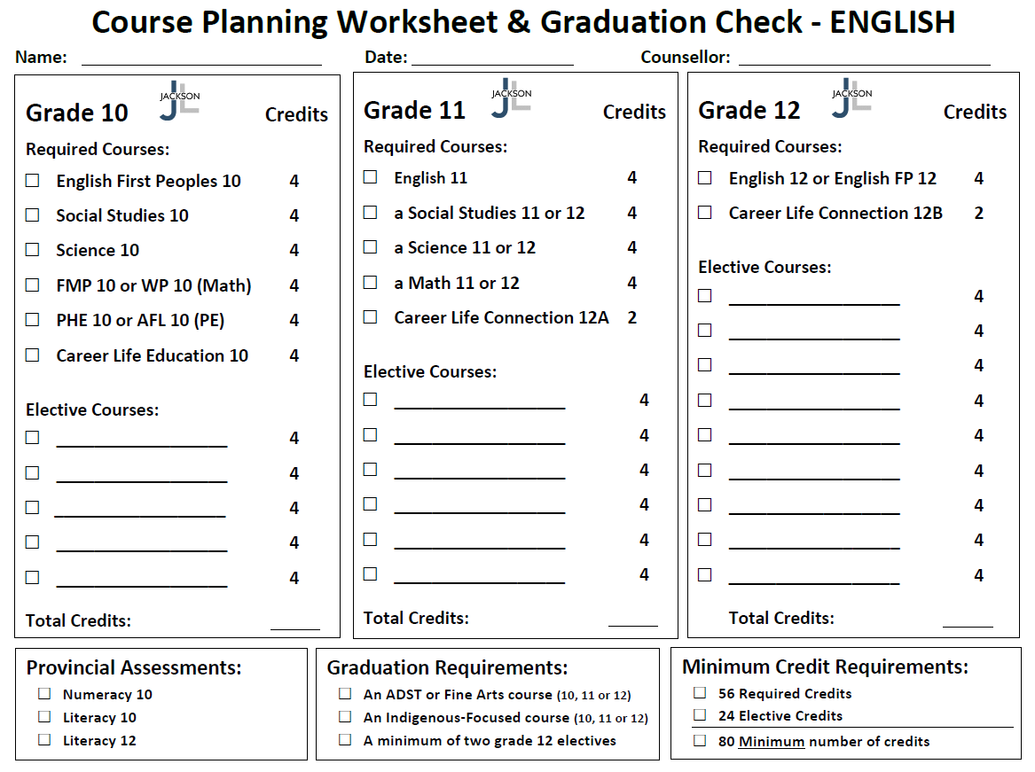
English Graduation Requirements

Slide 5
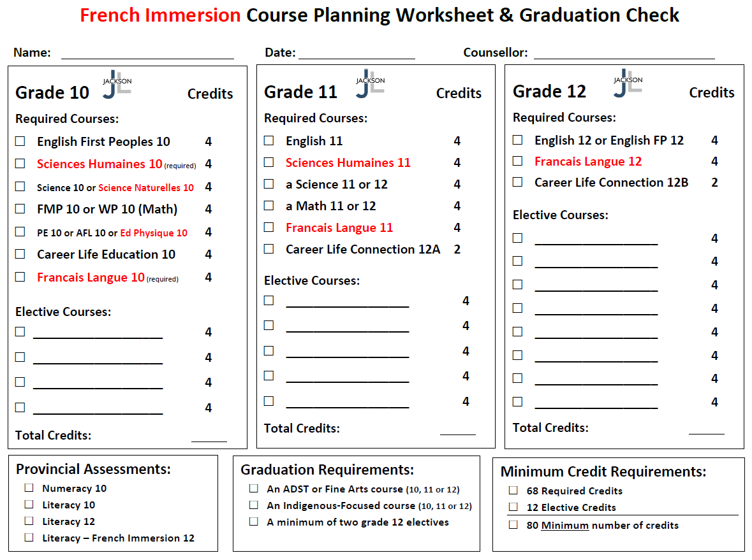
French Immersion Graduation Requirements

Slide 6
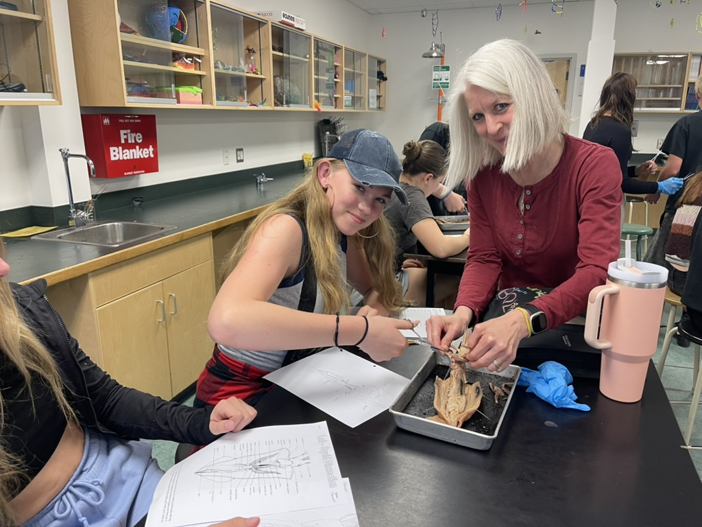
Graduation Requirements
In order to graduate all students must complete…
a minimum of 80 Credits (56 Required + 24 Elective)
an ADST or Fine Arts course (10, 11, or 12)
an Indigenous-Focused course (10, 11, or 12)
a minimum of two grade 12 Electives

Slide 7
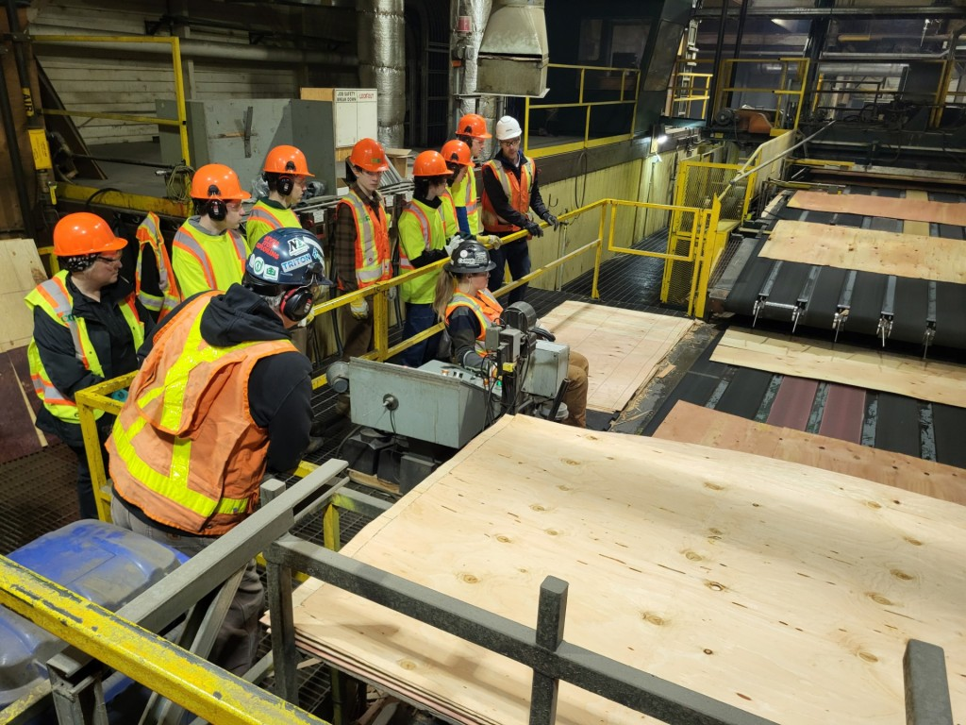
CaReer Life Connections 12A
Career Seminars
My Blueprint
Personal Career Exploration
Work Experience
Post-Secondary Tours and Spotlights

Slide 8
Here are a few things to think about wheN Planning your Grade 11 year…

Slide 9
Which English Course Should I take?
English 11 (Literary Studies)
Or
Creative Writing 11

Slide 10
Which Math Course Should I take?
Pre-Calculus Math 11
Or
Foundations of Math 11
Or
Apprenticeship Math 12

Slide 11
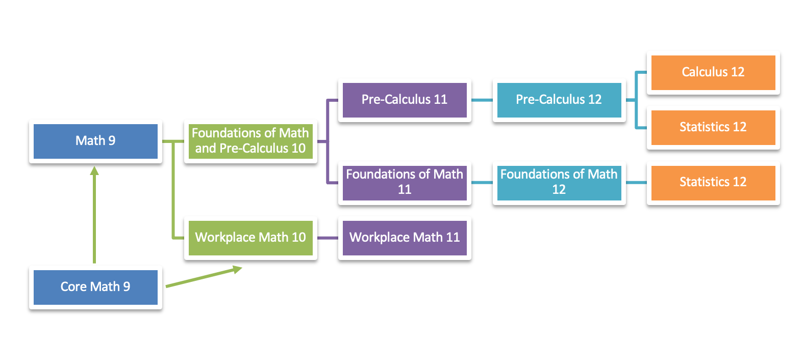
Apprenticeship
Math 12

Slide 12
WORKPLACE/APPRENTICESHIP MATHEMATICS is designed to provide students with the mathematical understandings and critical thinking skills identified for entry into most trades and the work force.
FOUNDATIONS OF MATHEMATICS is designed to provide students with the mathematical understandings and critical-thinking skills identified for most post-secondary programs.
PRE-CALCULUS is designed to provide students with the mathematical understandings and critical-thinking skills identified for entry into specific post-secondary programs, such as sciences and engineering.

Slide 13
Which Science Course Should I take?
Chemistry 11
Or
Environmental Science 11
Or
Life Science 11
Or
Physics 11

Slide 14
Which Social Studies Course Should I take?
20th Century World History 12
Or
BC First Peoples 12
Or
Comparative Cultures 12
Or
Physical Geography 12
Or
Philosophy 12
Or
Economic Theory 12
Or
Social Studies 11

Slide 15
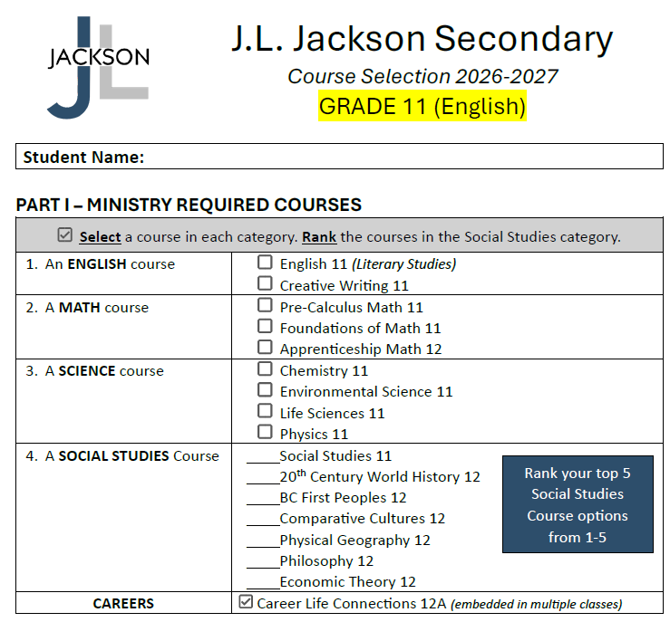

Slide 16
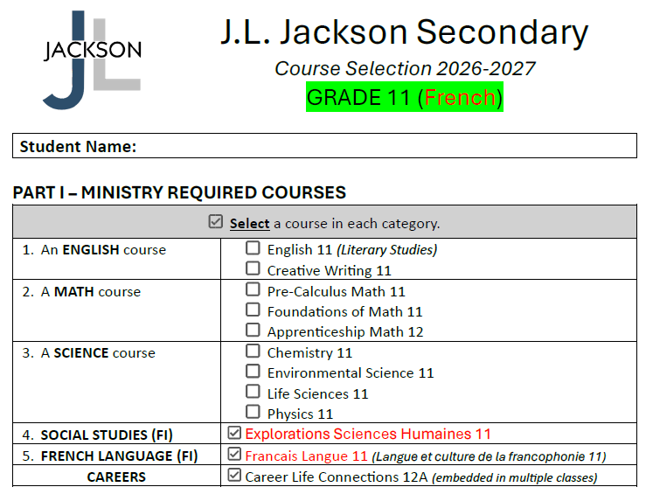

Slide 17

Second Languages
Students may want to continue with a Second Language at the grade 11 level.
French 11
Japanese 11
*A Second Language could be required for entrance into a specific university degree program or be part of degree program once at university.

Slide 18
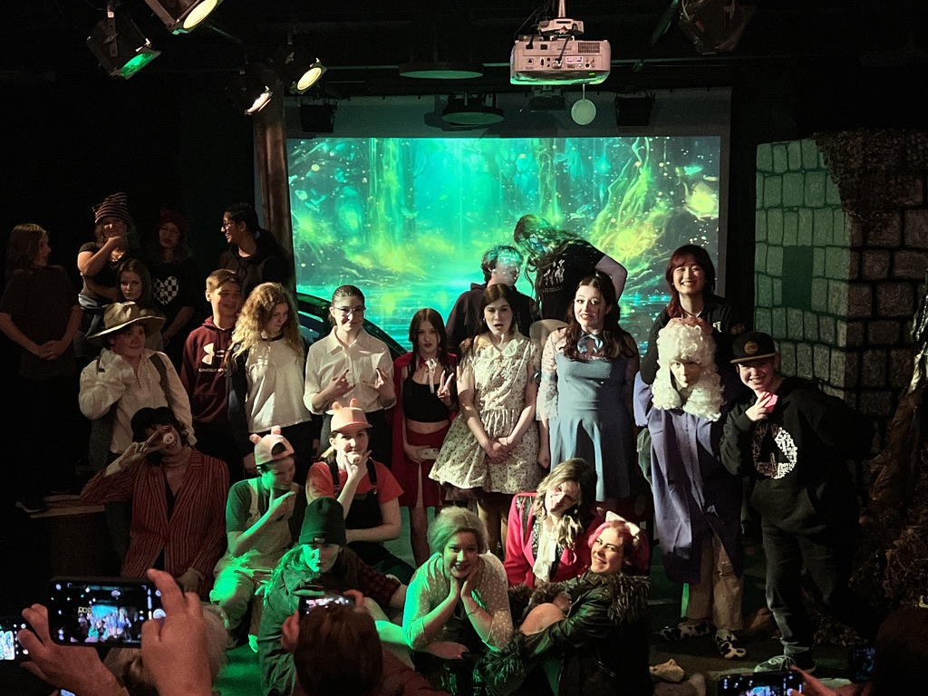
Choosing Electives
Make Individual Choices based on Personal Interest
Choosing the same elective as a friend does not mean you will be in their class
Read through the course catalogue on our website

Slide 19
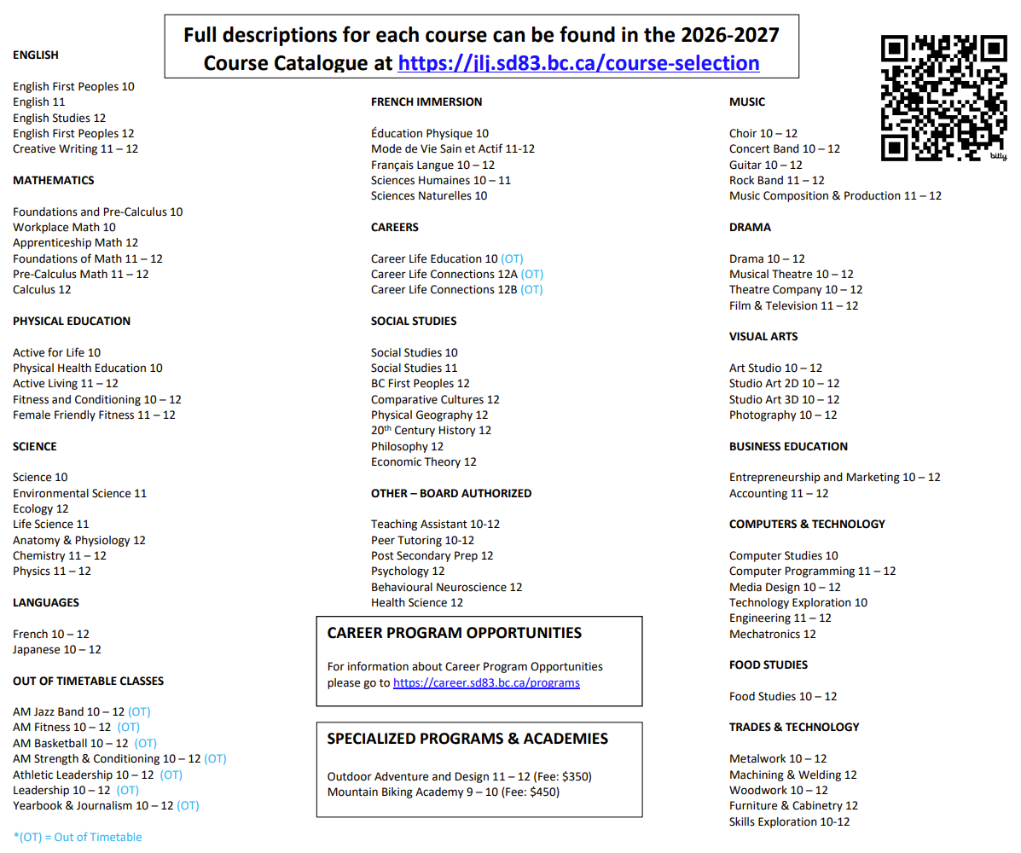

Slide 20
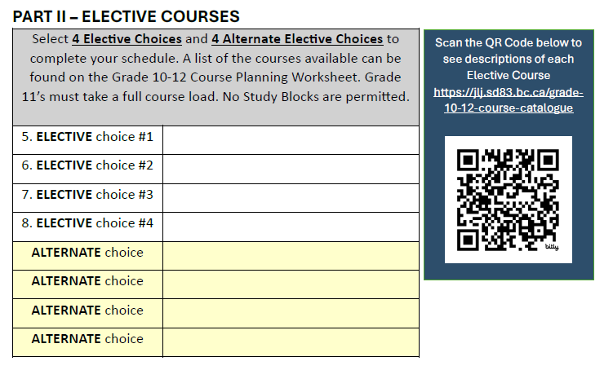

Slide 21
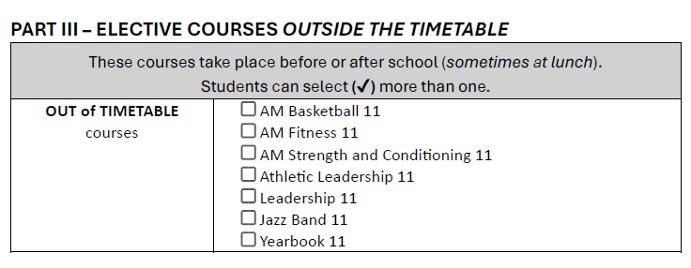

Slide 22
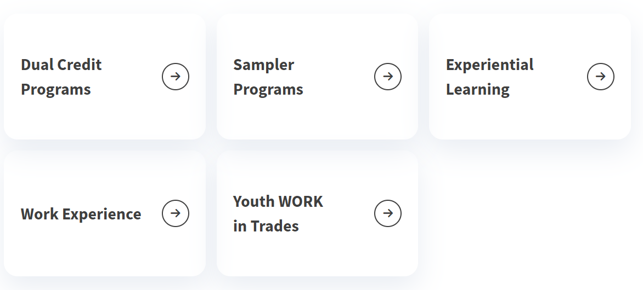
SD83 Career Programs (https://career.sd83.bc.ca/)
See Mr. Hollatz in the Career Centre for more details about career program options !

Slide 23
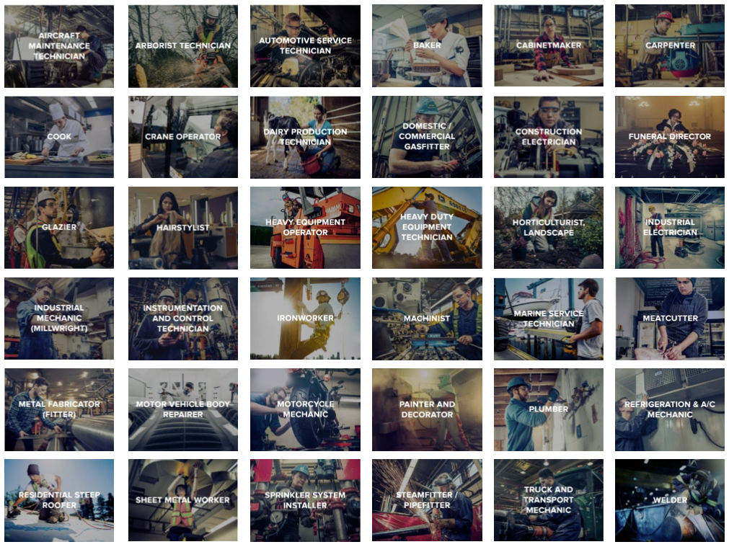

Slide 24
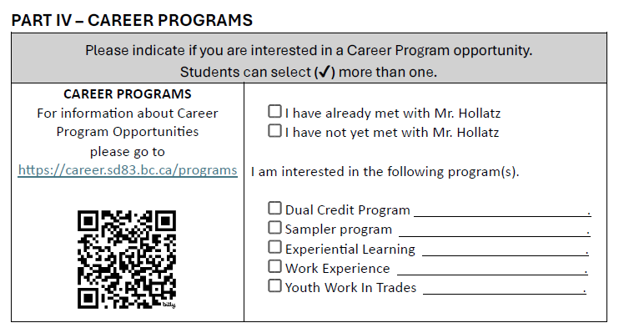

Slide 25
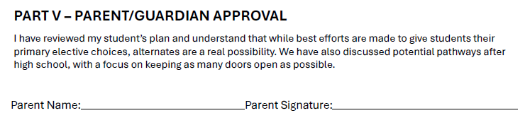

Slide 26
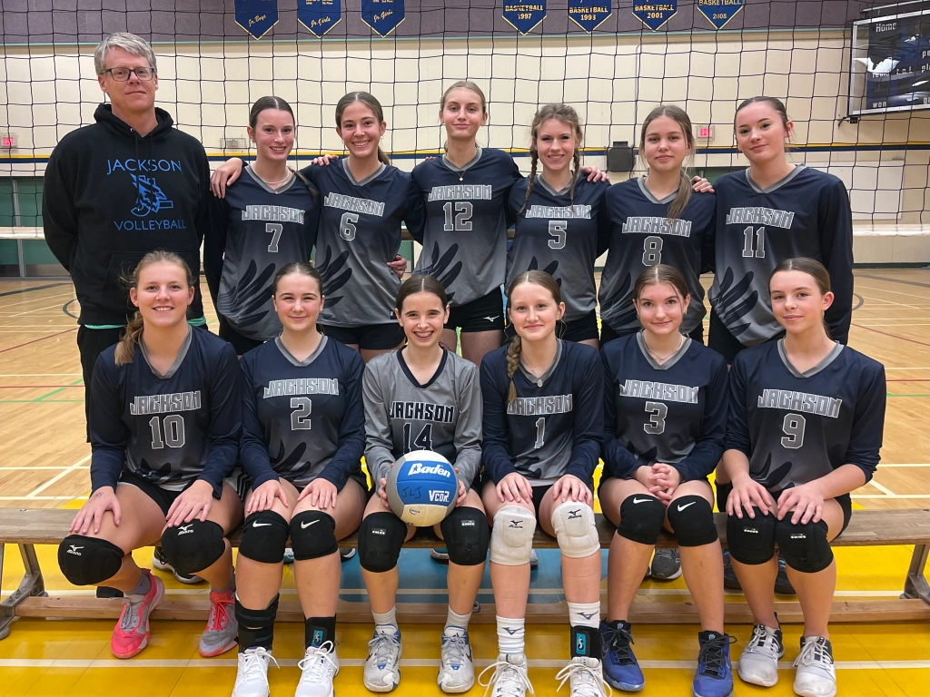
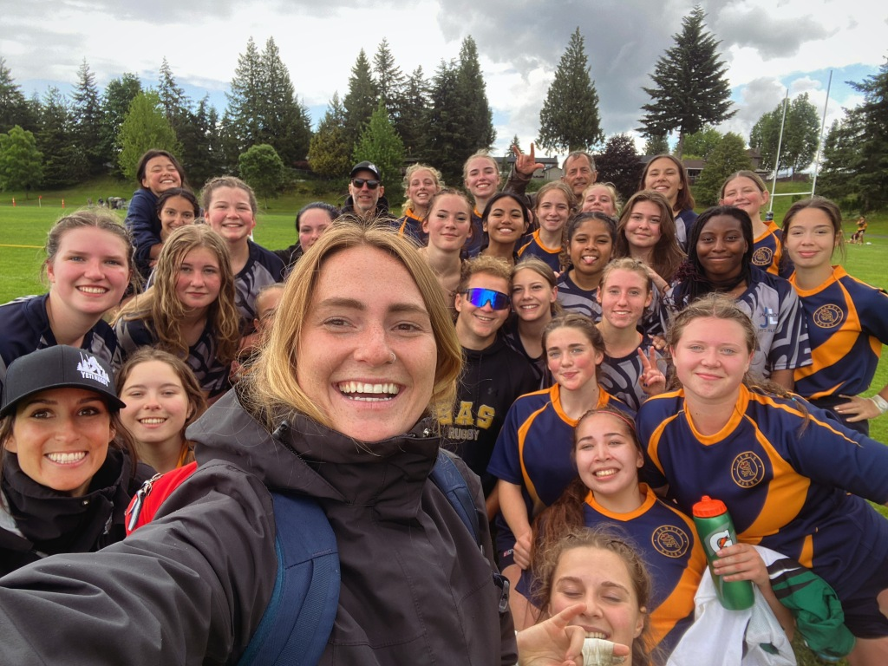

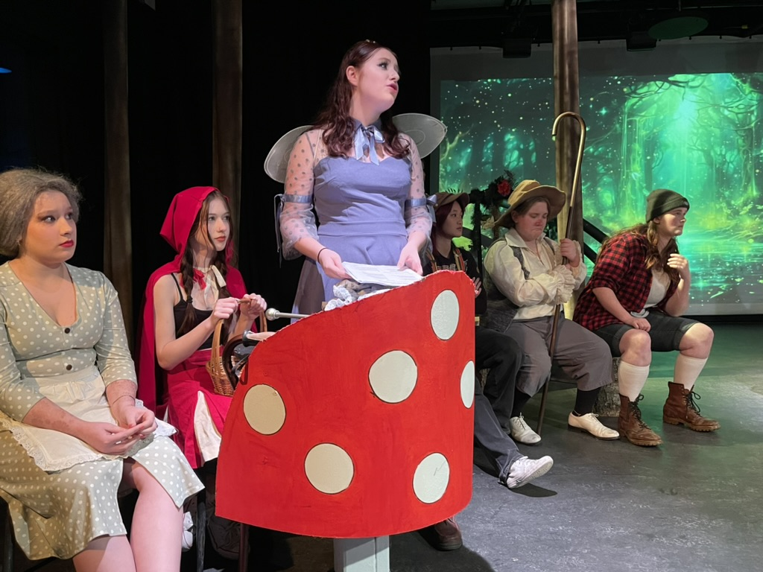
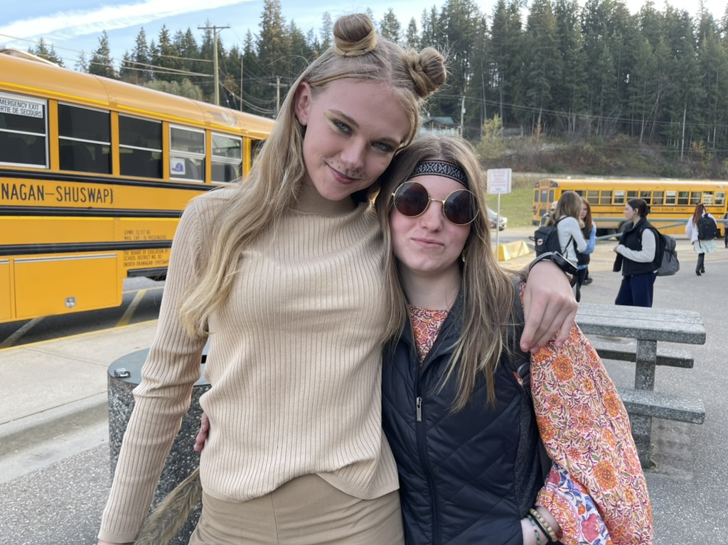

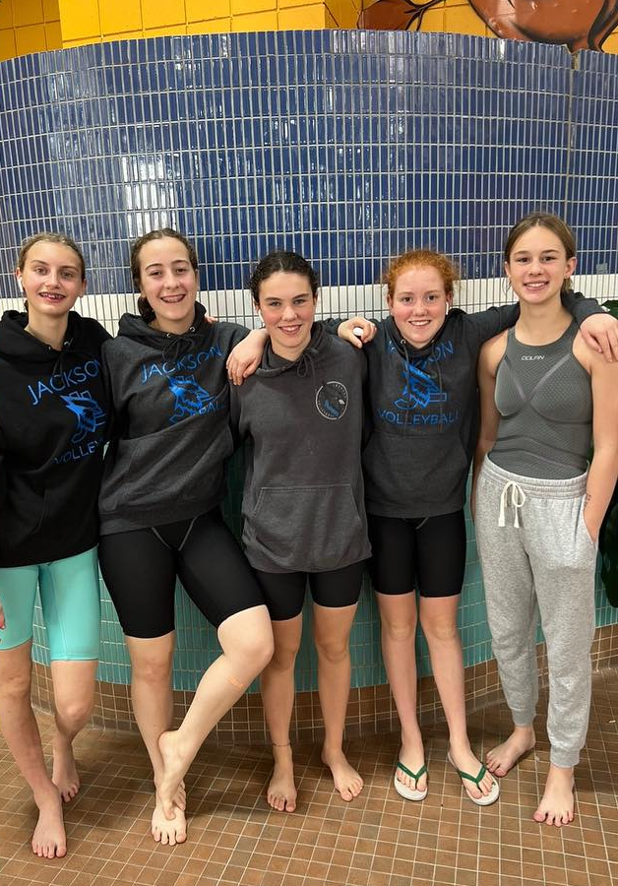
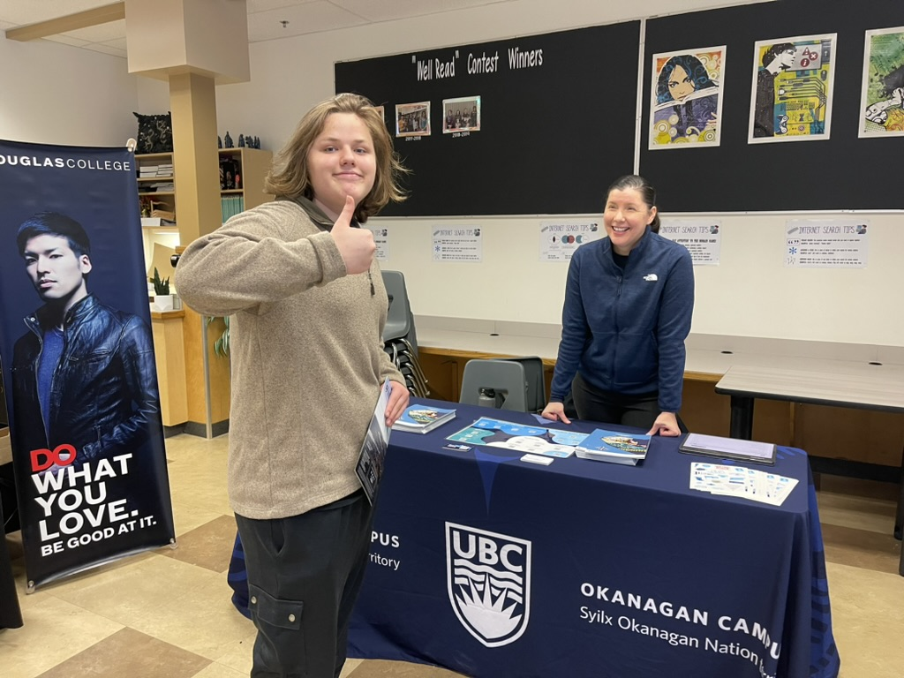

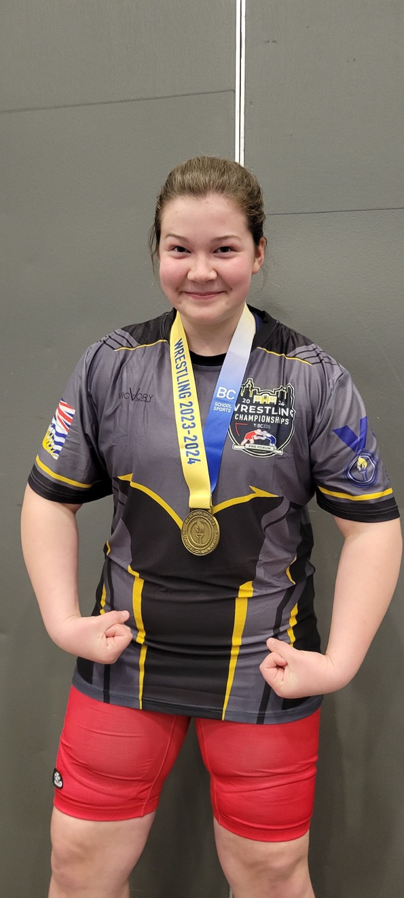
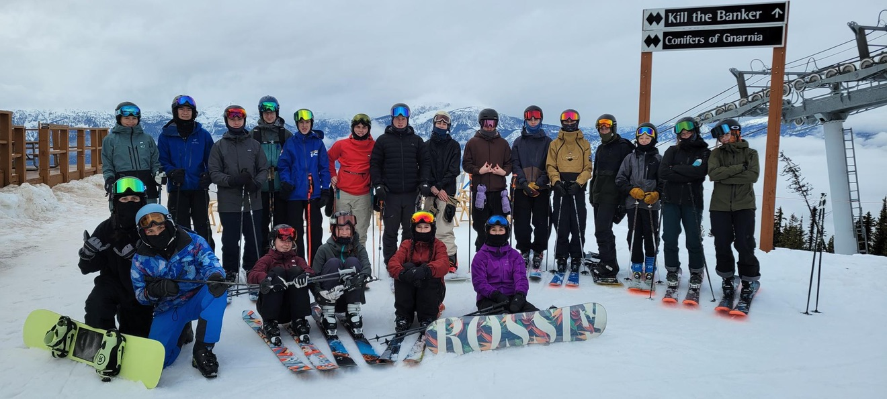
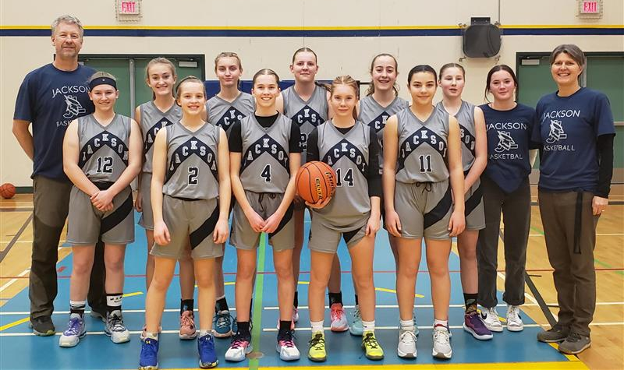
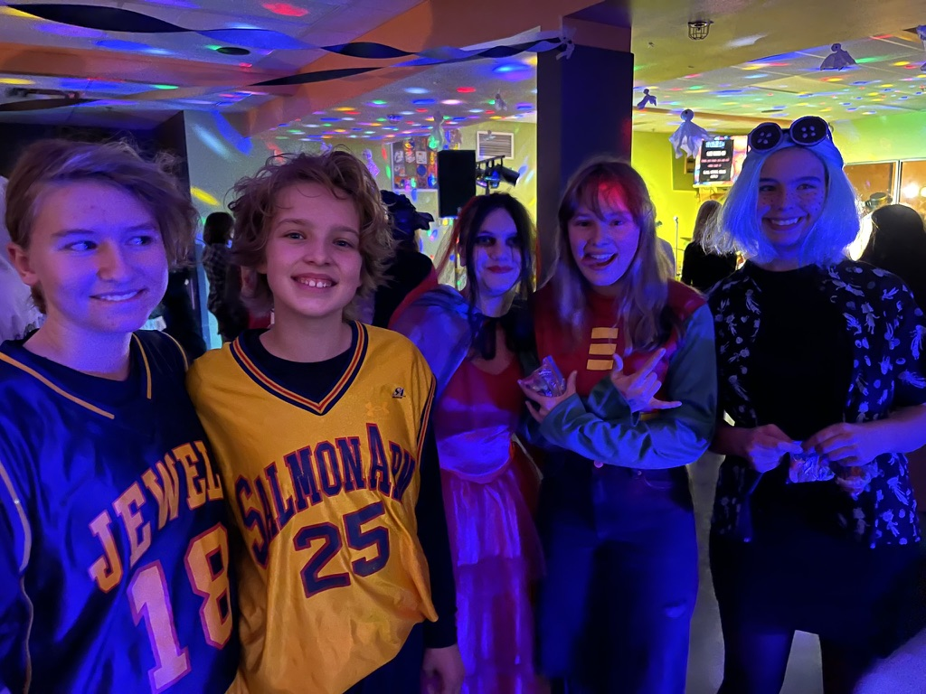
Make the most of your high school experience!

Slide 27
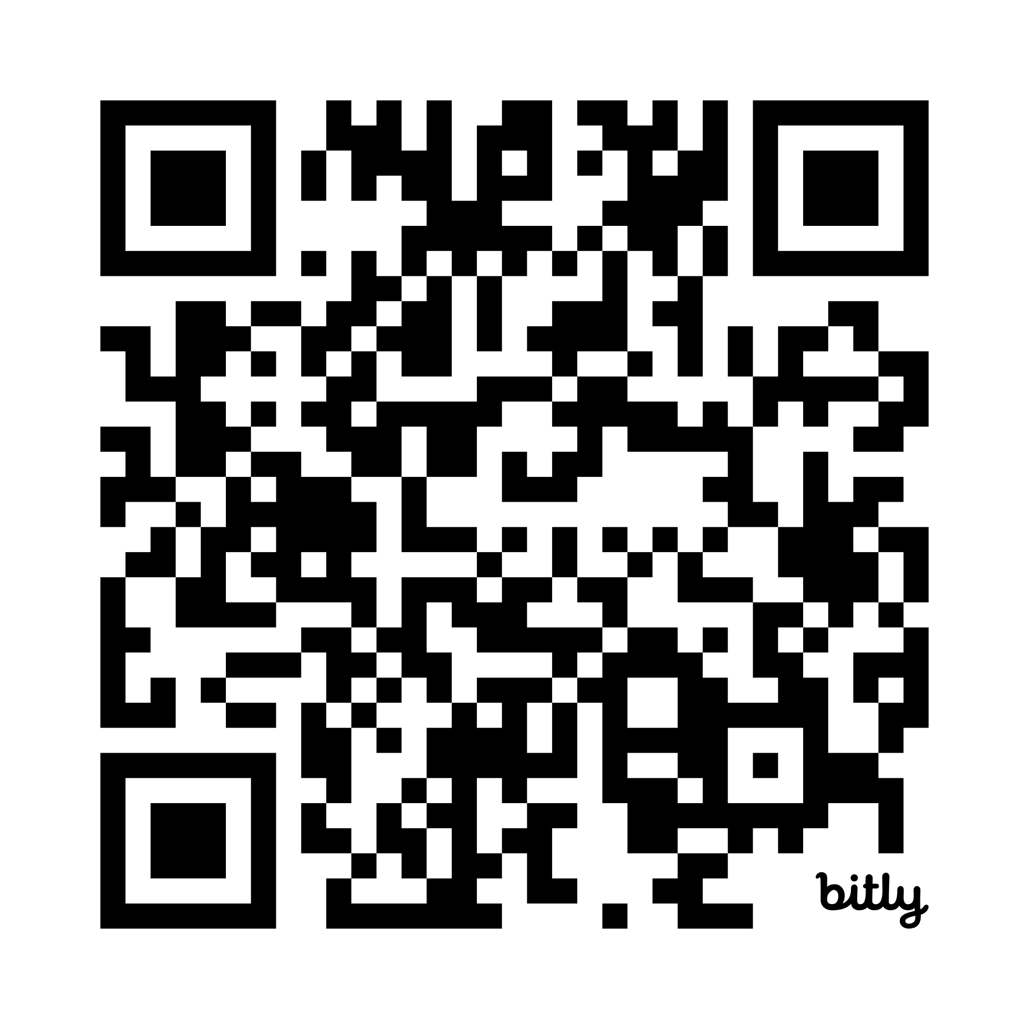
Do your Research!
(starting Feb 13)
Scan the QR Code below to see descriptions of each Elective Course
https://jlj.sd83.bc.ca/grade-10-12-course-catalogue

Slide 28

Questions?

