Slide 1


Grade 12 Course Selections 2026-2027
JL Jackson Secondary School

Slide 2
Course Selection TIMELINe
9-13 February
Grade 11 Course Presentations
2-6 March
Prepare Draft Course Selection in myBlueprint
Grade 11 Course Selections
15-27 Feb

Slide 3


Where to begin?
What courses do I need to Graduate?
What courses do I need to pursue my career goals?
Can use www.myblueprint.ca or www.educationplannerbc.ca

Slide 4
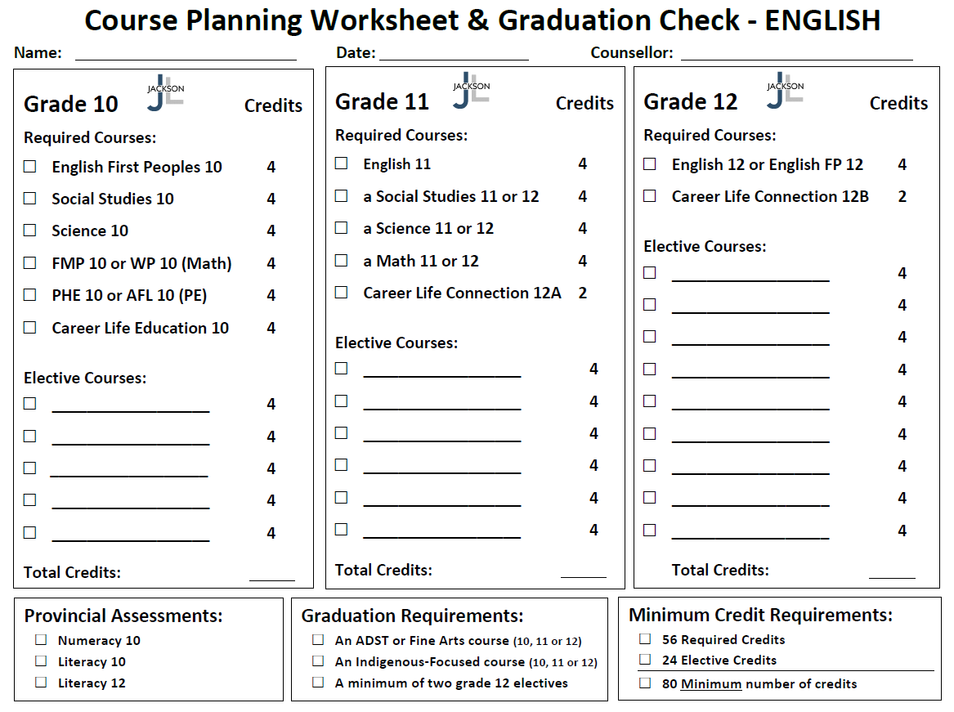
English Graduation Requirements

Slide 5
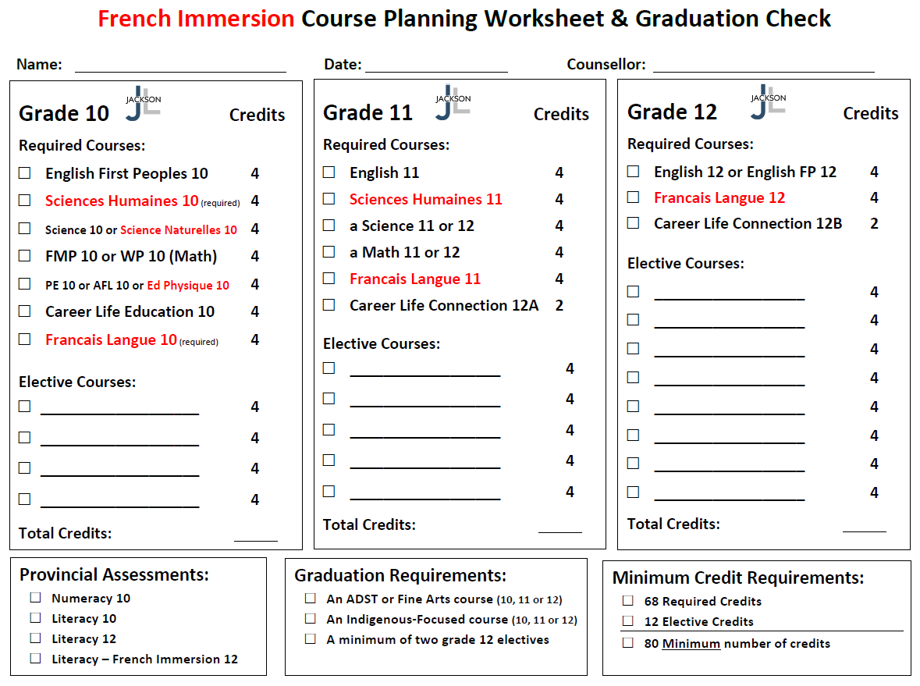
French Immersion Graduation Requirements

Slide 6
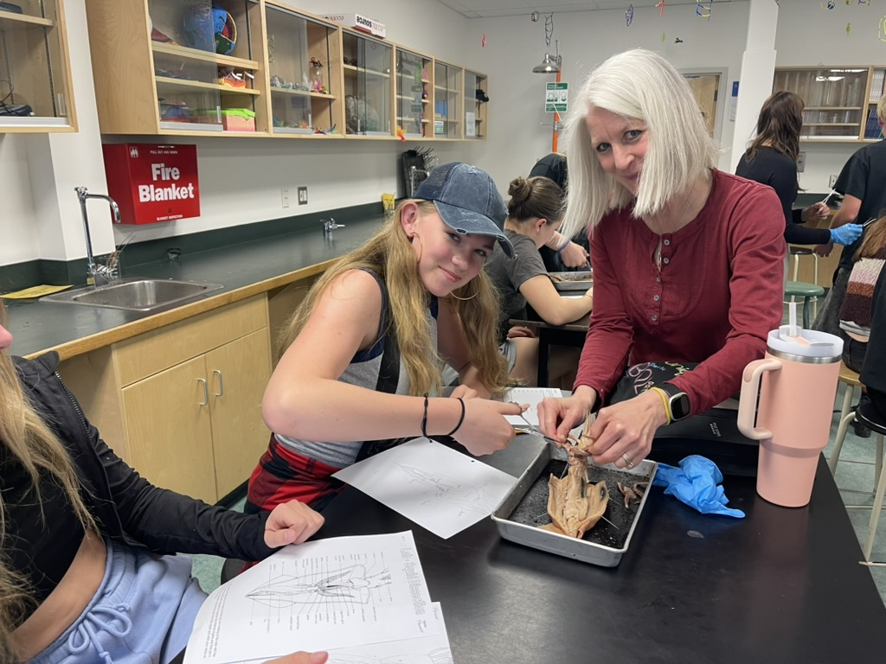
Graduation Requirements
In order to graduate all students must complete…
a minimum of 80 Credits (56 Required + 24 Elective)
an ADST or Fine Arts course (10, 11, or 12)
an Indigenous-Focused course (10, 11, or 12)
a minimum of two grade 12 Electives

Slide 7
Here are a few things to think about wheN Planning your Grade 12 year…

Slide 8
Planning Grade 12
Grade 12 student must take a minimum of 8 courses, plus Career Life Connections 12 B
Study Blocks
Early Grad

Slide 9
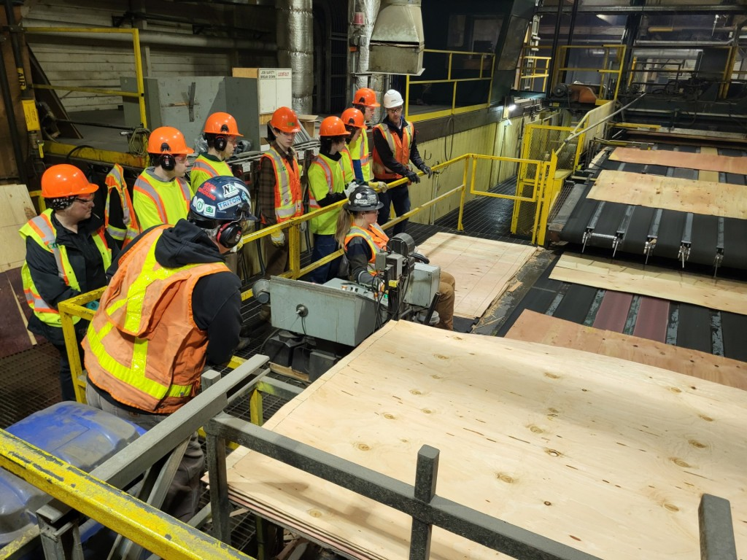
CaReer Life Connections 12B
Career Seminars
My Blueprint
Personal Career Exploration
Work Experience
Post-Secondary Tours and Spotlights

Slide 10
Which English Course Should I take?
English Studies 12
Or
English First Peoples 12

Slide 11
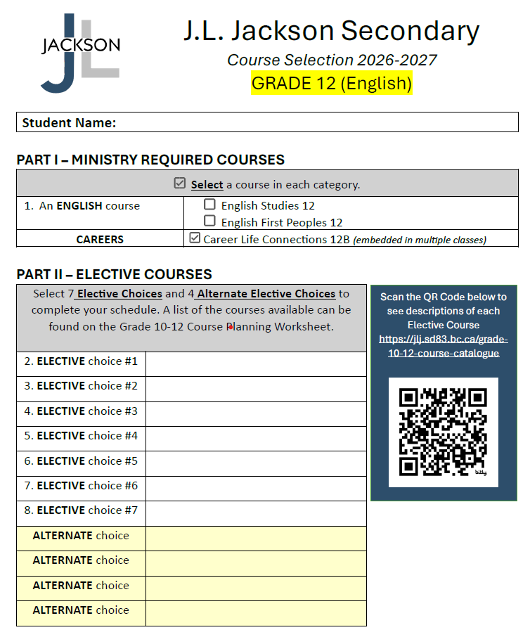

Slide 12
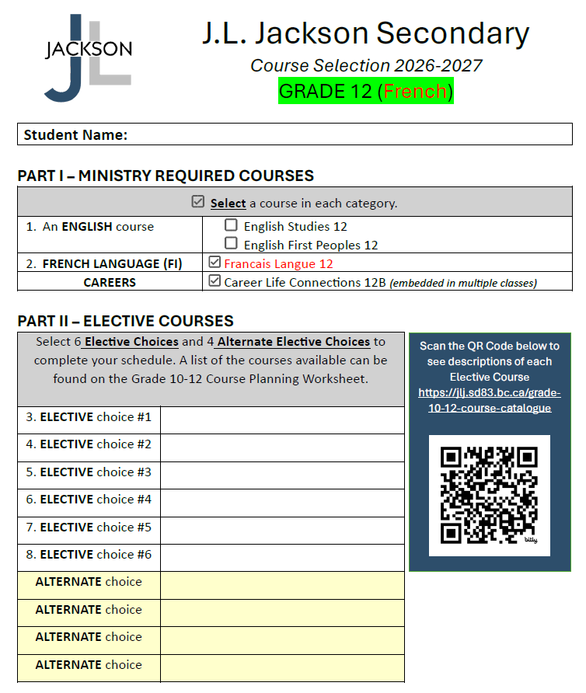

Slide 13
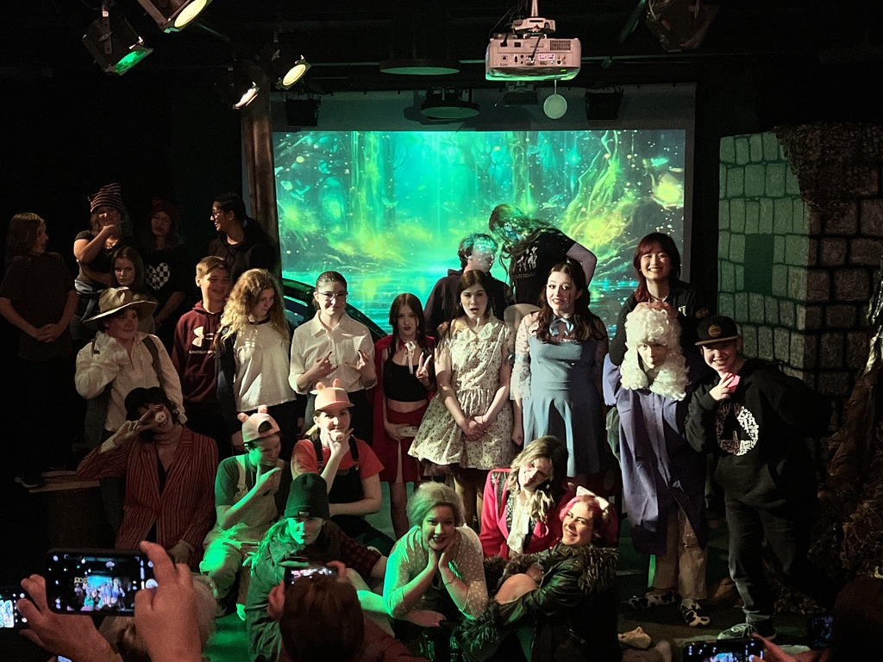
Choosing Electives
Make Individual Choices based on Personal Interest
Choosing the same elective as a friend does not mean you will be in their class
Read through the course catalogue on our website

Slide 14
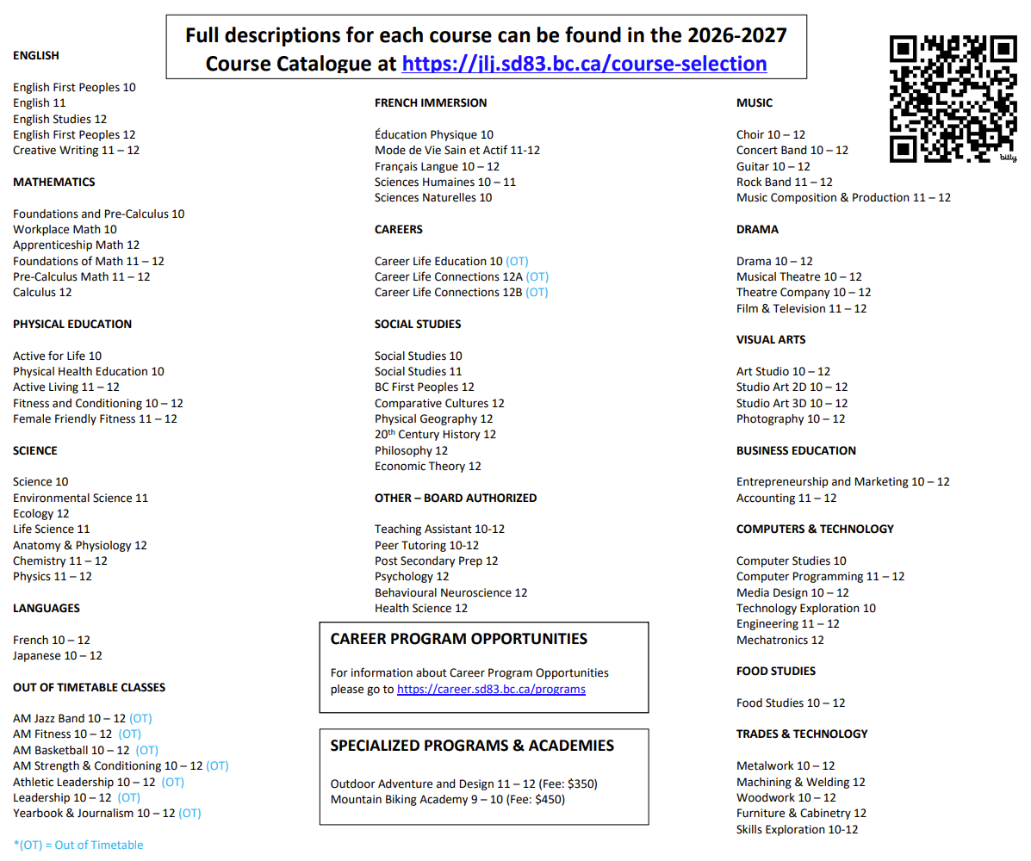

Slide 15
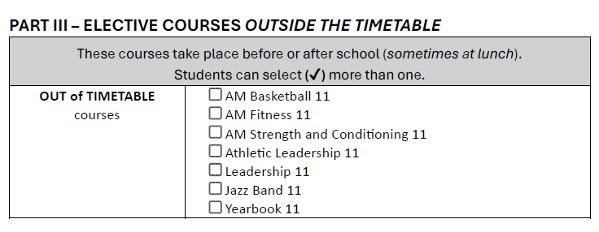

Slide 16
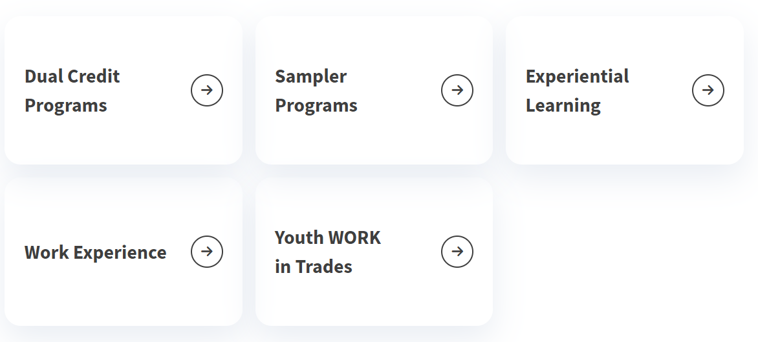
SD83 Career Programs (https://career.sd83.bc.ca/)
See Mr. Hollatz in the Career Centre for more details about career program options !

Slide 17
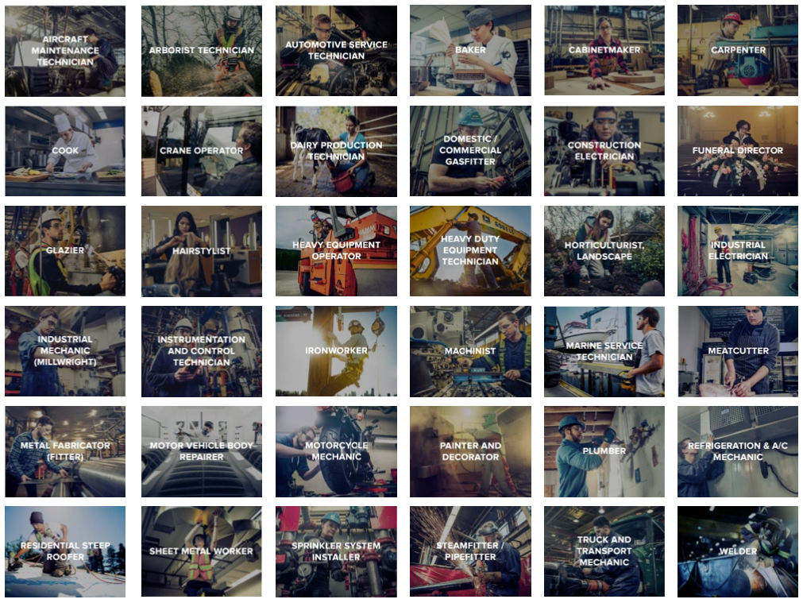

Slide 18
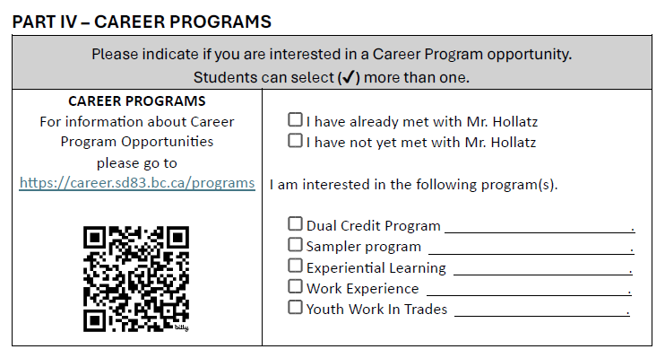

Slide 19
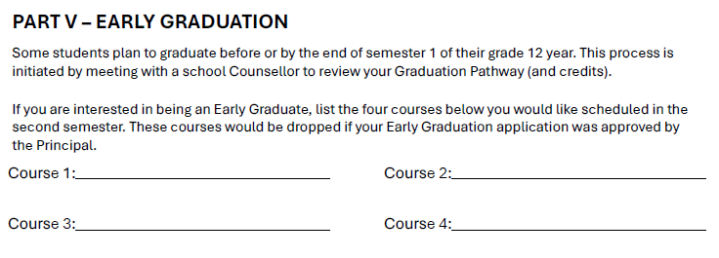

Slide 20
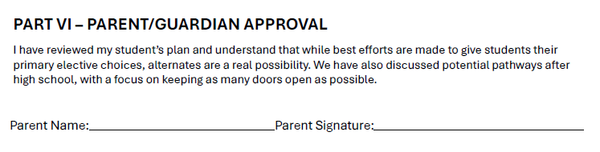

Slide 21
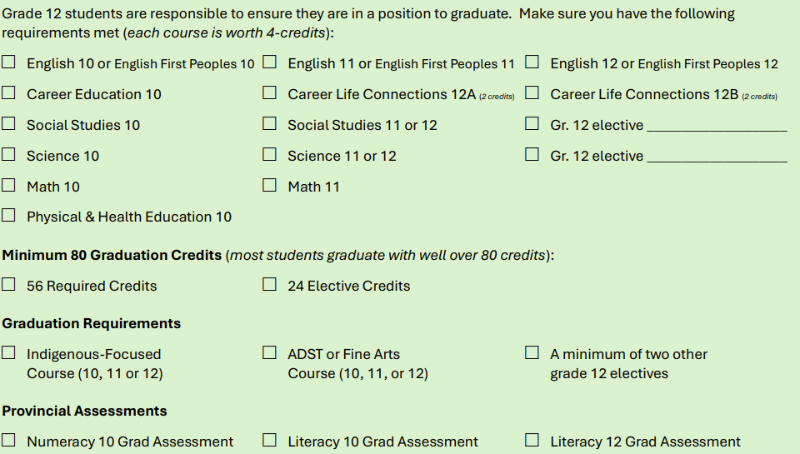
Graduation Checks

Slide 22
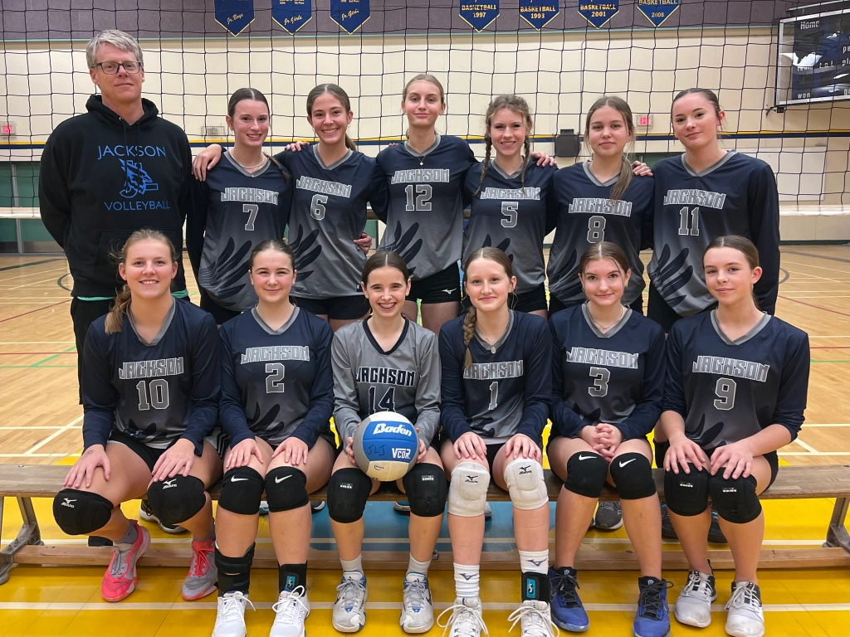
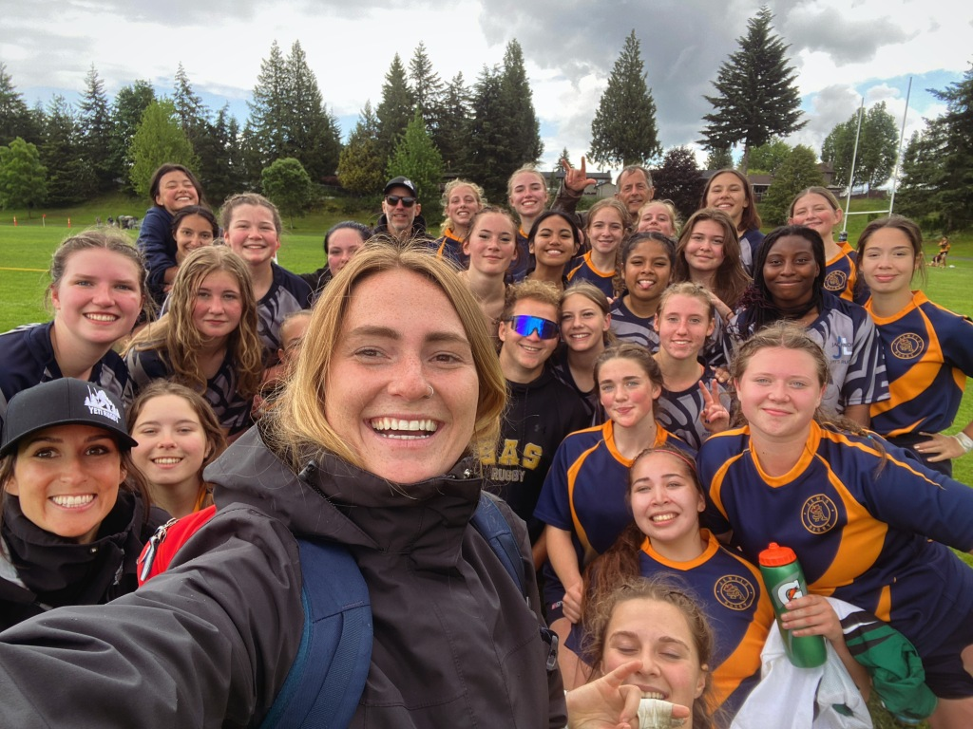
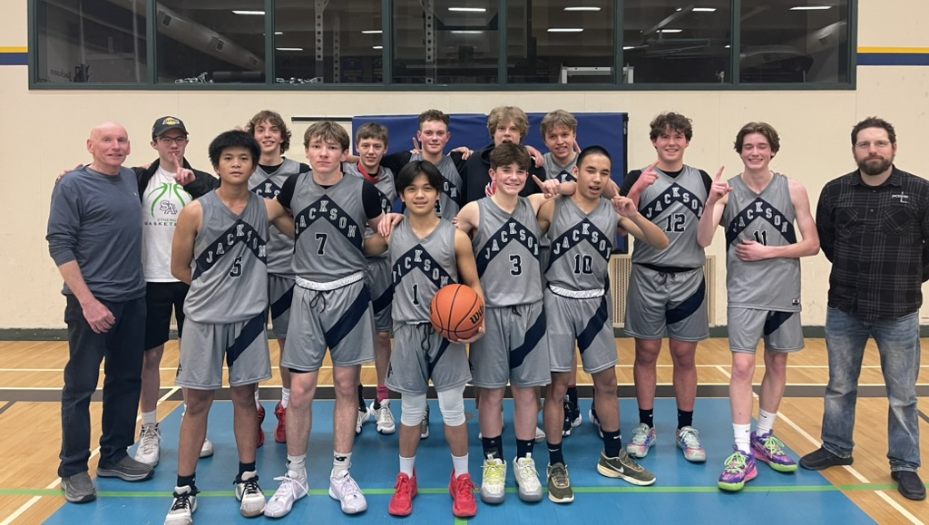
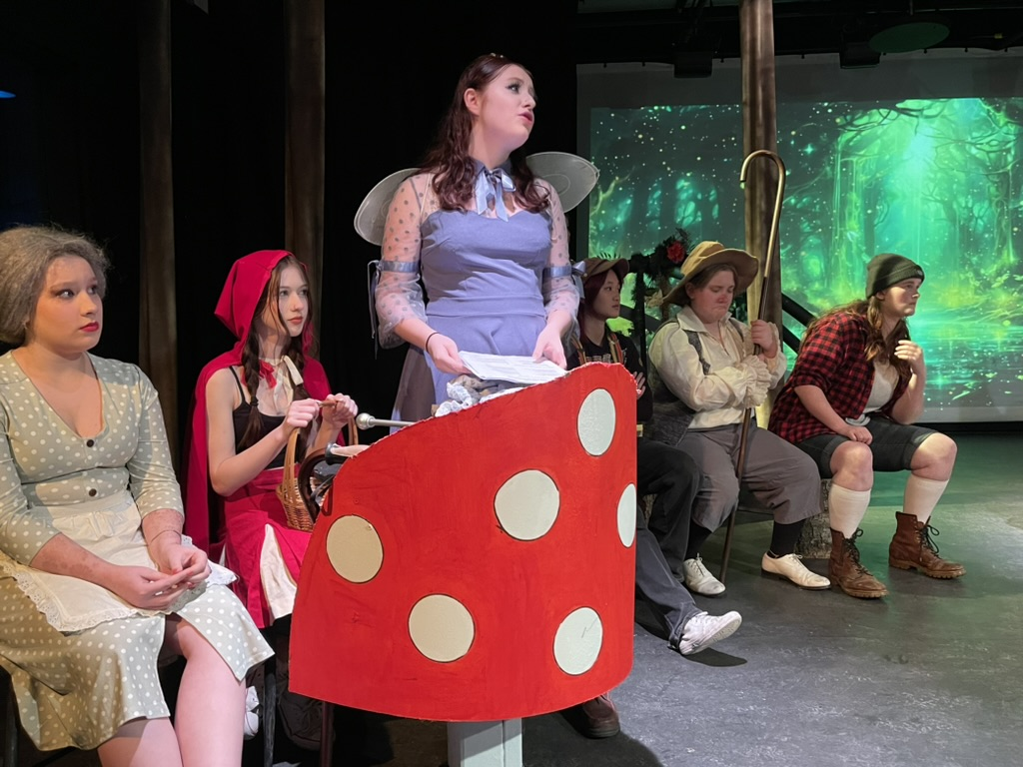
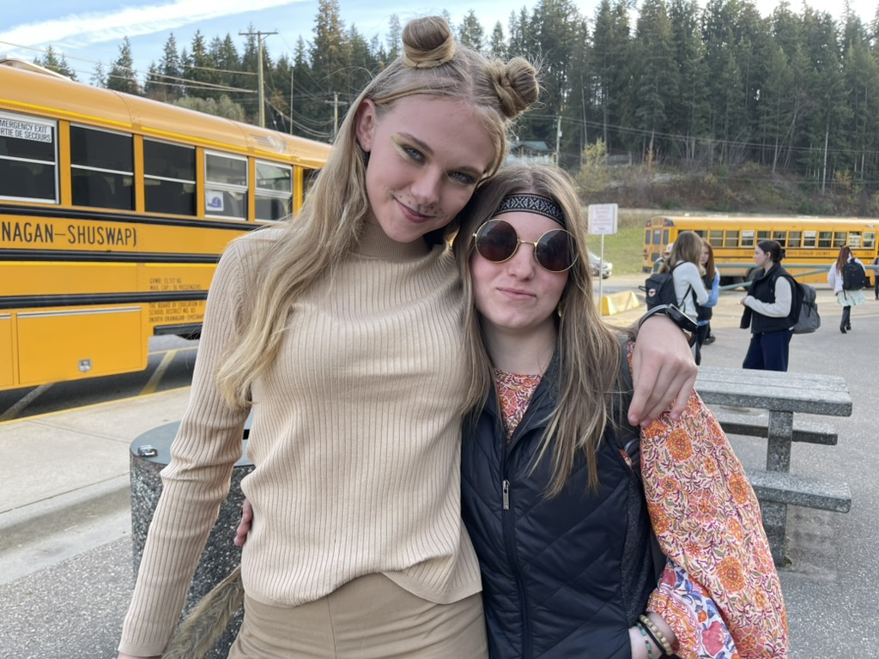

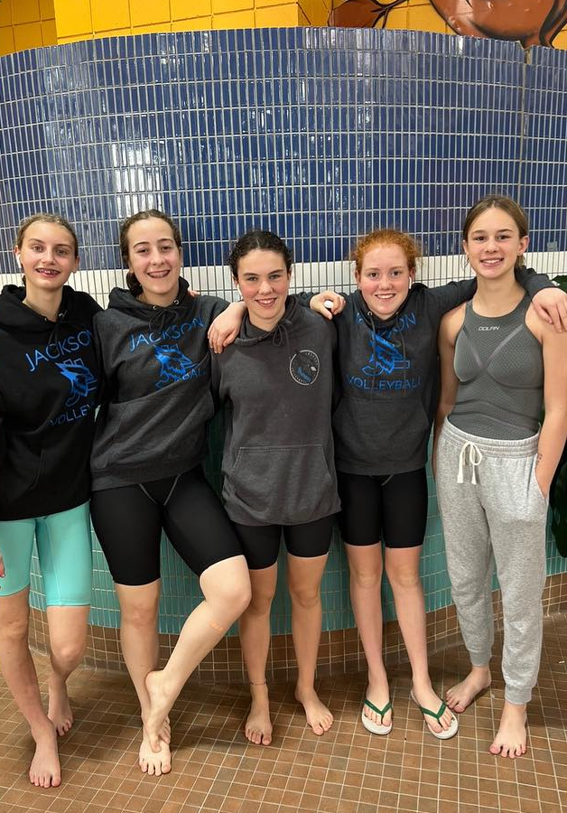
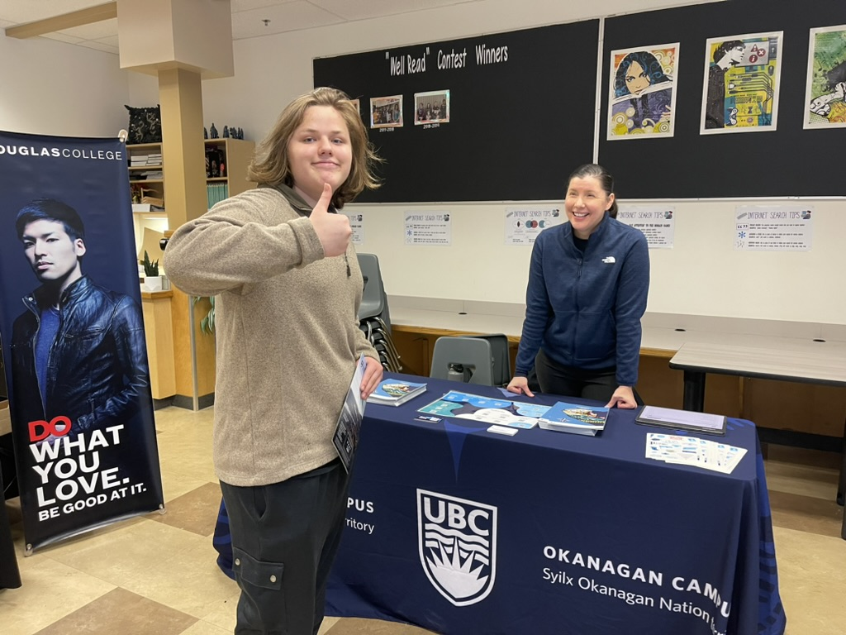

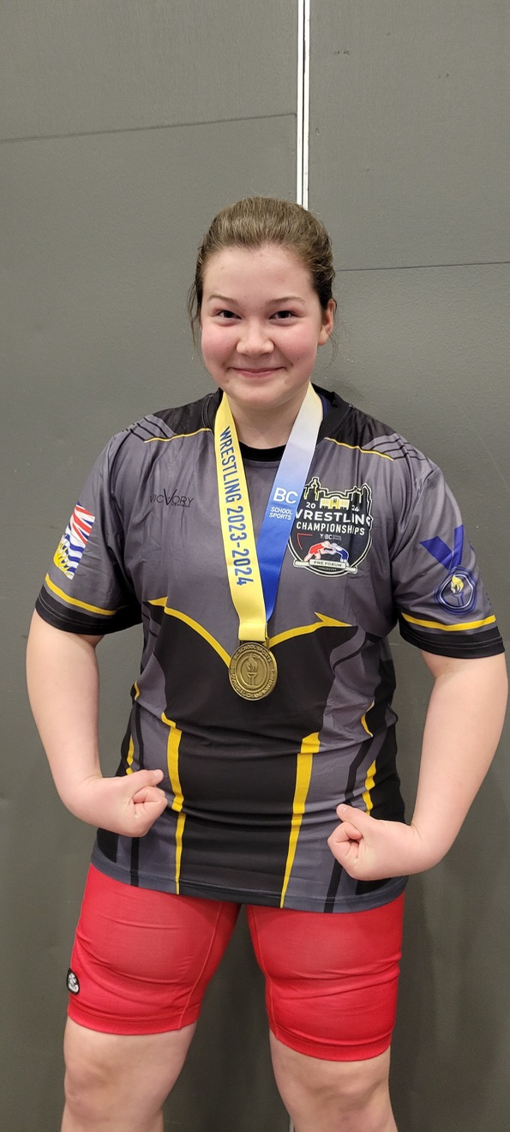
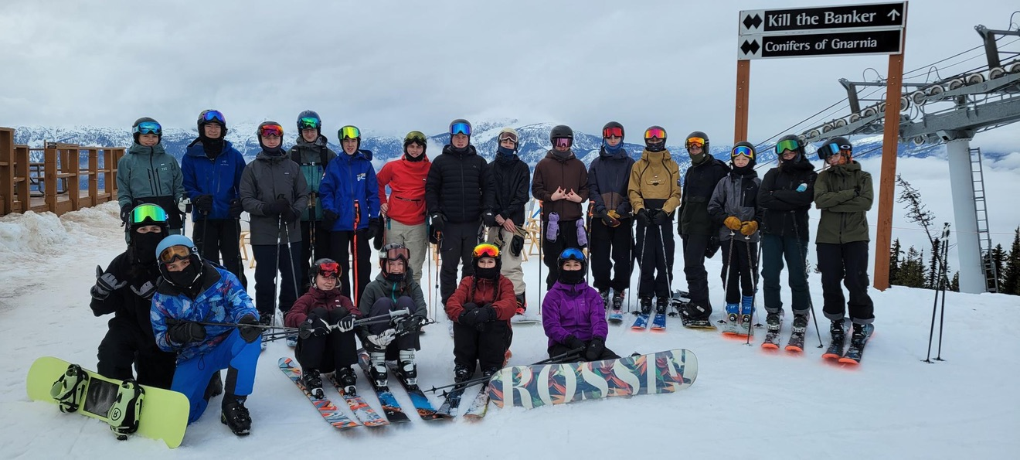
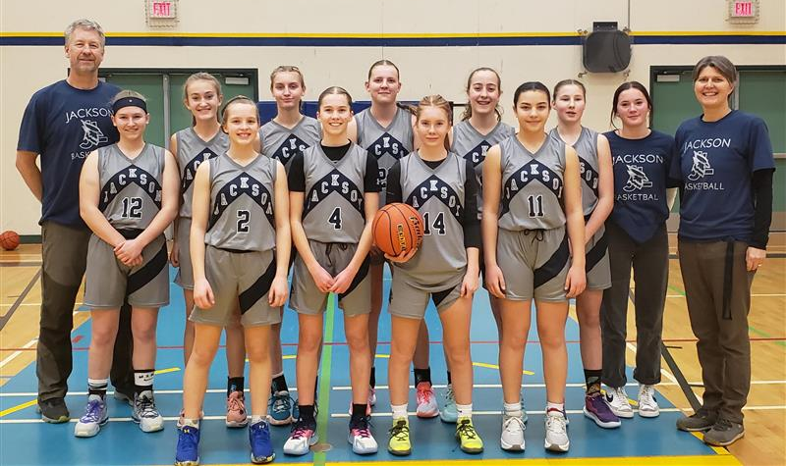
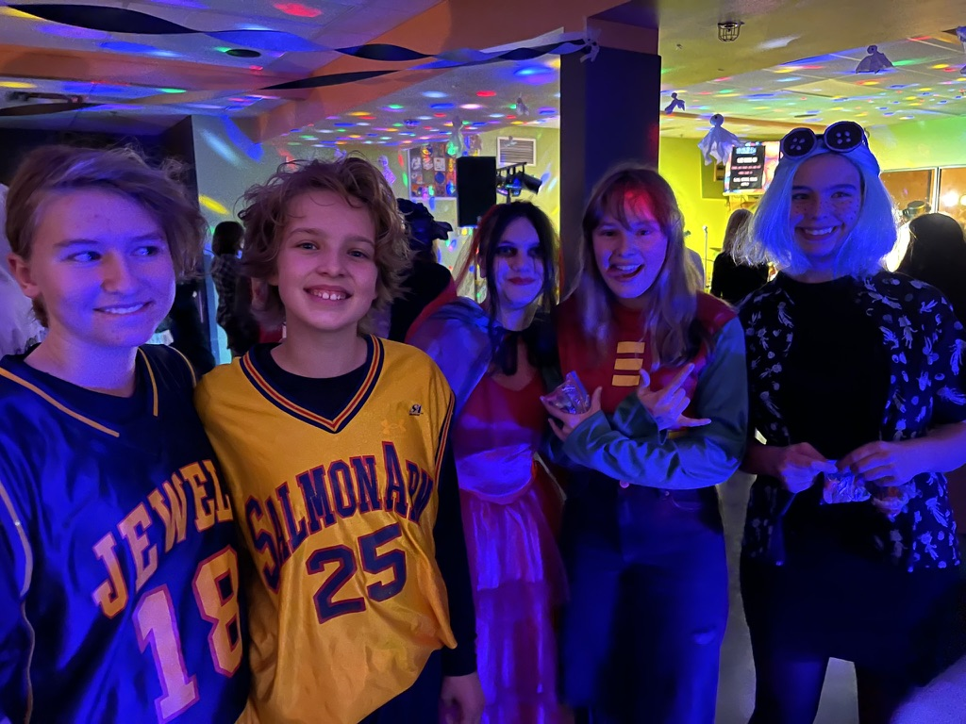
Make the most of your high school experience!

Slide 23

GRAD Committee
First Meeting – Thursday Feb 19 @ 12:00 (Library)

Slide 24
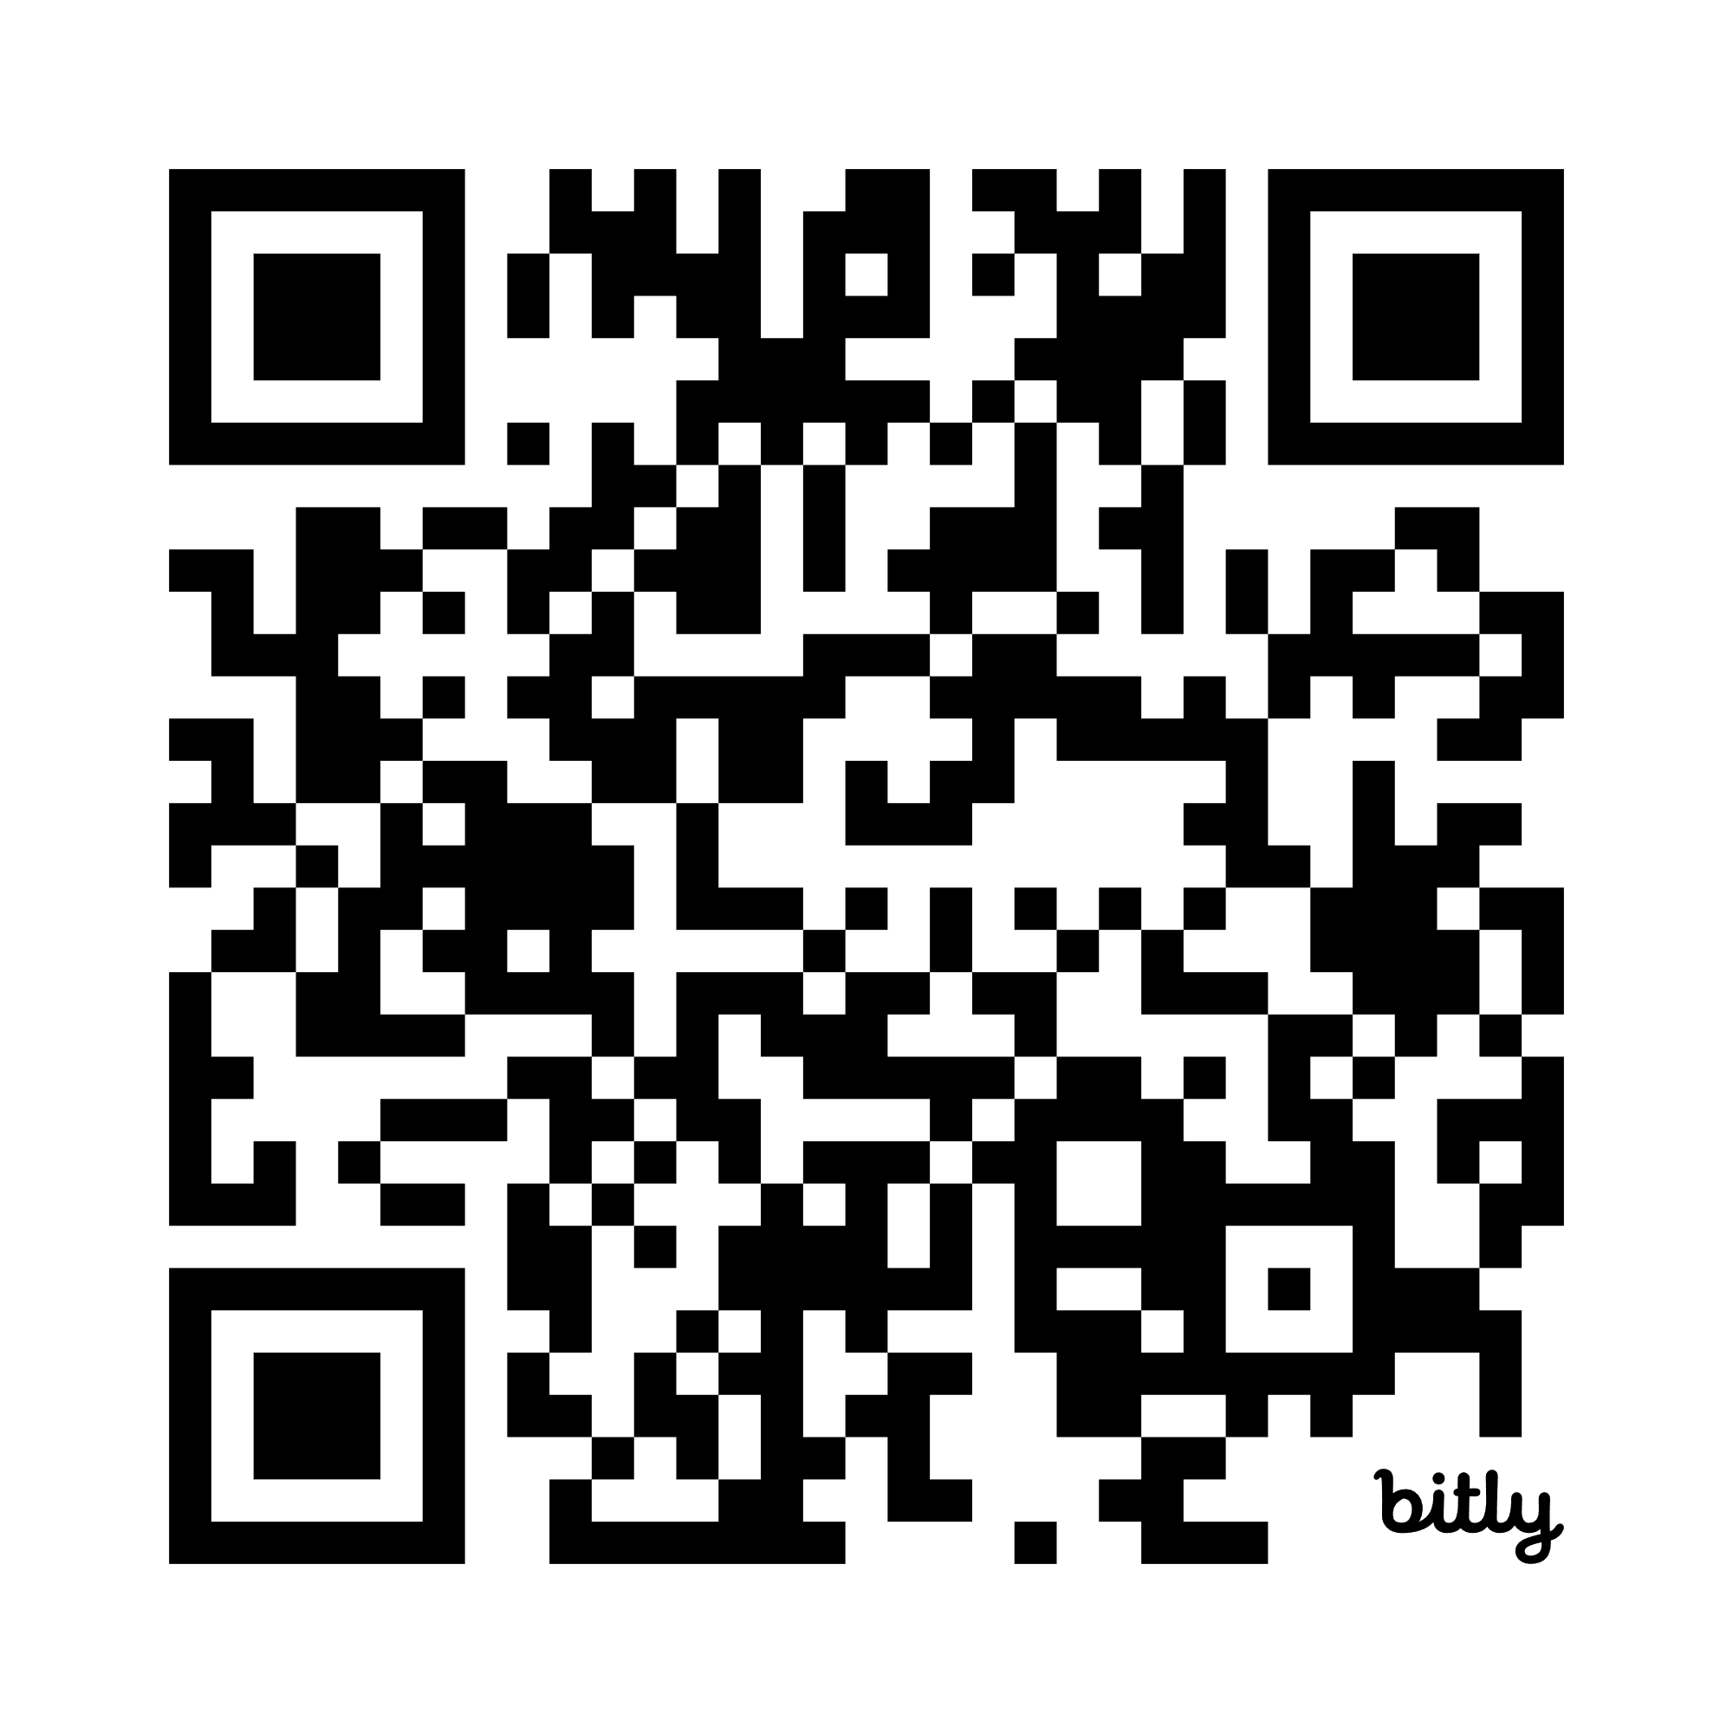
Do your Research!
(starting Feb 13)
Scan the QR Code below to see descriptions of each Elective Course
https://jlj.sd83.bc.ca/grade-10-12-course-catalogue

Slide 25

Questions?

