Slide 1


Grade 10 Course Selections 2026-2027
JL Jackson Secondary School

Slide 2
Course Selection TIMELINe
9-13 February
Grade 11 Course Presentations
2-6 March
Prepare Draft Course Selection in myBlueprint
Grade 11 Course Selections
15-27 Feb

Slide 3

Welcome to the BC Grad Program!
Covers grades 10-12
Courses are now worth credits
Credits are the currency with which you graduate
You need enough of the right credits to graduate
3 Provincial Assessments

Slide 4


Where to begin?
What courses do I need to Graduate?
What courses do I need to pursue my career goals?
Can use www.myblueprint.ca or www.educationplannerbc.ca

Slide 5
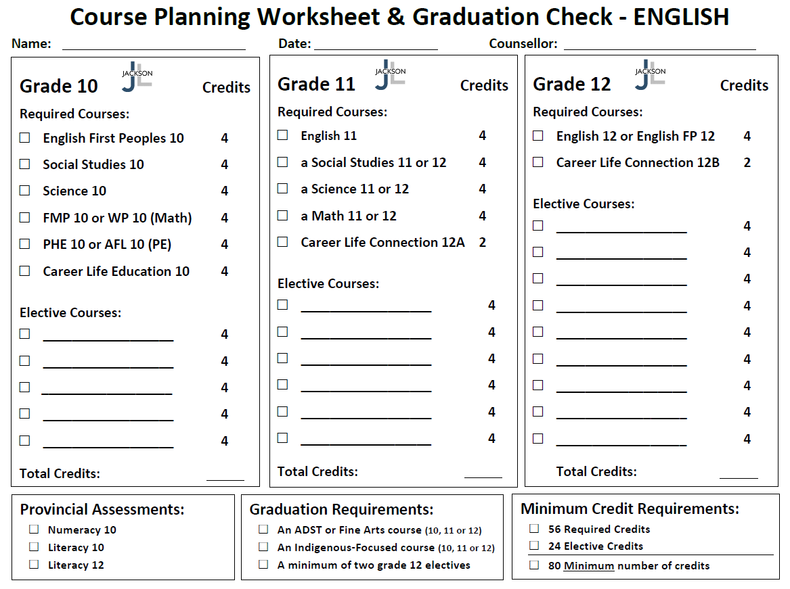
English Graduation Requirements

Slide 6
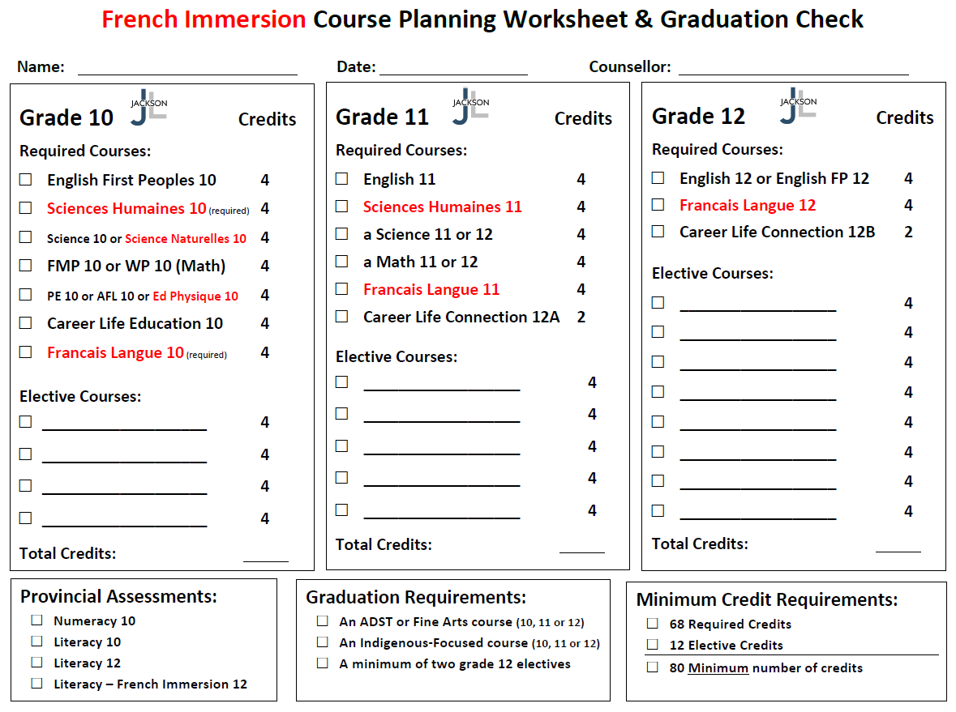
French Immersion Graduation Requirements

Slide 7
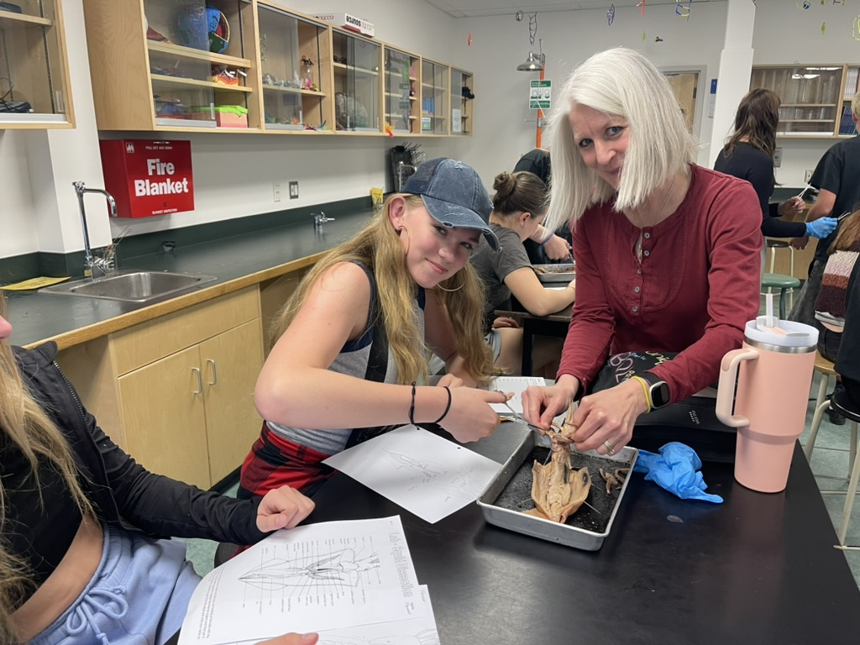
Graduation Requirements
In order to graduate all students must complete…
a minimum of 80 Credits (56 Required + 24 Elective)
an ADST or Fine Arts course (10, 11, or 12)
an Indigenous-Focused course (10, 11, or 12)
a minimum of two grade 12 Electives

Slide 8
Here are a few things to think about wheN Planning your Grade 10 year…

Slide 9
Which Math Course Should I take?
Foundations and Pre-Calculus Math 10
or
Workplace Math 10
You can also take Pre-Calculus 11 if you like!

Slide 10
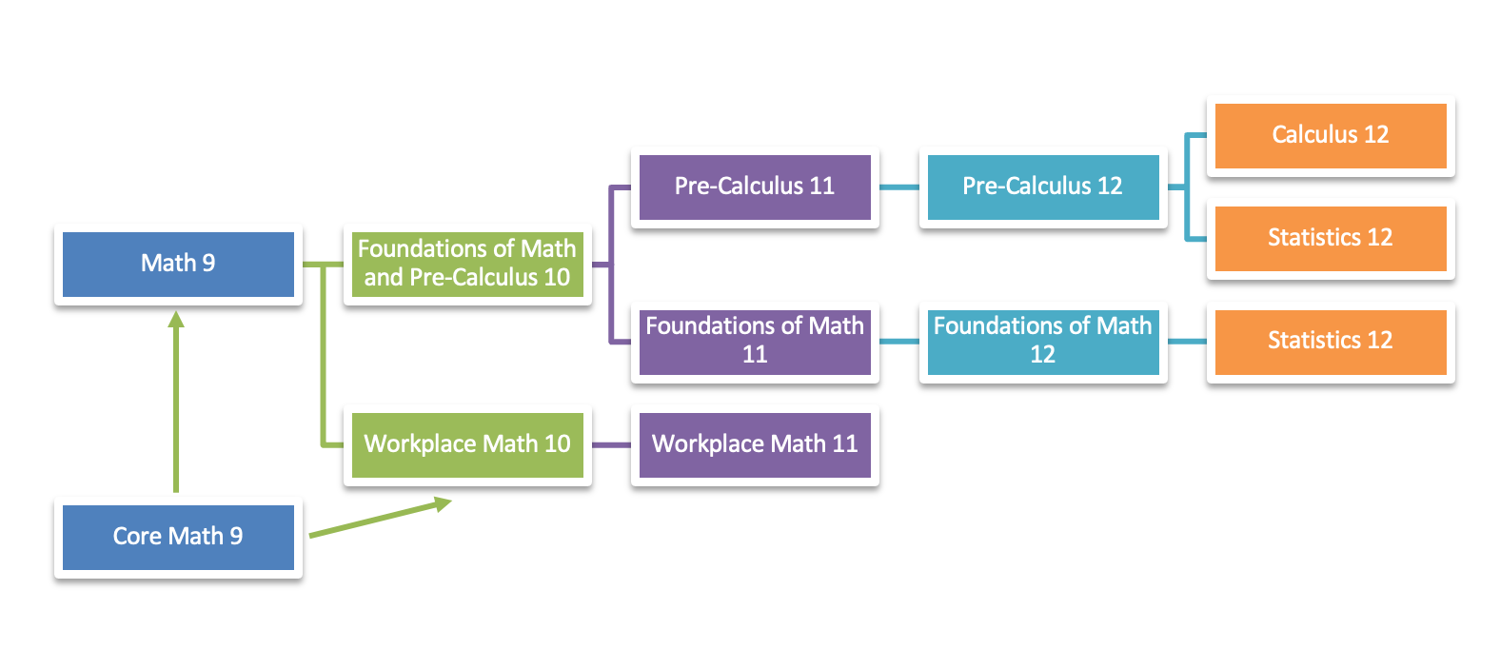
Apprenticeship
Math 12

Slide 11
WORKPLACE/APPRENTICESHIP MATHEMATICS is designed to provide students with the mathematical understandings and critical thinking skills identified for entry into most trades and the work force.
FOUNDATIONS OF MATHEMATICS is designed to provide students with the mathematical understandings and critical-thinking skills identified for most post-secondary programs.
PRE-CALCULUS is designed to provide students with the mathematical understandings and critical-thinking skills identified for entry into specific post-secondary programs, such as sciences and engineering.

Slide 12
Which PHE Course Should I take?
Physical Health Education 10
or
Active for Life 10
or
Education Physique 10

Slide 13
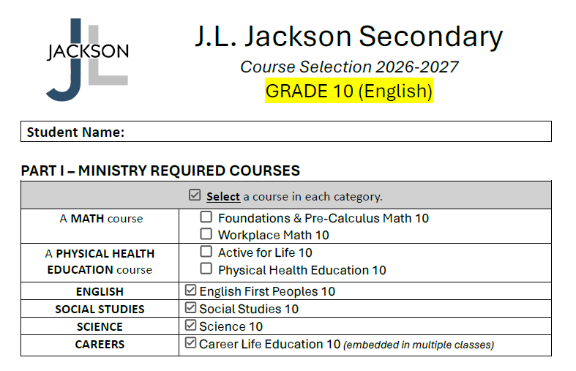

Slide 14
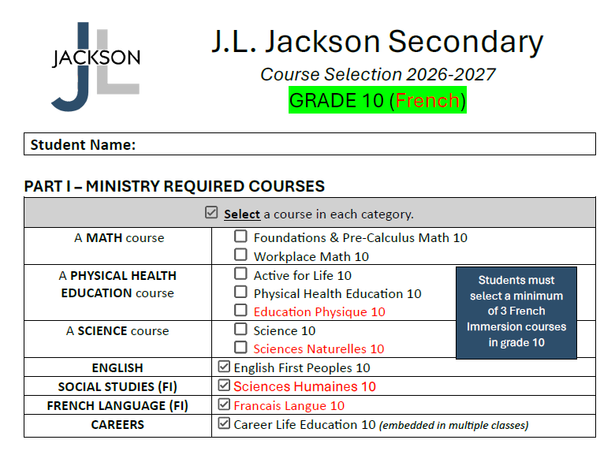

Slide 15
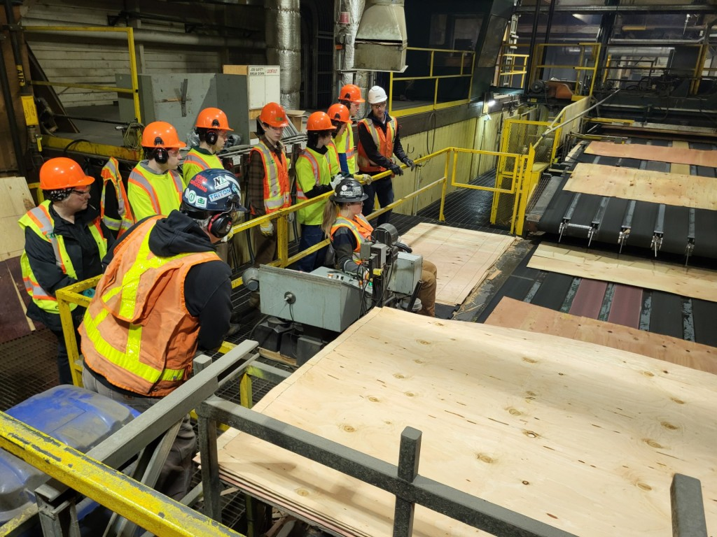
CaReer Life Education 10
Monthly presentations in scheduled classes
Some work to be completed outside class time
Uses MyBlueprint for Career Exploration and Portfolio
Sign up for careers spotlight sessions, field trips, etc.

Slide 16
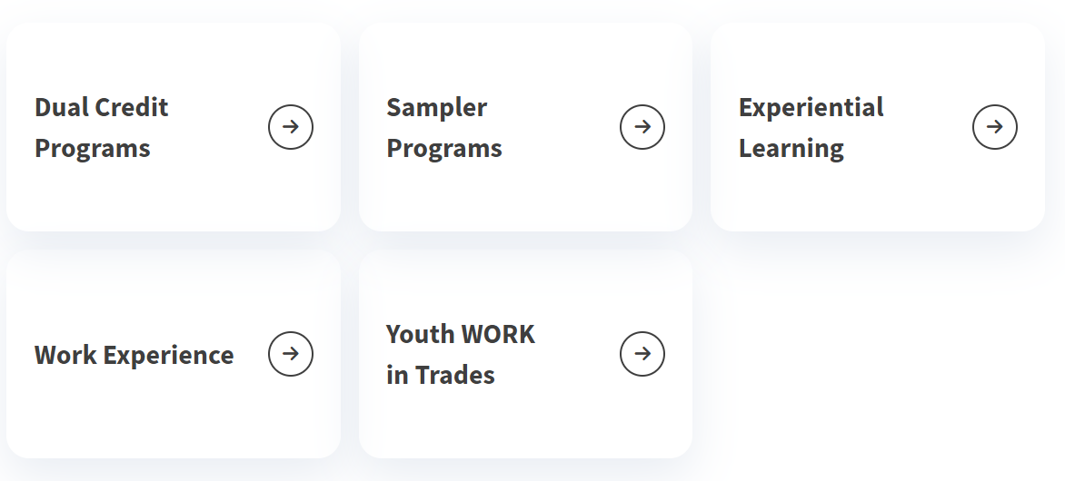
SD83 Career Programs (https://career.sd83.bc.ca/)
See Mr. Hollatz in the Career Centre for more details about career program options !

Slide 17
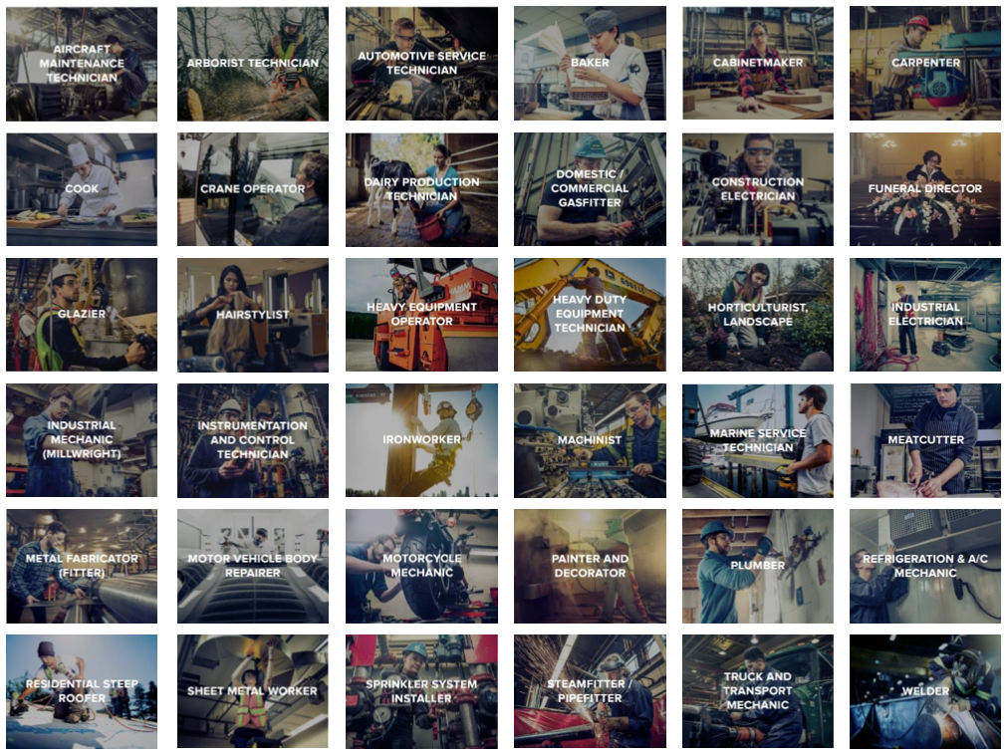

Slide 18
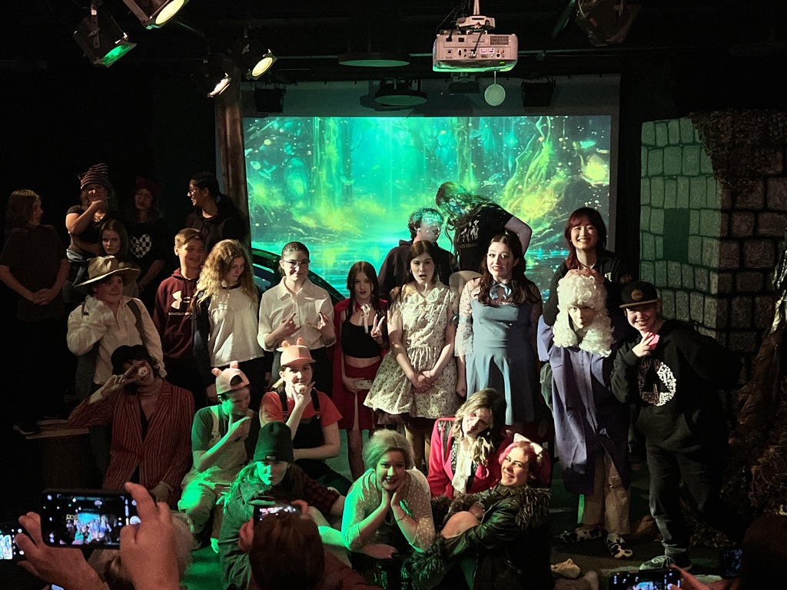
Choosing Electives
Make Individual Choices based on Personal Interest
Choosing the same elective as a friend does not mean you will be in their class
Read through the course catalogue on our website

Slide 19
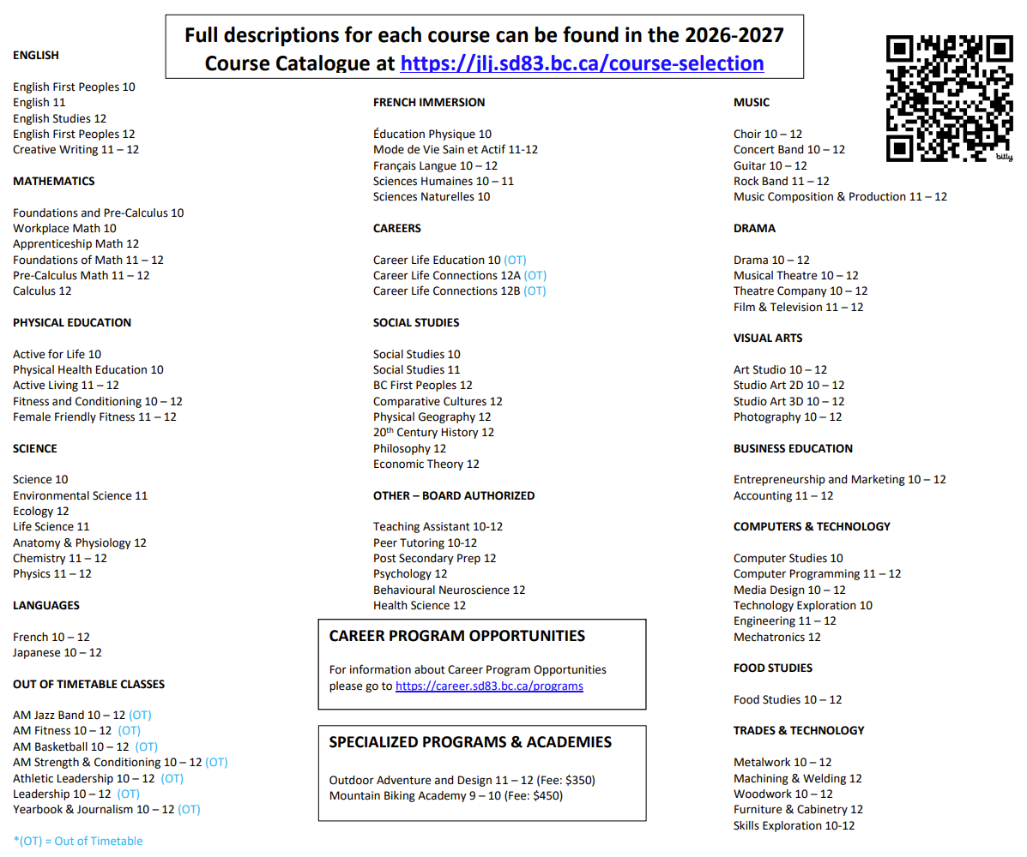

Slide 20

Second Languages
Students may want to continue with a Second Language at the grade 10 level.
French 10
Japanese 10
*A Second Language could be required for entrance into a specific university degree program or be part of degree program once at university.

Slide 21
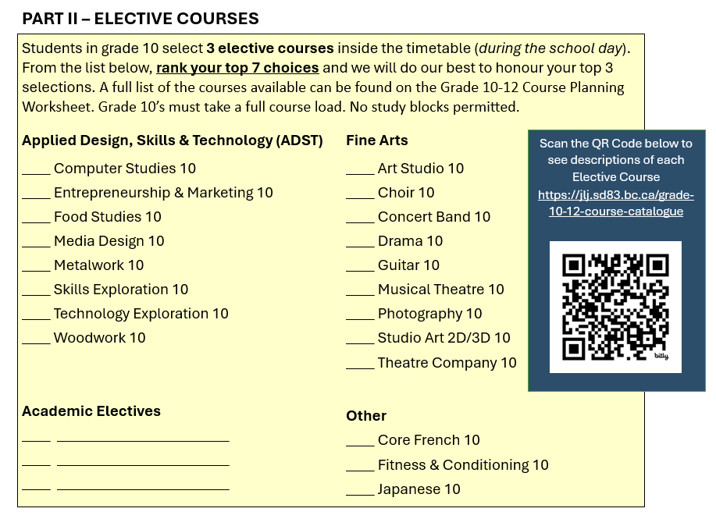

Slide 22
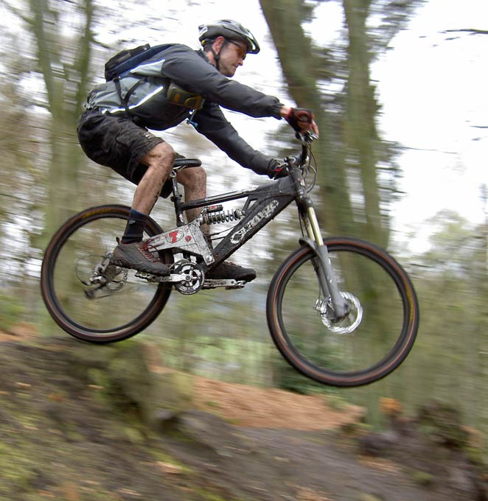
Mountain Biking Academy
Half Day Program (8 Credits)
PE and Mountain Bike Skills Credit
Fee is around $450
Spring Semester
Expression of interest form online

Slide 23

Outdoor Adventure and Design
Half Day Program (8 Credits)
PHE and Woodwork credits
Fee is around $350
Spring Semester
Hands on and outdoor activities
Expression of interest form online
Build fishing nets, camping chairs, drums…then use them on your adventures!

Slide 24
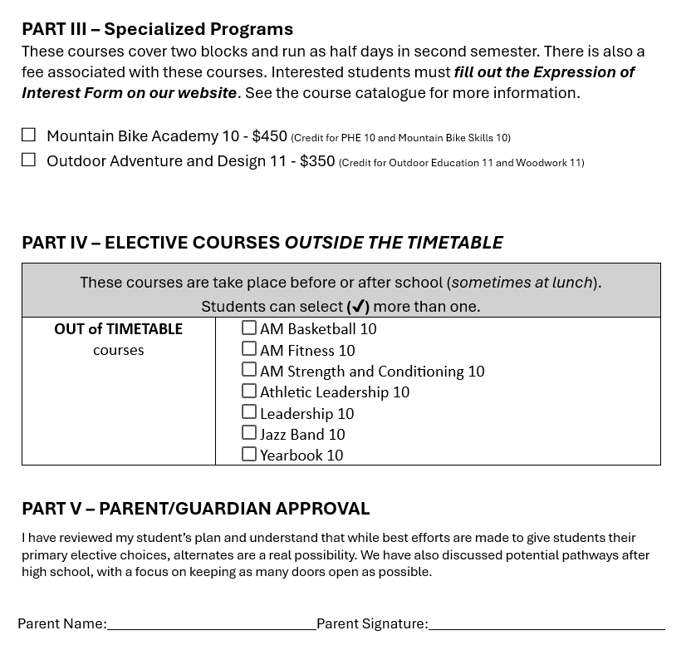

Slide 25
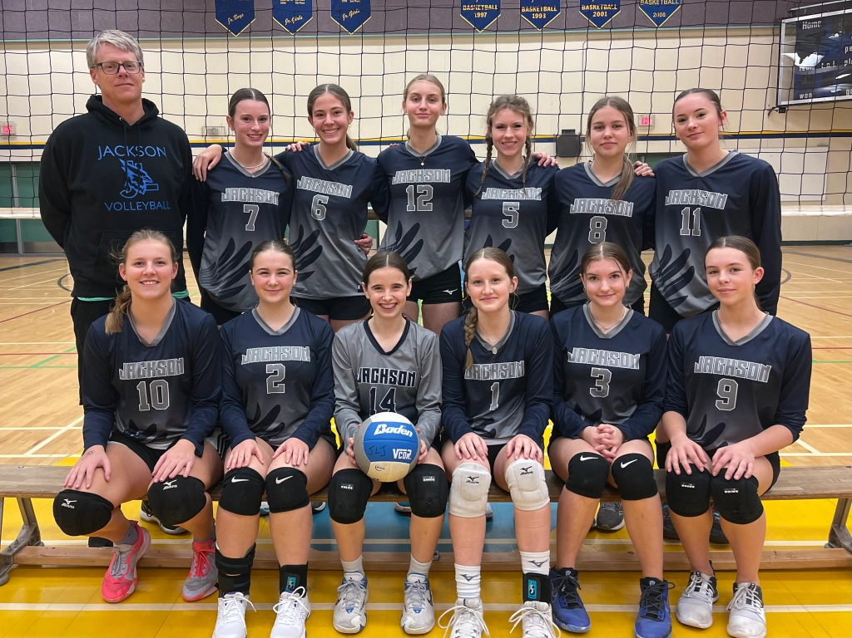
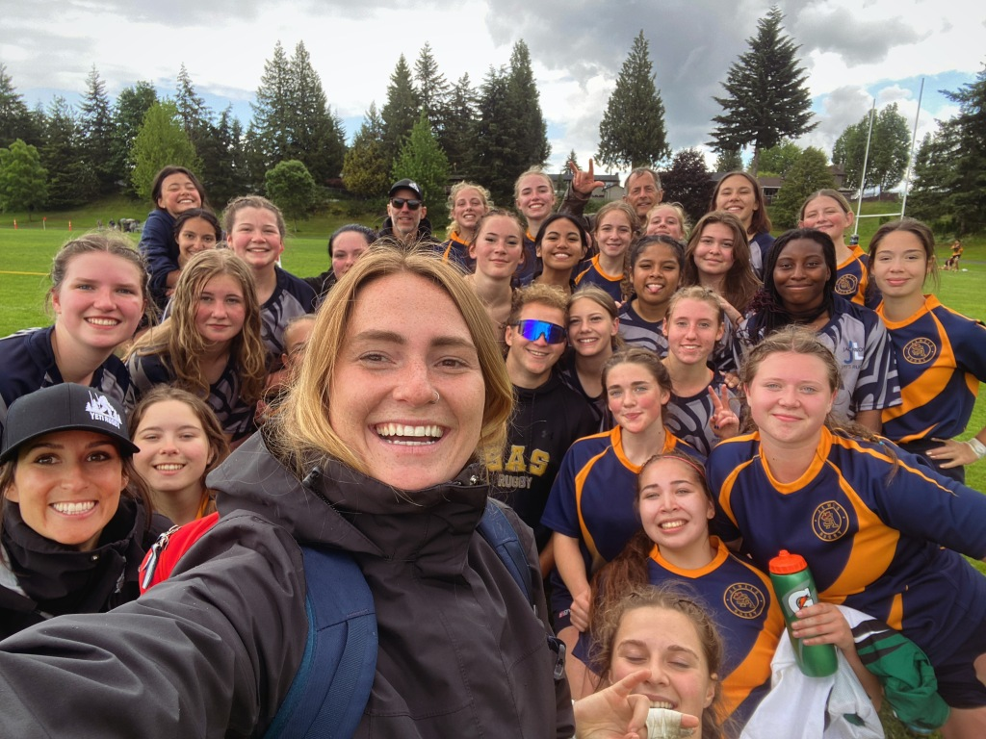
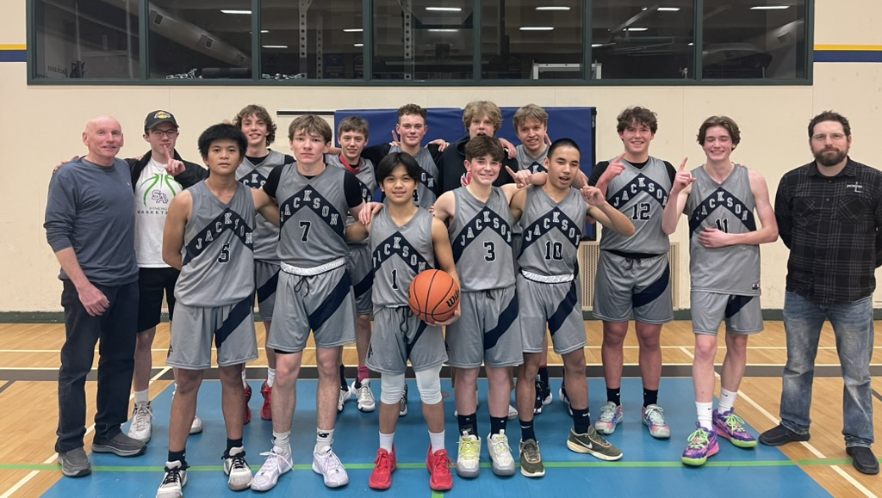
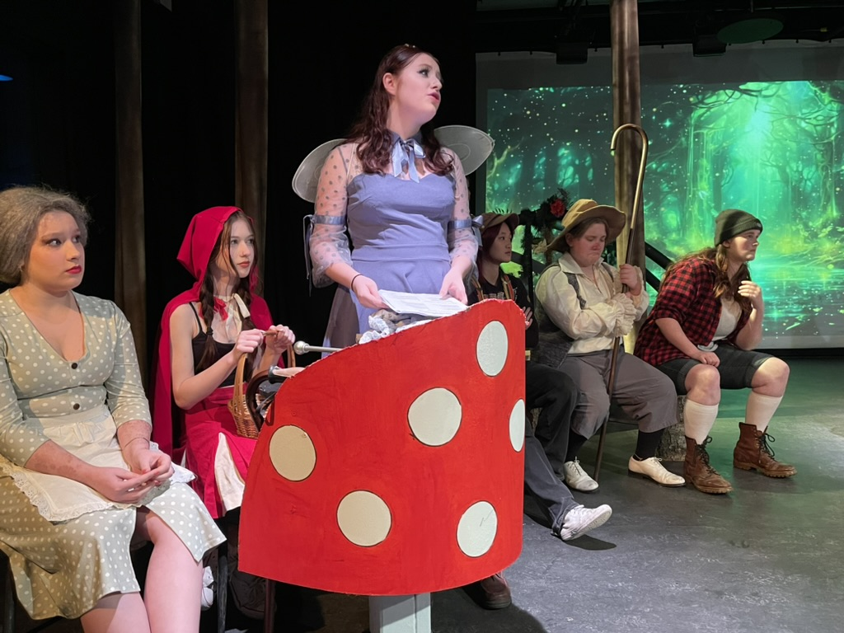
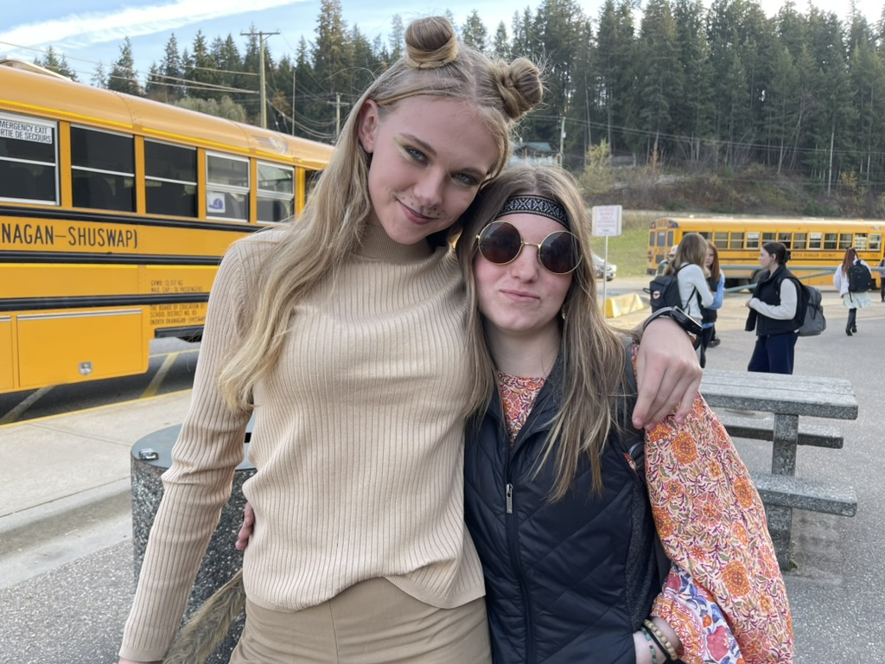
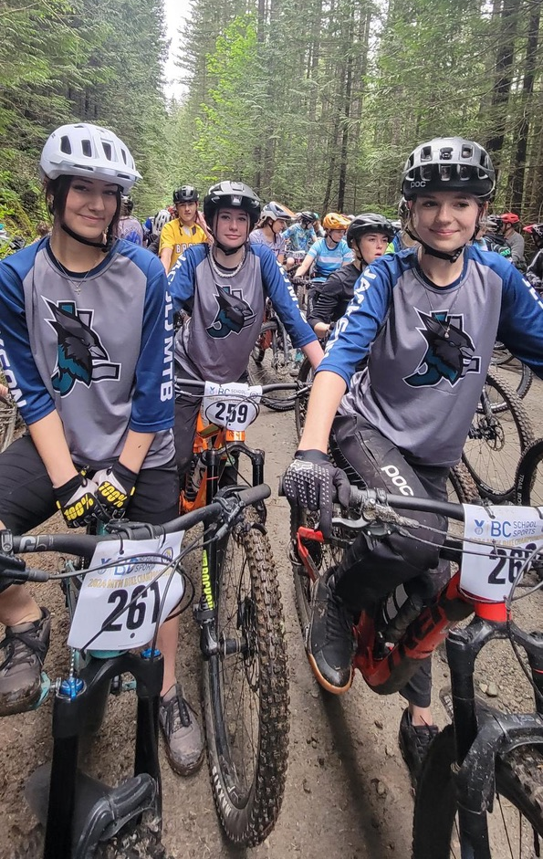
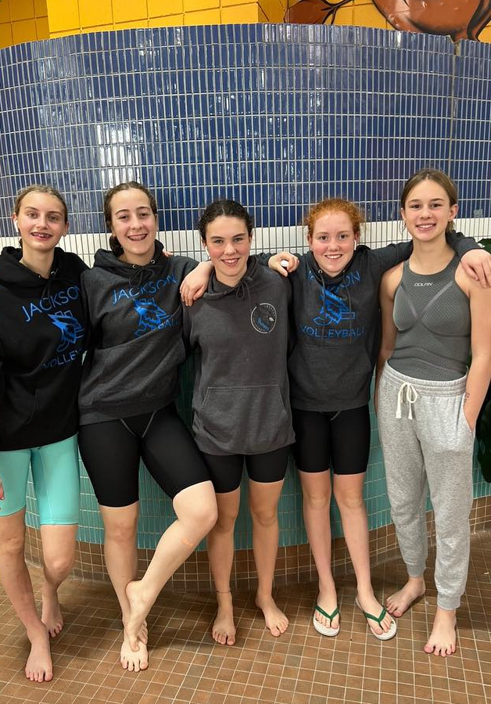
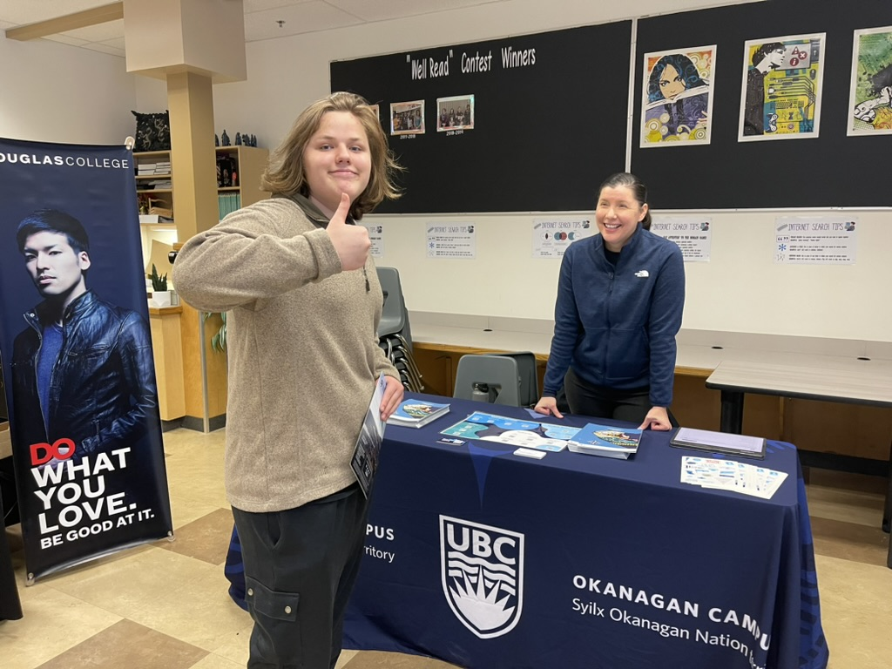

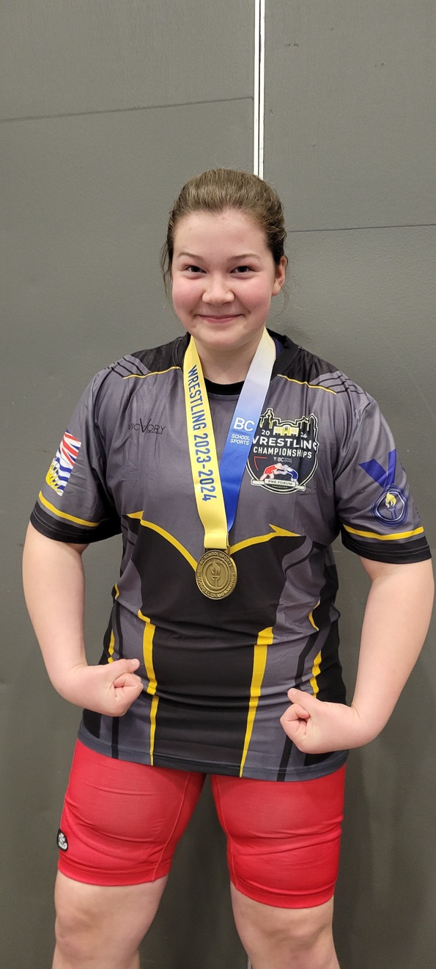
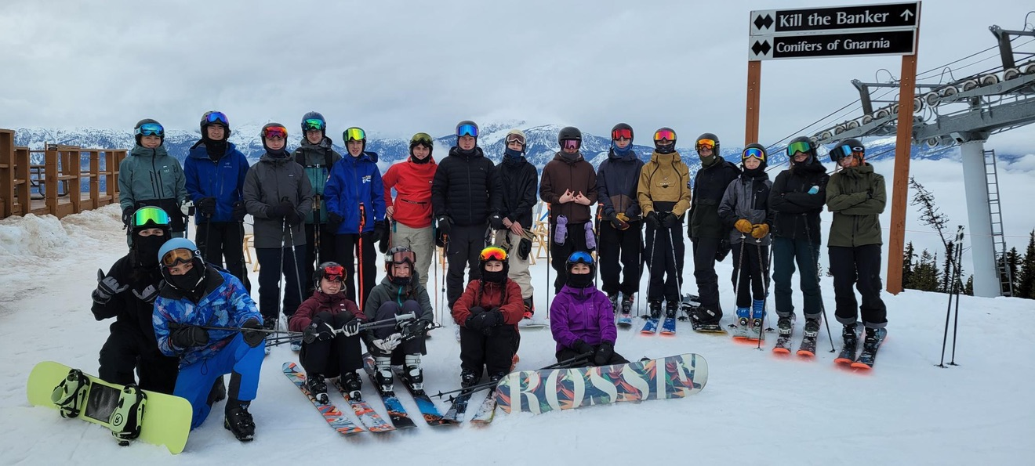
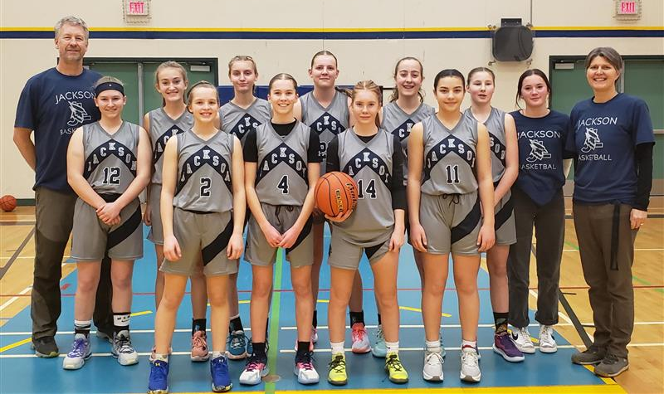
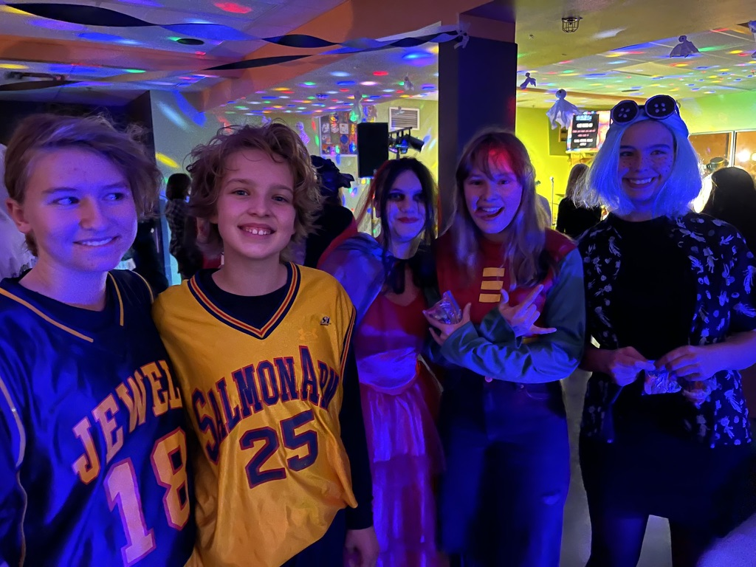
Make the most of your high school experience!

Slide 26
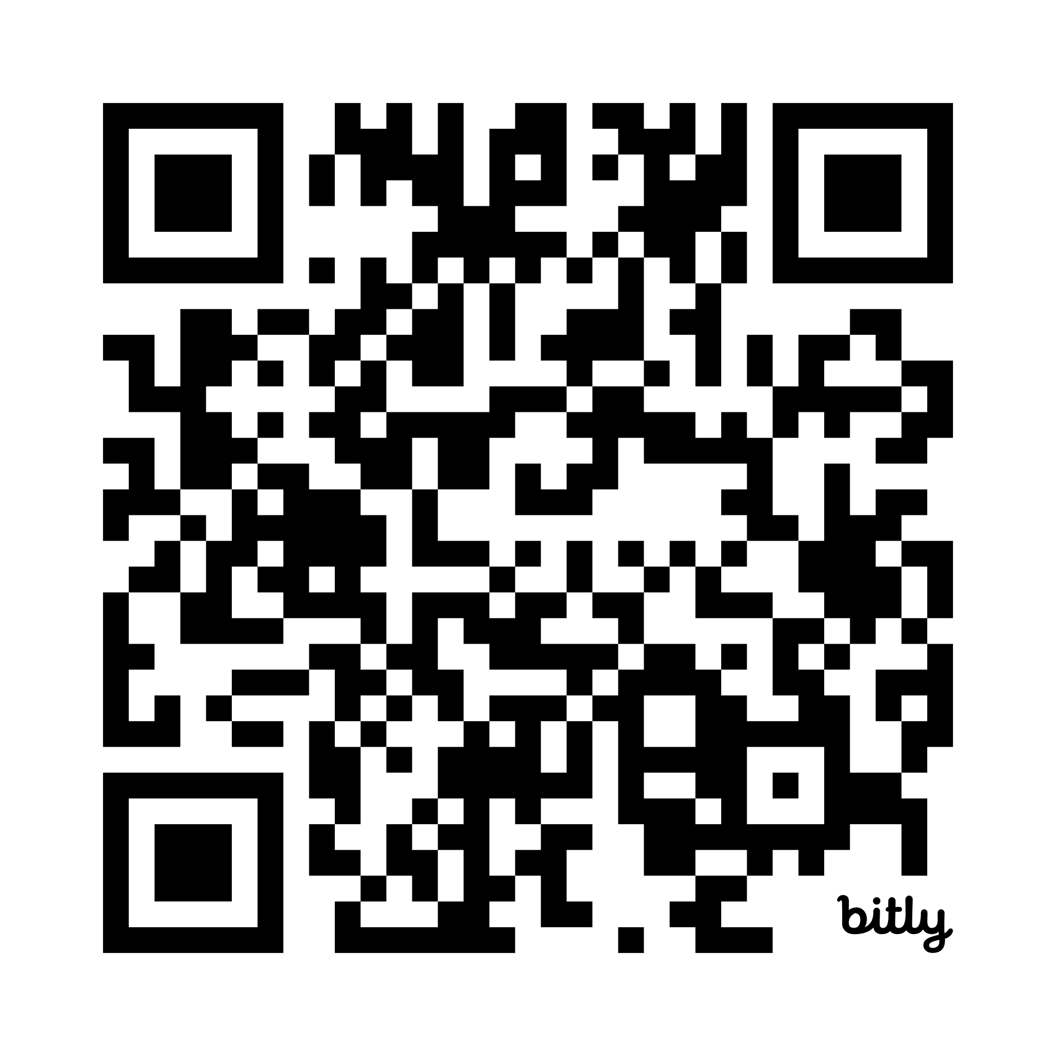
Do your Research!
Scan the QR Code below to see descriptions of each Elective Course
https://jlj.sd83.bc.ca/grade-10-12-course-catalogue

Slide 27

Questions?

